Slide 1

Intro to the
8th Control System
Cyber-Security
Workshop
(CS)²/HEP

Slide 2
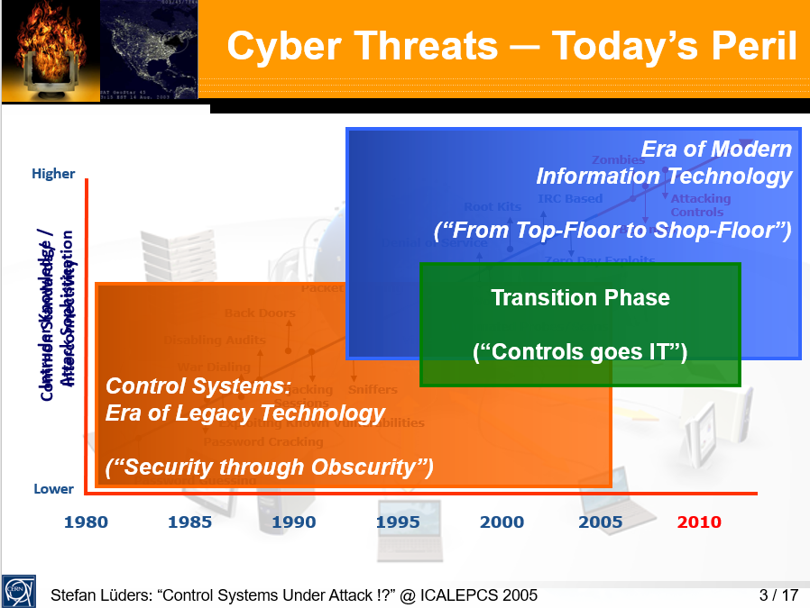
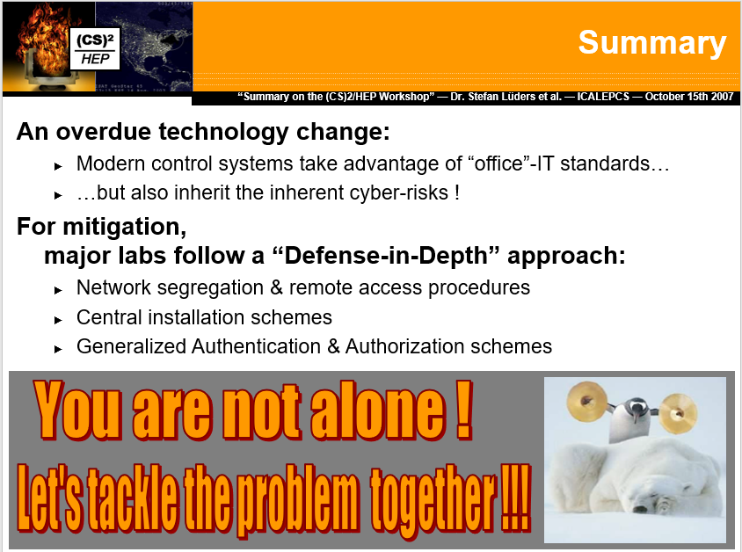
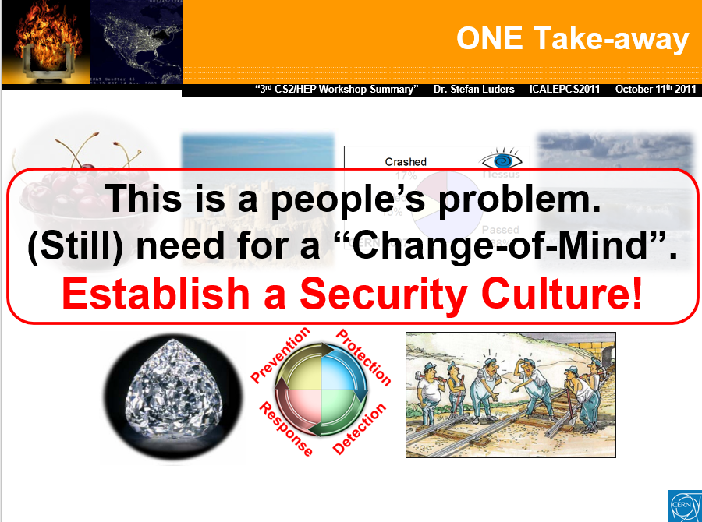
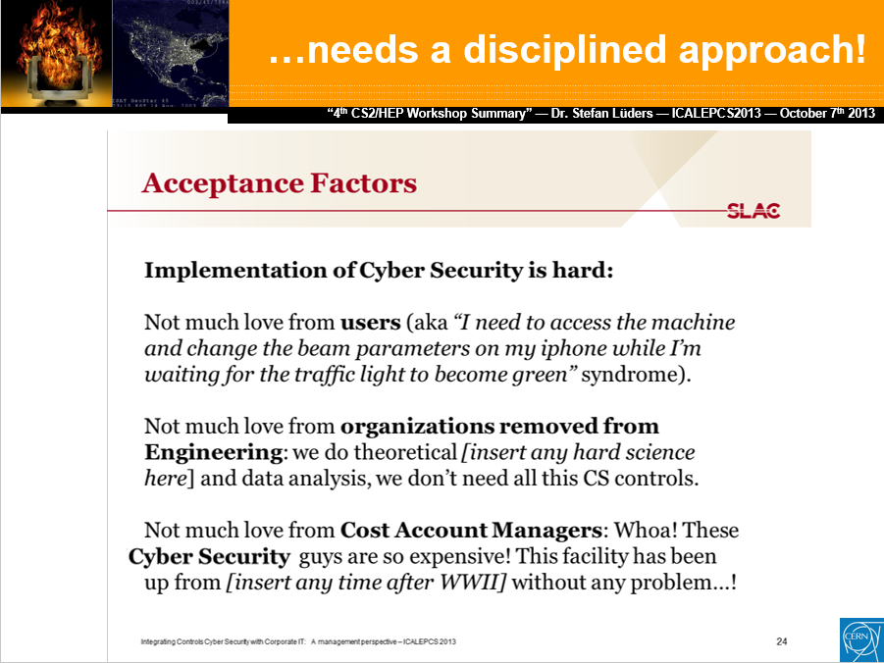
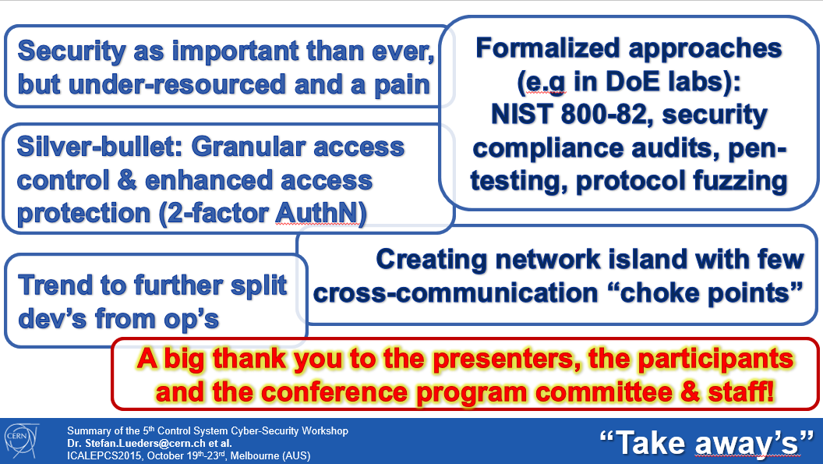

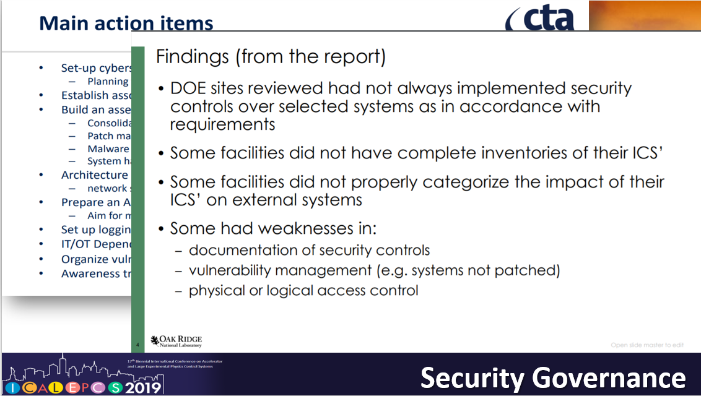
A Long Way

Slide 3

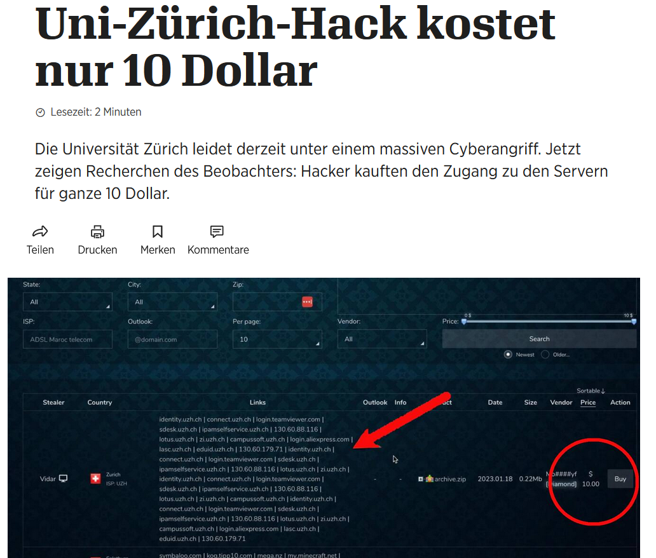

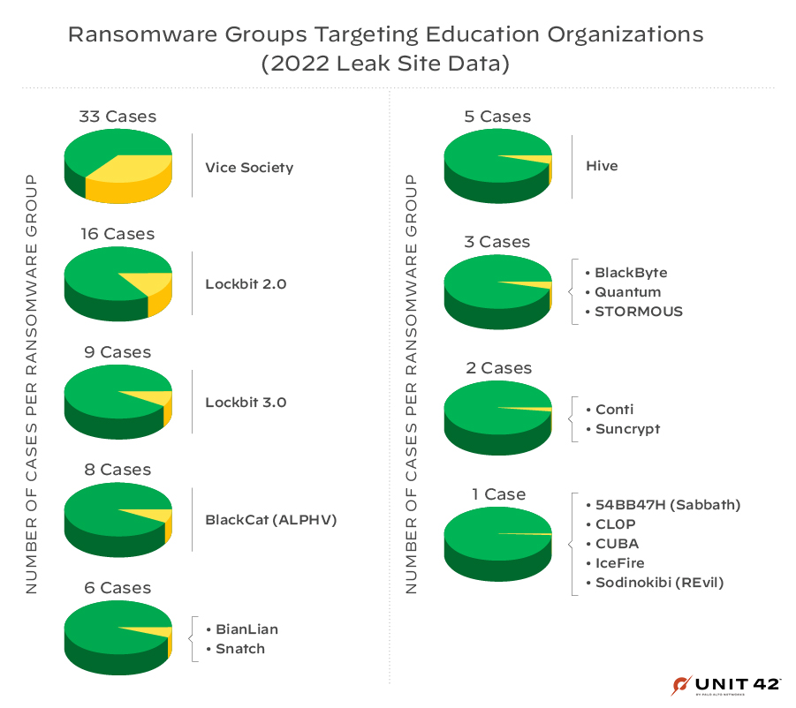
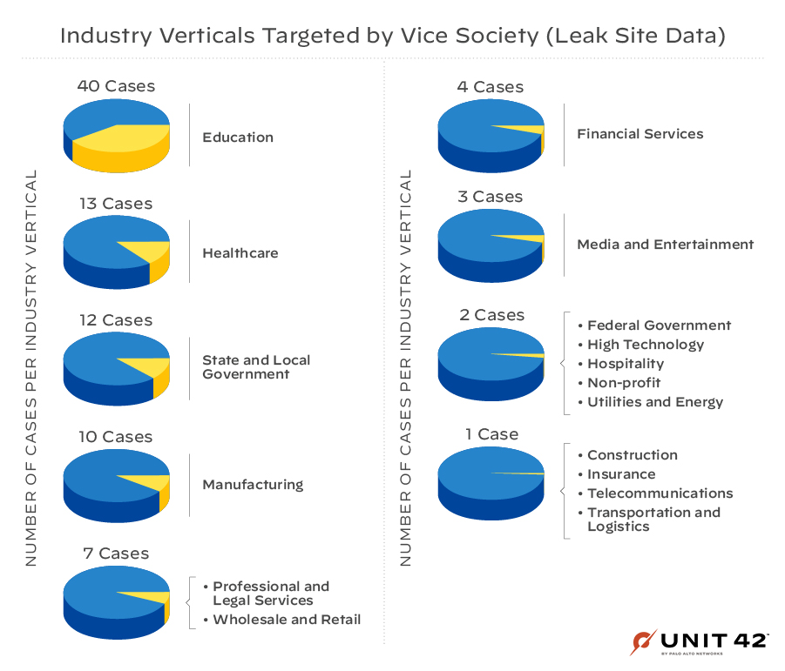


The #1 Threat

Slide 4

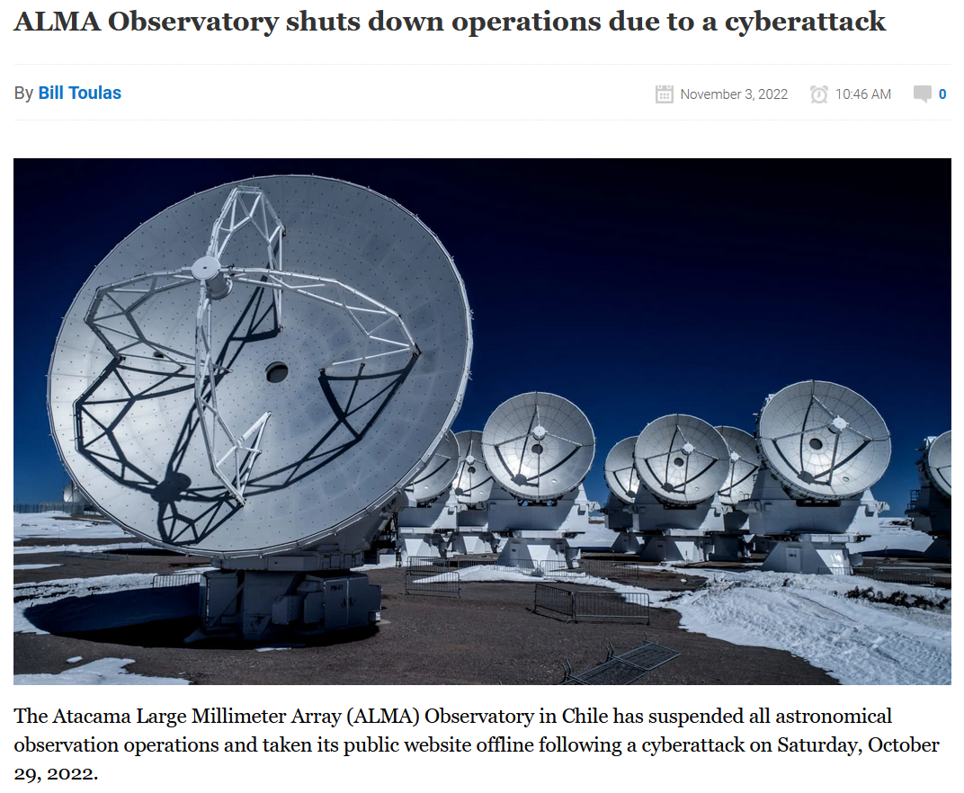
It is NOT getting better
Ransom
Data
encryption;
Decrypt key
for money
Extortion
Data
exfiltration;
Hand back
for money
2xExtortion
Ransom
+Extortion
3xExtortion
2xExtortion
+Selling Data
4xExtortion
o
3xExtortion
+Alerting
clients & partners

Slide 5
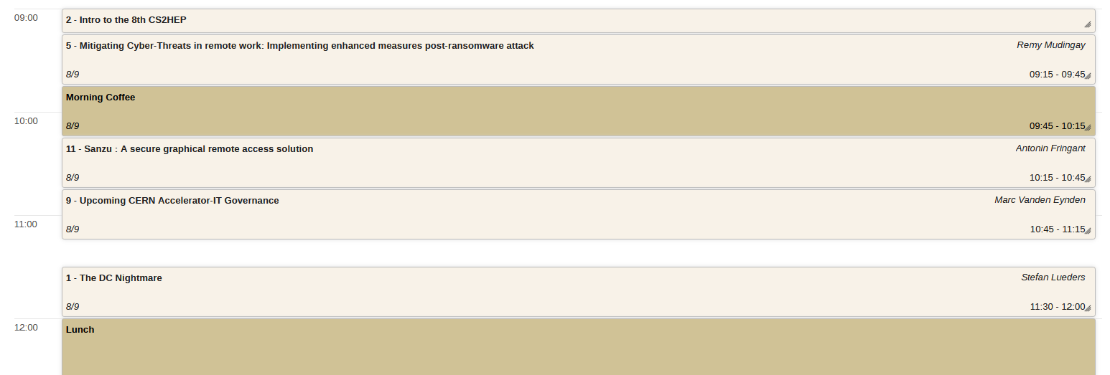
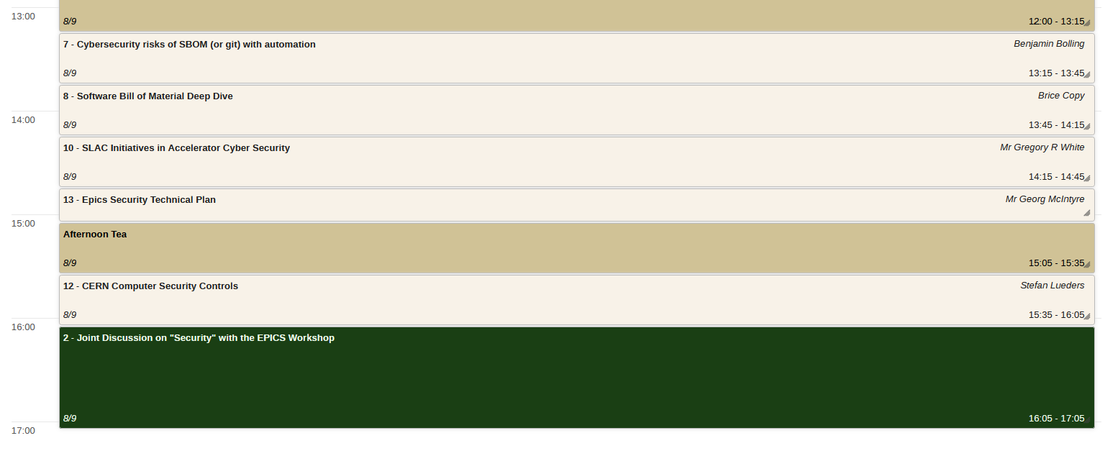
indico.cern.ch/event/1270052/timetable

