Slide 1
SLAC Initiatives in
Accelerator Cyber Security
Greg White,
Prepared for ICAEPICS 2023 Cyber Security Workshop
October, 2023
Greg White, for Erwin Lopez, Mark McCullough, Amedeo Perazzo, Ken Brobeck, Mark Foster, Daron Chabot,
Mike Zelazny, Debbie Rogind, Lance Nakata, Matt Gibbs, Andrea Chan, Arash Alavi, Poonam Pandi, Lisa Christiansen, Uy Chu, Syed Hasan (SLAC), Bob Dalesio, Michael Davidsaver (Osprey DCS), George McIntyre (Level-N Ltd),
Dale Dale Hugo Leschnitzer, Mark Hahnert (US Dept of Energy, Office of Science)
Many Thanks to David Manz (PNNL), Jozsef Gacsal (SecurityLit), Jason Carter (ORNL), Ralph Lange (ITER)

Slide 2
Contents
  Accelerator computing
  Example Cyber Statistics, Regulations, and Thinking
  Typical Cyber Computer Architecture for Accelerators
  Conducting a Cyber Security Review
  Extant Accelerator Control System Cyber Issue, EPICS
  Plan for Improving EPICS cyber security
  New Cyber Regulatory Framework, Compliance Challenge, and Future
  Summary

Slide 3
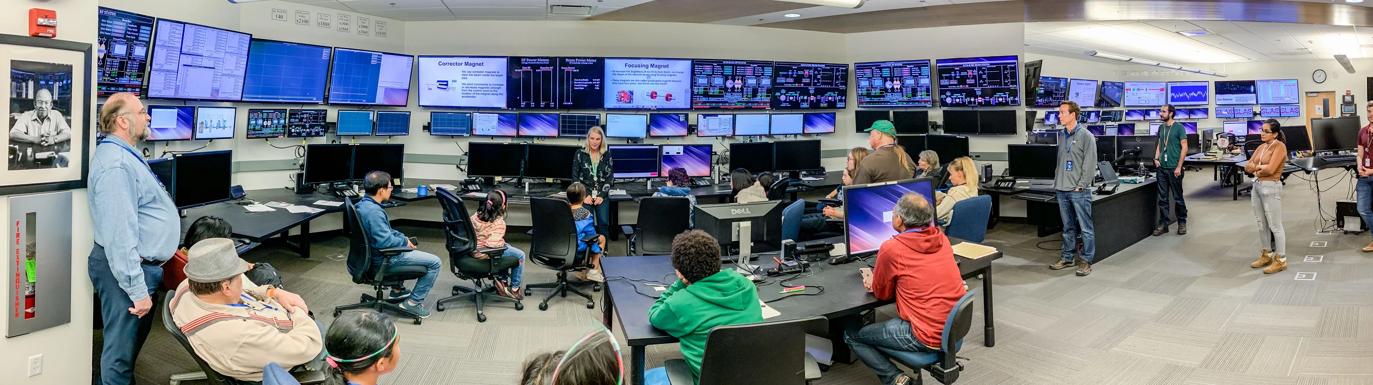
Accelerator Computing
User facing computers. Unix/Linux, Windows, Apple OS, etc
Control System Software Framework – commonly EPICS DOE labs
Fast network, typically Ethernet (10 Gb/s), some proprietary
Front End computing (Input Output Controllers - IOCs)
Field Buses (VME, CAMAC)
FPGA, PLC, programmed logic.
Display managers (User interface to process variable values)
High level support software; Matlab, Python, C/C++
Beam diagnostics, analysis, and beam optimization (High Level) Applications (HLAs)
Beam Modelling and simulation, High Performance Computing
Machine Learning (multi-parametric analysis and heuristic reasoning)
Many users, some only peripherally associated with the laboratory. Many kinds of computers, many kinds of network, many tools. Some developed in the community without security oversight, some brought in from outside.

Slide 4
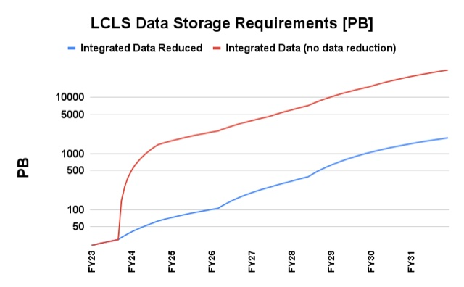
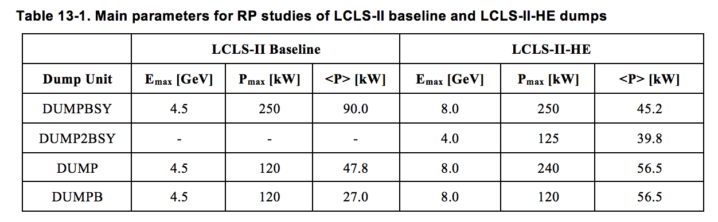
Challenges in Accelerator Computing, Implications for Cyber Security
Accelerator data and detector data sizes and rates -> Data centers
Machine Learning, large-scale optimization -> HPC and Data Center is in production
Continuous, online multi-particle modeling -> HPC in production
More software for more sophisticated machines -> Vulnerability scanning in prod
Machine security. New boundaries in beam power and intensity. Accidental damage
Cyber Security of large US national assets. Malevolent Damage.
Notes:
Accelerator Data Rates:
Eiger single phton detector: 1 unit ½ MB. Largest combination 9 MB.
LCLS 120 KHz -> 1 MHz.
16MB @ > 100 Hz, or 1 MB @ 3 kHz. Any one of these can fill a 10 Gb Ethernet link
Experimental Data rates. 1 PB->1 ExaByte next year. 1PB = 10^15B. ExaByte 10^18Bytes. A million million million bytes. 1 HD move, 4.7 GigaBytes. 5 million Bytes.
Serious threat of malevolent damage is quite new for us. It hasn’t been in serious thinking before. We’re only now thinking about it.
-> # 7, the intractability of received wisdom.

Slide 5
Cyber Threat Statistics and Context
SLAC CYBER EVENT DATA | Q4 2022 | Q2 2023
Perimeter defenses stopped attempts. Scanning for known vulnerabilities. Like ssh user brute force attack, Apache path traversal, ZeroShell command execution, etc. Or actual exploits. Like Remote Code Execution (RCE), SQL injection, etc. | 33,149,555 | 509,750,086 (Yes, 509 M)
Endpoint protection events stopped: Crowdstrike. Malicious software detected. Successfully mitigated by Endpoint protection and response | 130 | 490
Control system intrusions known | 0 | 0
Front-end intrusions known | 0 | 0
  Context and thinking
  Historically, accelerator control systems have not included strong cyber security within the network
  We have relied on “secure–perimeter” (sometimes called sequestered network, or “walled garden”)
  The world is a different place
  Is secure-perimeter still advisable? Cf Executive Order (EO) 14028, Improving the Nation’s Cybersecurity and Zero Trust Architecture (ZTA) and DOE SC orders
  Is EPICS secure? See later in talk.

Slide 6
Contents
  Accelerator computing
  Example Cyber Statistics, Regulations, and Thinking
  Typical Cyber Computer Architecture for Accelerators
  Conducting a Cyber Security Review
  Extant Accelerator Control System Cyber Issue, EPICS
  Improving EPICS cyber security
  New Cyber Regulatory Framework, Compliance Challenge, and Future
  Summary

Slide 7
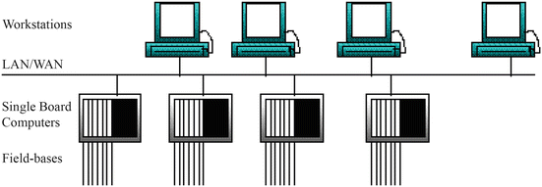
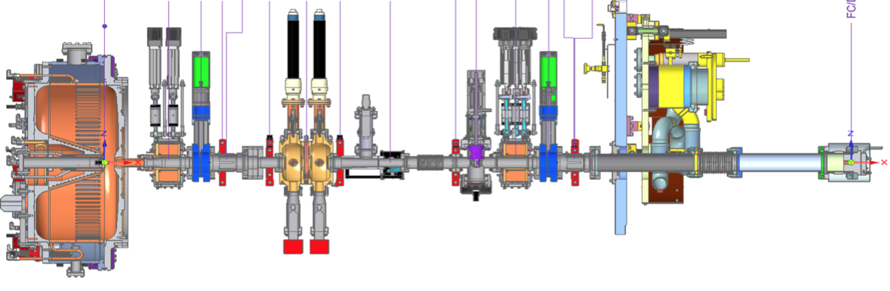
Distributed Control System AAA + EPICS Cyber Schematic
Control Network. EPICS (CA and/or PVA) in most DOE labs. Others include ACNET, TANGO, SLCMSG etc. EPICS has Authorization but no intrinsic Authentication.
⇒ Server can’t be sure who made a control request. Client can’t be sure data came from a given device.
Field Buses;
Allen-Bradley, VME, CAMAC
Input Output Controllers (IOCs). Pseudo real-time dataflow databases and device drivers, maybe also real-time PLC or FPGA. Essentially no authentication nor authorization. No software signing.
⇒ Can’t be sure the computer code you think is running your accelerator is in fact running your accelerator.
Glossary. “AAA”:
Authentication: Establish you are who you say you are
Authorization: What set of things are you allowed to do once authenticated
Audit: Keeping track of what you did.
Figure: Simplest Schematic of an Accelerator Control System Network. Computers users, for instance in the control room, connect over a fast network (Gb/s) to front end computers. Those computers in turn connect by field buses and cabling to accelerator hardware for particle generation, beam condition and guidance (electro-magnets), acceleration (RF), diagnostics (beam position), human and machine protection systems, vacuum, cooling etc.
Borrowing from M. Thuot 1996.

Slide 8


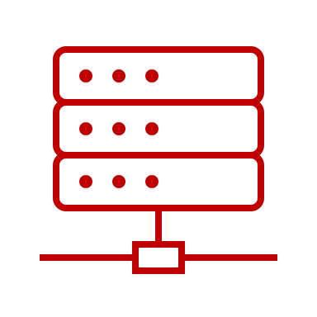
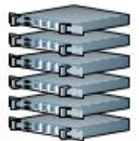


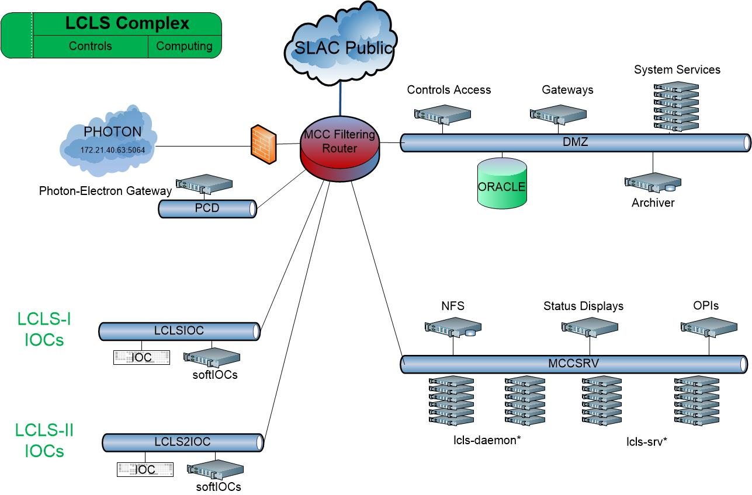
Typical Accelerator Computing Architecture (LCLS complex at SLAC)
Big Data stores
High Performance Computing Network
Experiment Data Analysis
Office Network
Science Data Facility
SLAC Network
SDF Disk
SDF Disk
Accelerator Physics Analysis
Documents, Engineering Drawings
Oracle, People-soft etc
Multi-particle Tracking (s-2-e)
Machine Learning Training
Data Systems Analysis Network
Experiment Network
Non-critical Data Services
Simulation
Software development
Controls Network
Production Services and Control Room Network
Control room displays
High Level Apps execution
Online modeling
Critical Data Services
Optimization, ML and slow feedback
EPICS Input Output Controllers (IOCs) - 100s
Accelerator devices - 1000s. Producing control and diagnostics signals (Process Variables) - > 8 million at LCLS

Slide 9
Typical Accelerator Computing Architecture (LCLS complex at SLAC)
Big Data stores
High Performance Computing Network
Experiment Data Analysis
Office Network
Science Data Facility
SLAC Network
SDF Disk
SDF Disk
Accelerator Physics Analysis
Documents, Engineering Drawings
Oracle, People-soft etc
Multi-particle Tracking (s-2-e)
Machine Learning Training
Data Systems Analysis Network
Experiment Network
Non-critical Data Services
Simulation
Software development
Controls Network
Production Services and Control Room Network
Control room displays
High Level Apps execution
Online modeling
Critical Data Services
Optimization, ML and slow feedback
EPICS Input Output Controllers (IOCs) - 100s
Accelerator devices - 1000s. Producing control and diagnostics signals (Process Variables) - > 8 million at LCLS

Slide 10
EPICS Authorization. Access Control File (ACF)
[physics@lcls-srv01 .../epics/iocCommon/facility]$ more access_security_cryo.acf
UAG(CRYO) { dianek, smcqueen, rredford, vivienl, eidle, kdouglas, gclooney, cryoegr }
UAG(SYSMAN) { sysman }
HAG(CRYOMCR) { cryo-opi01, cryo-opi02, cryo-opi03, cryo-opi04, cryo-opi05 }
HAG(ACR) { opi10, opi11, opi12, opi13, opi14, opi15, opi16, opi17, opi20, opi21, opi22, opi23, opi24, opi25, opi26, opi30, opi31, op
i32, opi33, opi34, opi35, opi40, opi41, opi42, opi43, opi44, opi45, opi46, opi47 }
ASG(CRYO) {
INPA(ZIOC:CP00:CR01:CRYO_ACCESS) # Subsystem-specific permissions bit
RULE(1, READ)
RULE(1, WRITE) { UAG(SYSMAN) }
# Global permissions ("CRYO only")
RULE(1, WRITE, TRAPWRITE) {
HAG(CRYOMCR)
}
# Subsystem Specialist access
RULE(1, WRITE, TRAPWRITE) {
CALC("A=1")
UAG(CRYO)
HAG(SRV)
}
}
Example: Access Control File for LCLS Cryogenic Systems,
showing individual user names, computer names, that the cryo control
room can write a cryo PV at any time, and that cryo specialists can write
to a cryo PV only if they have been enabled to do so by operations.

Slide 11
SLAC Accelerator Cyber Assessment Experience (2021)
1. Scope and Objective
System Experts charged with assessment of resilience to cyber attack on:
Operations (for instance deletion of required software)
Physical accelerator controls (e.g. malicious write to PVs of cryo facility)
Accelerator configuration basis (e.g. magnet polynomials in Oracle)
Data, analysis or diagnostics (e.g. deletion or change of archived values).
PPS cyber security was not investigated. We did NOT consider physical security such as vacuum of cryomodule, cavity tune, etc.
Results used to plan immediate improvements and further analysis. Experts directed to highlight items that worried them. And to use the systems analysis to investigate and propose fixes.

Slide 12
Experience of SLAC Accelerator Cyber Assessment cont’d
2. Systems in Scope
SLAC IT Network; routers, gateways, Domain Name Services.
Control System Access mechanism:
Enterprise (SLAC) Identity Access Management -> DMZ bastion -> ssh public key
Accelerator Control System Hosts
Control System Software security
  PV write authorization security (EPICS Channel Access - “ACLs” for PVs)
  Control Protocol security (EPICS Channel Access, PvAccess)
  Front end computer security (EPICS IOC software, FPGA, field busses etc)
  Beam diagnostics, tuning and optimization security (Matlab, Python)
Data Stores: EPICS Archiver, High Performance timeseries data stores
Intellectual Property Stores: Physics Log, Operations Log
Databases: Oracle (Device Infrastructure, Magnet, Cabling, Issue management, etc)
High Performance Computing Systems
Controlled Document store (Sharepoint)
Engineering Drawings (Windchill, Solid Edge, AutoCAD, SODA)

Slide 13
Experience of SLAC Accelerator Cyber Assessment cont’d
3. Systems Specialists Briefing & Response Template
For each system assignment:
Describe the use of the system in brief
Describe existing security measures, assess any weaknesses, and highlight missing coverage
Security or Cyber Defense Type | Describe
Authentication, Authorization, Audit. Kerberos, SSL public/private key | How is a user authenticated to the system. Is Authentication for instance by Kerberos? How are communications encrypted (if at all)
Known Vulnerability scanning | Is the system scanned for known ways to hack?
Backups | Verify backups exist and are being updated. Document the backup schedule and where backups are located. Are backups secure against system failure, power, fire.
Malware Detection | Is the system included in Crowdstrike?
Accelerator self-defense – EPICS LO/HI limits, MPS, BCS | For accelerator controls, what mechanisms exist to ensure proper operating range?
Air-gapped processor-observer pattern (as in PPS) | Does any part of the system include air-gapped or one-way only communications (data diode) security?
Network segmentation | Is the system hosted in a controlled or otherwise confined network?

Slide 14
Findings of SLAC Accelerator Cyber Review
System | Authentication Authorization and Audit | Vulnerability Scanning | Malware Det. (Crowdstrike) | Backups | Accelerator Protection system | Air-gap / process-observer | Network Segmentation
MCC. Accelerator Controls Networks - ~ OSI 7 Layer Model levels 1-5 | ssh rsa/dsa public-private key using SLAC User ID and mcclogin as a bastion host. VMS password. | No vulnerability scanning on accelerator networks, for fear of interference with ops. Yes, at DMZ level. | No malware scanning on accelerator networks, for fear of interference with ops. Yes, at DMZ level. | Yes. All NFS data and systems are backed up by coordination with OCIO. Operational to MCC (bldg. 5). Disaster recovery to ANR (B52). Large data to AFS. | N/A | No. Direct authenticated login is supported. | Yes. Filtering Router enforces DMZ intermediates SLAC to prod. Each accelerator network is segmented into a few functional VLANs.
EPICS. Accelerator Controls Networks ~ OSI 7 Layer Model levels 6-7 | No control network user Authentication. EPICS PV change Authorization being added. | No. IOC processes and client servers are not scanned for vulnerabilities. | No. No malware detection of EPICS processes on Production . No front end executable certification | Access Control Files backed up by virtue of AFS. | Yes, extensive but may be incomplete. Facilitated by EPICS DRV-L/H, MPS, BCS. | Not as such, but separation mediated by router is sometimes used. | Yes. Production networks are isolated via DMZ.
SLAC Science Data Facility (aka S3DF) | Kerberos (until SLAC standard federated is available) | Yes. S3DF DMZ daily. Others biannual. | Yes - DMZ & Workstations. No - HPC and core. | Yes (as of Aug 22). | N/A | Not employed. S3DF is intended for access internally and externally. | Yes.
SLAC Enterprise Networks (SLAC IT) | Networking device management requires authentication by Kerberos + DOE PIV card. | Yes, admin. by SLAC cyber. | Yes. Networking management hosts have CrowdStrike. Devices (routers etc) do not. | Yes. Backups daily to SLAC AFS and Stanford AFS. | N/A | No. SLAC IT does not operate any air-gapped enterprise networking | Yes. SLAC Networks are segmented; access and firewall implemented individually for each.
Oracle & APEX. | UserID + Oracle db pwd or Oracle wallet. LDAP & WebAuth for APEX. | Yes, admin. by SLAC cyber. | Yes on main SLACPROD dbs. No on MCCO dbs. | Yes. Full and incremental backups daily. 30 day retention. | N/A | No. | DBs segmented by content. Diff. pwd/wallet required for each. MCCO is in DMZ.
Controlled Document Management System (CDMS) | SLAC Active Directory & MFA. MS has no access to SLAC cloud data. | Yes, admin. by MS. | Yes, administered by MS. | Yes, redundancy and resiliency by MS. We assume their diligence | Content describes Accelerator Protection Systems. | No. | Yes [2]
Engineering Drawings and Data (TC / SEDA) | TC req SLAC ID of named license holder. SEDA req SLAC ID/ MFA | Yes, admin. by SLAC cyber. | Yes, admin by SLAC cyber. | TC: Yes, admin by SLAC IT. SEDA: Yes, admin by MS. | N/A | No. | Per TC system.
High Level Applications (HLA) | Presently, all HLAs are on prod, so AAA is per MCC and EPICS above. | No, not in production. | No, not in production. | Yes, per MCC. | Partly. Mostly rely on EPICS limits. | No. However do have read-only gateway. | Yes, per MCC.
SLAC
SLAC Summary: Positive Overall. Our cyber security was found complete with respect to common practice.
Login security is comparable to most facilities. Will soon be leading
Backups are complete
Malware Detection & Vulnerability Detection are complete (subject to the norm that malware detection is not run in production)
CA Security (authorization to change PV) is designed, in cryo IOCS, and ready for broad implementation
All EPICS Labs
However, EPICS itself is insecure. Its use is based on aging assumption of secure perimeter. Lacks strong authentication and software signing.
Figure: Example table of cyber review findings, showing each of 8 system’s cyber situation on 7 metrics

Slide 15
Contents
  Accelerator computing
  Example Cyber Statistics, Regulations, and Thinking
  Typical Cyber Computer Architecture for Accelerators
  Conducting a Cyber Security Review
  Extant Accelerator Control System Cyber Issue, EPICS
  Improving EPICS cyber security
  New Cyber Regulatory Framework, Compliance Challenge, and Future
  Summary

Slide 16
EPICS Controls Security Issues & Recommendations
Passive Traffic Inspection
Passive attacker can observe and learn Process Variable and server names. Not considered serious.
⇒ Could Mitigate by TCP+TLS(*)
PV Denial of Service by search spam
Active attacker responds to PV search requests, directing to null server
PV Search Hijacking / Man in the Middle Attack
Active attacker responds quickly to all observed searches, redirect clients to rogue EPICS server. Returns fake data, or proxy forwards bad control data to a legitimate control system EPICS server. Very bad things.
⇒ Mitigate by adding Transport Layer Security (as long as attacker does not hold certificate)
Server impersonation / credential theft
Theft of server certificate used to maliciously impersonate PVs provided a legitimate server.
⇒ Mitigate by something like certificate “pinning.”
(*) Transport Layer Security (TLS); Encryption, certificate-based authentication, compression.
Work of Michael Davidsaver, Osprey DCS, under SLAC contract, 2021

Slide 17
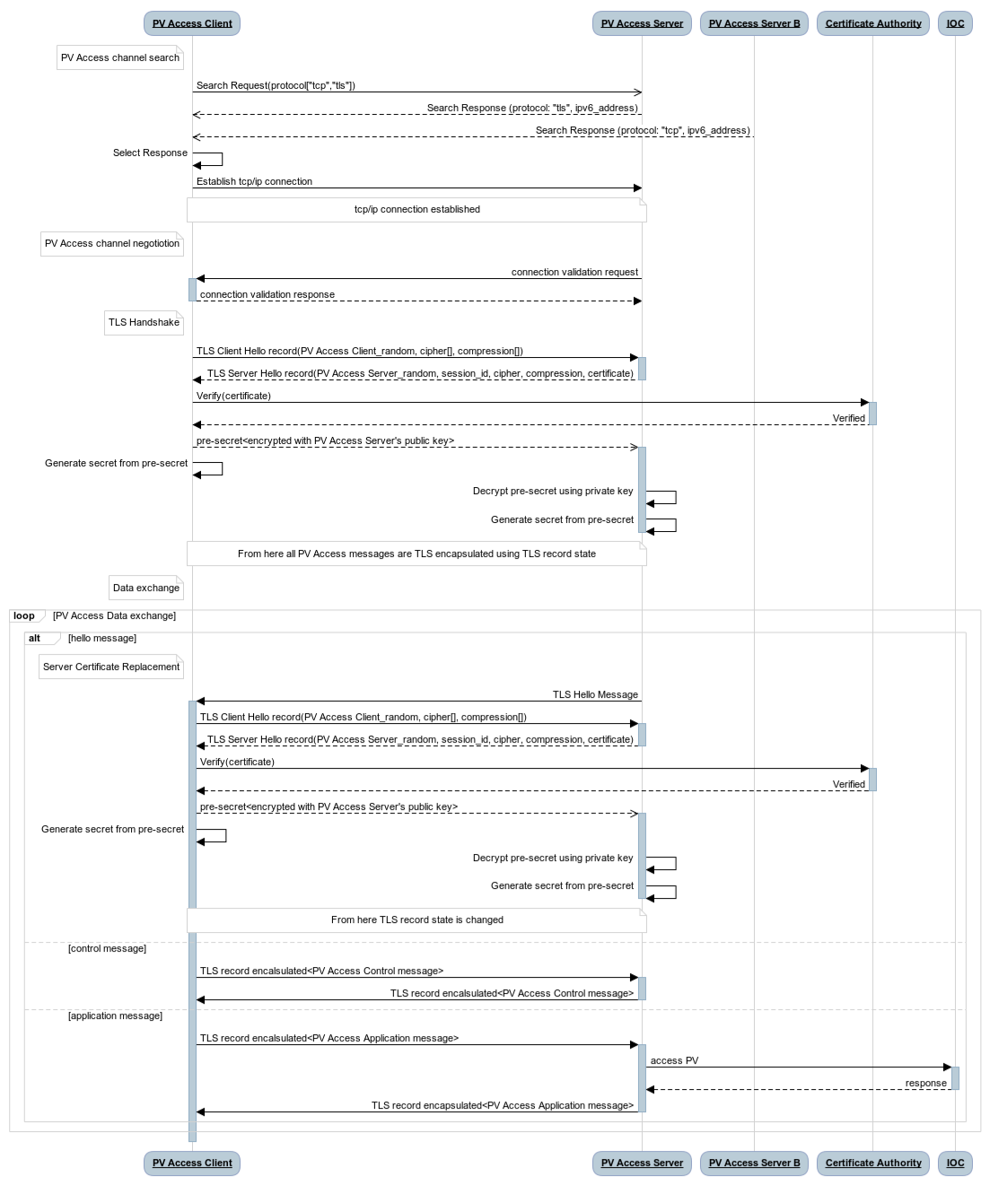
EPICS Security Improvement:
PvAccess and Transport Layer Security (TLS)
PvAccess += Transport Layer Security.
First step to Zero Trust Architecture in EPICS Accelerator controls
Multi phase project:
  Server side authentication
  Client side
  Yr 2 / 3. Certificate server? Name Server? Pinning?
Transition phase: EPICS pvAaccess TLS fully backward compatible. TLS endpoints co-exist with non TLS.
GOAL: All endpoints use PvAccess + TLS.
NOTE security implies removal of Channel Access protocol from EPICS systems (!)
Very early Prototypes now available.
Figure: EPICS PVA negotiation with TLS proposal, showing:
TLS handshake after message validation, ”tls” message, cipher handshake, and certificate verification additions to EPICS PvAccess protocol.
Modification uses the “magic” byte in the pvAccess header, and existing protocols field in the search response.
Work of George McIntyre, Level-N Ltd, + Michael Davidsaver, Bob Dalesio, Osprey DCS, for SLAC. Kay Kasemir for ORNL.

Slide 18
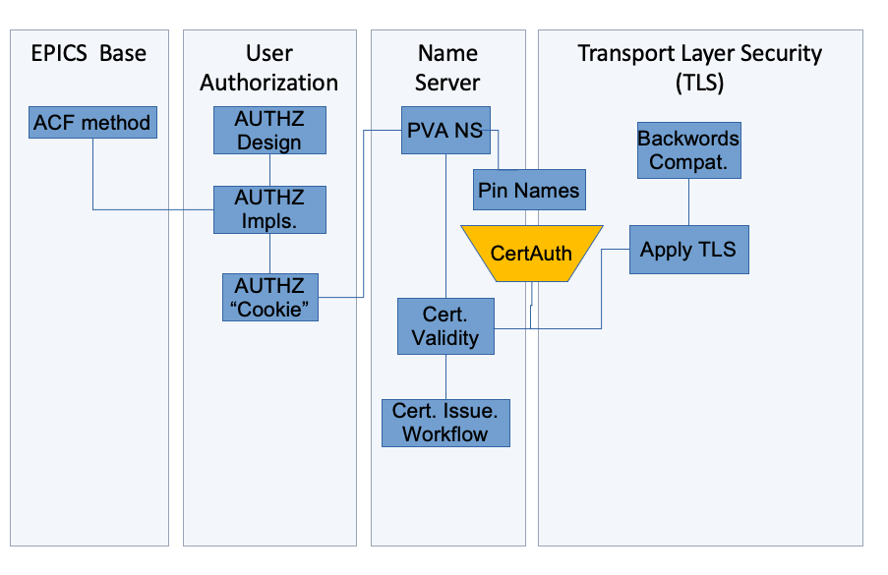
EPICS Security Improvement 2:
US Dept of Energy sponsored project to add TLS to PvAccess for the EPICS community
$ 1.4 M over 2 years. SLAC leading, Osprey primary contractor (M. Davidsaver, G. McIntyre). Kay Kasemir (ORNL) adding for core-pva. Many, many thanks to Dale Dale Hugo Leschnitzer & Mark Hahnert (US Dept of Energy, Office of Science).
Year One
1. Technology analysis and selection
2. Implement a simple prototype containing TLS additions to the EPICS PV Access protocol
3. Design changes to EPICS
4. Implement prototype for PV Access Name Server changes
5. Implement prototype for client authorization via certificate
6. Integrate with site-specific authentication protocols
7. PVA Protocol Performance tests
8. PV Access Name Server Performance tests
9. Functional Verification Testing and Combined Report
Year Two
1. Implement Beta version of PVA TLS
2. Update Beta with performance and usability improvements
3. Update Beta with certificate management improvements -
4. Release Beta to SLAC and monitor
6. Release Beta to selected facilities and monitor results
Figure: The basic architecture of PVA+TLS in context of an EPICS installation, shoing integration with enterprise authentication, certificate validation and management, and integration with EPICS Access Control.

Slide 19
Contents
  Accelerator computing
  Example Cyber Statistics, Regulations, and Thinking
  Typical Cyber Computer Architecture for Accelerators
  Conducting a Cyber Security Review
  Extant Accelerator Control System Cyber Issue, EPICS
  Improving EPICS cyber security.
  New Cyber Regulatory Framework, Compliance Challenge, and Future
  Summary

Slide 20
Cyber Security Recommendations and U.S. Regulatory Framework
Guidance – NIST SP 800-82, Guide to Operational Technology (OT) Security.
Regulatory - Executive Order (EO) 14028, Improving the Nation’s Cybersecurity.
Calls for a “Zero Trust” posture
  OMB Memorandum M-22-09, Moving the U.S. Government Toward Zero Trust Cybersecurity Principles
    DOE Plan to Implement Zero Trust Architecture (ZTA), July 11, 2021
    DOE Improving Cybersecurity: Guide to Implement Zero Trust Architecture, DOE OCIO, March 2022
    DOE Moving the U.S. Government Toward Zero Trust Cybersecurity Principles Zero Trust Strategy Document. M-22-09, Gina Fisk, DOE-SC CISO, July 2022

Slide 21
DOE Zero Trust Order Compliance Gap Analysis
    Zero Trust Architecture order [2] Principle; authenticate individuals for each action they take; and make authentication so ubiquitous that the secure perimeter can and should be dismantled.
DOE Zero Trust Guidance (from [6]) | Norms in Accelerator Distributed Controls network
Assume no implicit trust is granted to users, … or resources. | A lot of implicit trust granted to accelerator users
Foundational tenet… no resource is inherently trusted | Resources frequently trusted. No way to verify identity nor true operation of resource. EPICS+TLS would enable resource certification.
… and must be continuously authenticated | Rarely re-authenticate. Could add. Implies work disruption
Encrypt data-at-rest and data-in-transit | Control data-in-transit not encrypted. EPICS+TLS would enable encryption. Data-at-rest (stored, archived) not encrypted. Could add, though won’t be popular.
Multi-factor authentication | MFA rare inside controls. Possible to add MFA to ssh. Must consider MFA for operations.
Malware Detection everywhere | Uncommon for malware detection in high performance, high availability control systems. Rare for malware in front end computing.
      Sequestered network rather than strong internal authentication
      So some places we can continue to use MFA. But most can’t.
      Where can we put crowdstrike? Where is it not technically feasible: FPGA, firmware front end systems.
      Where could we but so far has been resisted. HPC? Control system?
      Write exceptions, but balance and mitigate the exceptions.
    OMB and EO hit DOE
    But: V low MFA usage
    Partnership between control, physics, and cyber security.

Slide 22
Contents
  Accelerator computing
  Example Cyber Statistics, Regulations, and Thinking
  Typical Cyber Computer Architecture for Accelerators
  Conducting a Cyber Security Review
  Extant Accelerator Control System Cyber Issue, EPICS
  Improving EPICS cyber security
  New Cyber Regulatory Framework, Compliance Challenge, and Future
  Summary

Slide 23
Our Plan for SLAC Accelerator Cyber Security
Pursue:
Penetration Test (complete 2023). Multi-phase - outside SLAC to SLAC, from inside SLAC to control, stealth, non-stealth etc.
EPICS PVA+TLS (+ associated authentication architecture). Prototype complete 2023. DOE funding for 2 years $ 1.4 M
  Server side first, then client,
  CA will have to be removed!
Complete Channel Access Security
  Individual Logins. Negotiate on OPI logins. Think through implication of common id on OPIs for EPICS attacks
  Deploy ACL files
SSH with MFA
MAC registration
Malware detection (CrowdStrike) in Accelerator Network assessment
Vulnerability detection in Accelerator Network assessment
Collaboration and Partnership with EPICS community.
Negotiate / seek exemption from DOE Office of Science on ZTA:
Encryption at rest. Cf Stanford Research Policy Handbook (RPH), section 1.4, Openness in Research
Re-authentication. Too disruptive to operations.

Slide 24
Penetration Test Experience
Method:
Safety Critical Systems addresses removed
Other production included (while machine was down)
Developers on dev networks (!) working on kinetic or high voltage systems need formal warning
Formal table of addresses whose pen test is controlled. Other addresses included
Pen Test Conclusions:
Pretty good.
For future pen testing - “canary traps” for port scans in important networks
  Developer safety (!). May have to control pen tests as a safety matter! Like LOTO.
  Critical systems (PPS, BCS etc)

Slide 25
Summary
Accelerator Computing involves many interconnected systems
Distributed control often relies on a sequestered network architecture and assumption of security within the network
The world is different, and we must adapt
Recent EO, OMB and DOE regulations require serious thought about assumptions
True Accelerator Cyber Security will be a long hard challenge
  We’ve started on the road with EPICS PvAccess + TLS
  Many challenges remain, particularly legacy systems ubiquity.
External Consultancy for penetration testing accelerator
Is port scanning a safety hazard that must be safety controlled (PJB, LOTO etc)?
DOE can help with clarification, funding and materially supporting collaboration toward a nominal architecture for controls and experimental systems cyber security.

Slide 26
References
NIST Guide to Operational Technology (OT) Security, SP 800-82r3, https://nvlpubs.nist.gov/nistpubs/SpecialPublications/NIST.SP.800-82r3.pdf
Cybersecurity Capability Maturity Model (C2M2), June 2019, DOE, https://apps.dtic.mil/sti/pdfs/AD1078768.pdf
Executive Order (EO) 14028, Improving the Nation’s Cybersecurity, https://www.whitehouse.gov/briefing-room/presidential-actions/2021/05/12/executive-order-on-improving-the-nations-cybersecurity/
Calls for a “Zero Trust” posture
OMB Memorandum M-22-09, Moving the U.S. Government Toward Zero Trust Cybersecurity Principles, https://www.whitehouse.gov/wp-content/uploads/2022/01/M-22-09.pdf
DOE Plan to Implement Zero Trust Architecture (ZTA), July 11, 2021
DOE Improving Cybersecurity: Guide to Implement Zero Trust Architecture, DOE OCIO, March 2022
DOE Moving the U.S. Government Toward Zero Trust Cybersecurity Principles Zero Trust Strategy Document, Gina Fisk, DOE-SC CISO, July 2022
Richard Evans, Jonathan Jacky, Gedare Bloom, Pierrick Hanlet, et al, EPICS tech-talk conversation “Re: [EXTERNAL] Re: EPICS Software Supply Chain Risk Management (SSCRM)” https://epics.anl.gov/tech-talk/2023/msg01072.php. [A lot of good work and references, mainly on OSS supply chain assurance]
Jonathan Jacky et al, AUTOMATIC FORMAL VERIFICATION FOR EPICS, https://accelconf.web.cern.ch/icalepcs2017/papers/tudpl02.pdf

Slide 27
BACKUPS

Slide 28
SLAC ACCELERATOR CYBER REVIEW FINDINGS
Accelerator Computing Cyber Security Assessment
Positive Overall. Our cyber security is complete with respect to common practice.
Login security is comparable to most facilities. Will soon be leading
Backups are complete
Malware Detection (Crowdstrike) & Vulnerability Detection are complete (subject to acceptance of the common principle that the control system be exempt from these).
CA Security (authorization to change PV) is designed, in cryo IOCS, and ready for broad implementation
However, EPICS is insecure. Its use is based on aging assumption of secure perimeter.
EPICS protocols lack strong authentication
  Man in the Middle attack. A PV could be changed without ACR knowledge
  EPICS users will be authorized for PV changes, but aren’t presently strongly authenticated
IOC Software is not certificate authenticated (user can’t be sure the IOC they’re talking to is not an imposter)
Additionally, some administration and management:
PV drive limits are not all set – can lead to machine errors
Understaffed with Oracle DB Admin

Slide 29
Argonne (APS) Controls Computing Example
Figure: Control system architecture at APS (circa 2016), is illustrative of common accelerator architecture. Control network includes control and also many high-level systems, databases and services.
Siniša Veseli, Andrew Johnson, Guobao Shen, ANL
Notes:
The Argonne APS is very much an example. But all facilities will look like this. At SLAC our network infrastructure is now basically just as APS plans.

