Slide 1
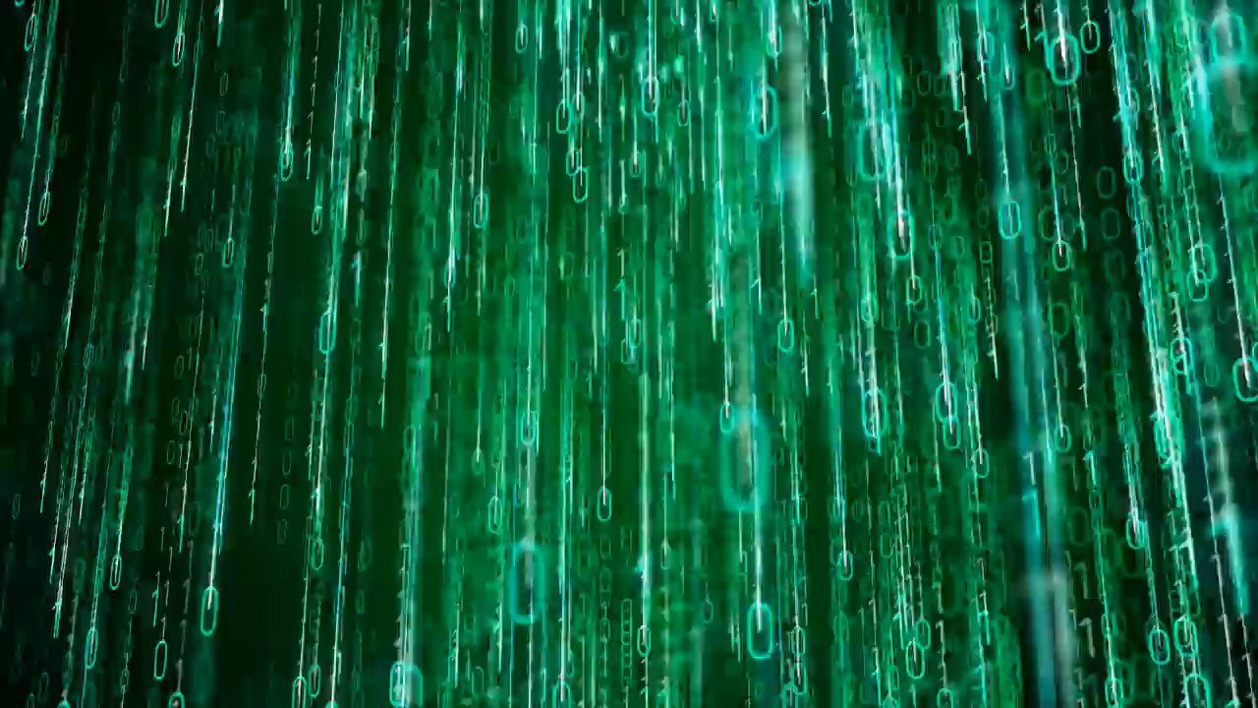
CERN
Computer Security
Controls

Slide 2
Overview
Security:
Know your security footprint
Risks:
Adversaries & Attack Vectors
Countermeasures:
CERN Computer Security Controls

Slide 3
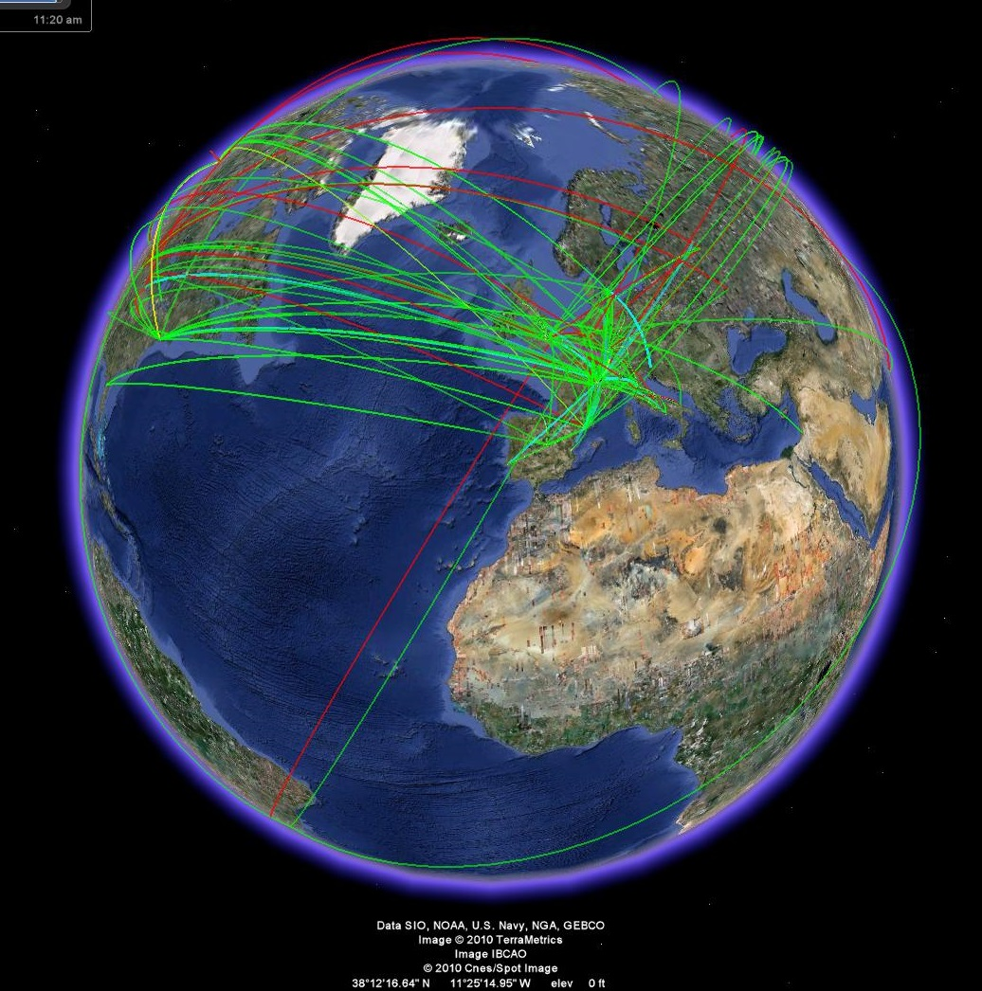
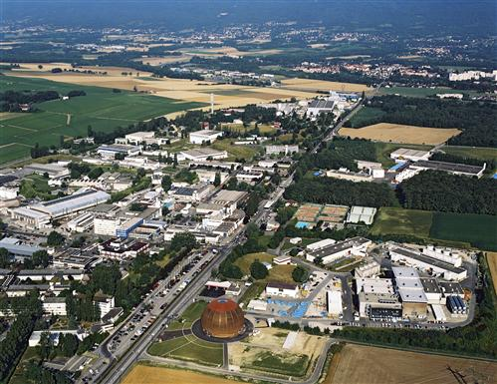
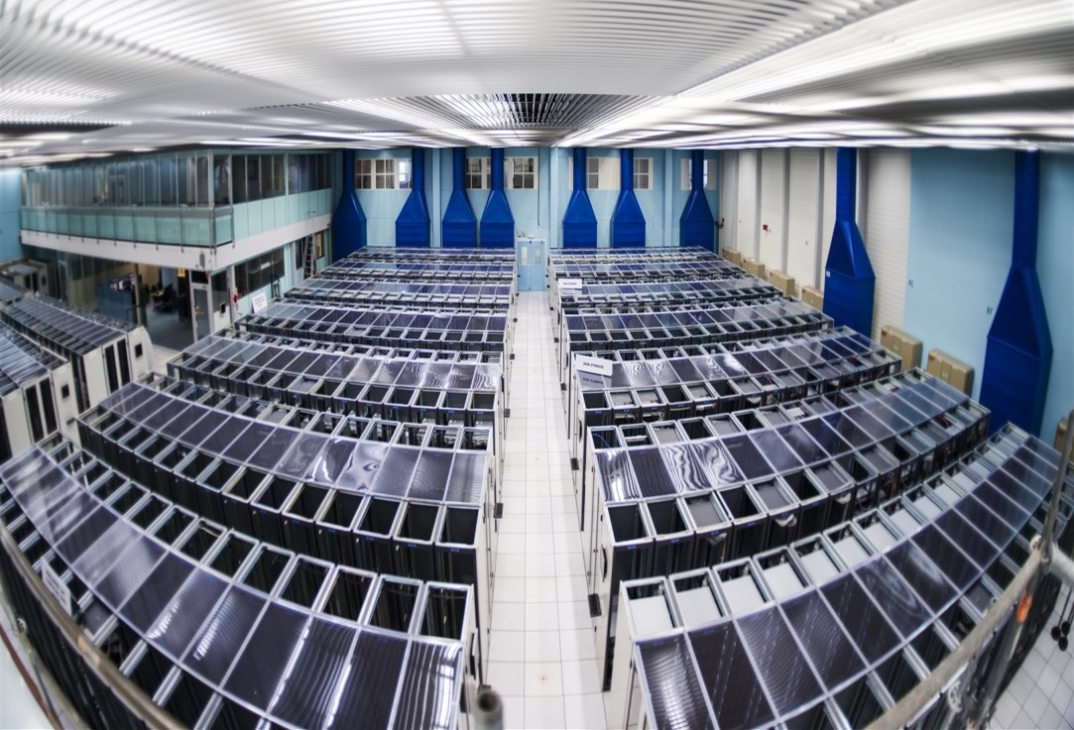
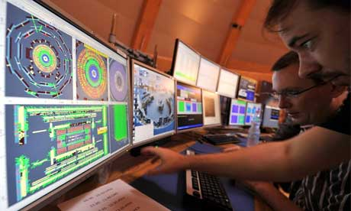
Four Sectors of Operation

Slide 4
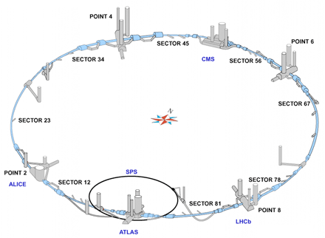
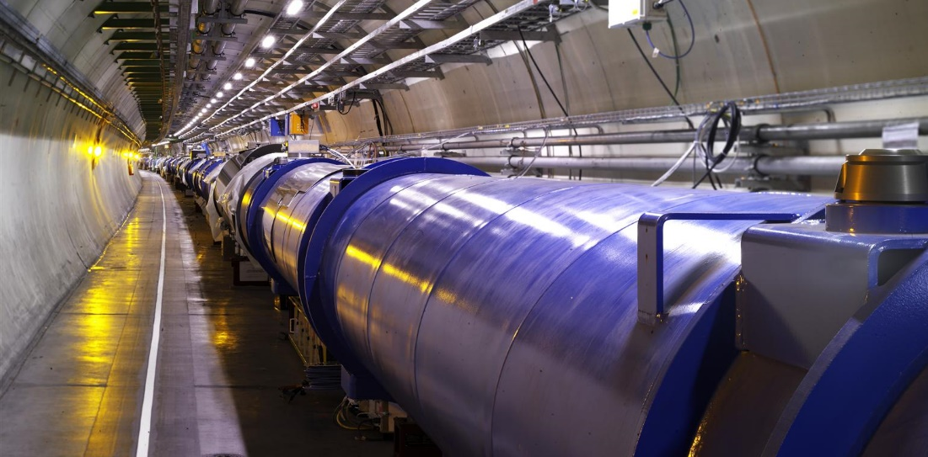
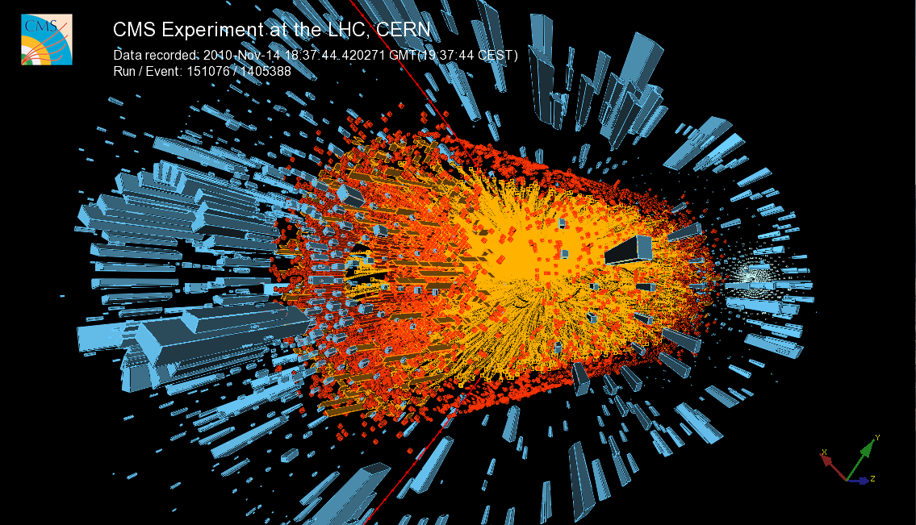
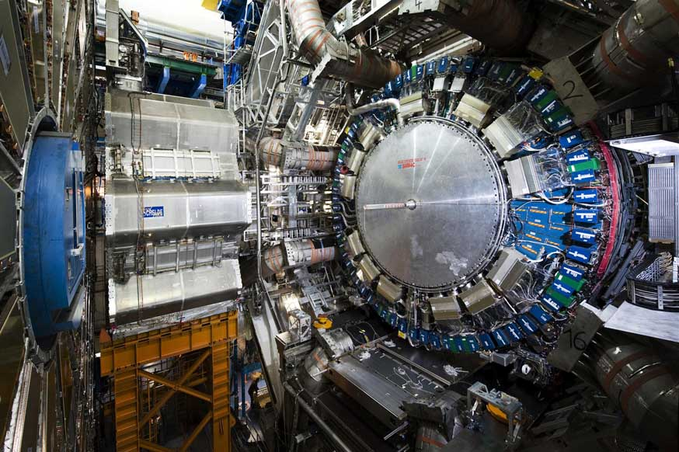
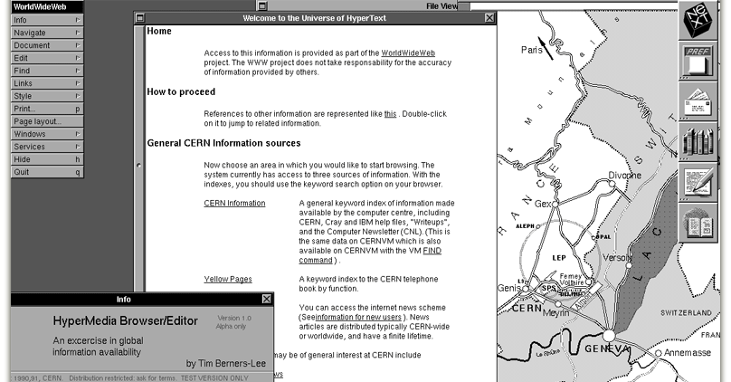
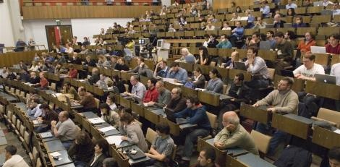
A Complex + Cacophonic Footprint

Slide 5
Office Computing Cyber-Security
One flat office, wireless & data centre network (visitor laptops on par with
office PCs and data centre services)
5 Class-B IPv4 & 4 IPv6 networks
(+many non-routable networks)
160Gb/s backbone, >20 Gb/s flat bandwidth,
4000 switches, 300 routers, 6k firewall openings
~271k heterogeneous devices registered:
any hardware, any operating system, any (legal) application
~37k user account & mailboxes, 2M emails/d, 70% SPAM

Slide 6
Computer Centre Cyber-Security
7 data centres serving users, infrastructure, compute & storage, accelerators & experiments
>6k servers, 213k cores, 30k virtual machines,
~1EB storage (71k hard disks + 49k tapes)
Provisioning of operating systems, printing, A/V software, office/engineering/HR/finance app’s,
data bases, versioning/build systems, virtualisation & container services, collaboration tools, video/audio conferencing, …
50 central + 500 decentral webservers, >10k websites, >1.5M webpages, webcast

Slide 7
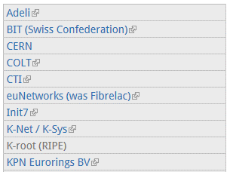
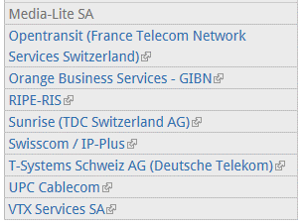
WLCG Cyber-Security
Worldwide LHC Computing Grid (WLCG):
Tier-0 (CERN: ~7k nodes)
13 Tier-1s, >150 Tier-2s and 3s
Permanently running >300k analysis jobs on >550k CPU cores
at >20Gb/s through-put
CERN Internet Exchange Point (CIXP):
20 Internet Service Provider (ISPs) & telecommunication companies

Slide 8
Control System Cyber-Security
Experiments:
ALICE, ATLAS, CMS, LHCb, LHCf and TOTEM
AD, Cast, Cloud, Collaps, Compass, Dirac, Gamma Irradiation Facility, ISOLDE/ISOLTRAP, MICE R&D, Miniball, Mistral, NA48/3, NA49, NA60, NA62, nTOF, Witch, …
GCS, MCS, MSS, and Cryogenics System
Accelerators:
AB/OP, AD, CNGS, CCC, CLIC, ELENA, ISOLDE, ISOLDE offline, LEIR, LHC, Linac 2/3/4, PS, PS Booster, REX, SM18, and SPS
Accelerator Infrastructure:
ADT, ACS, BQE, BPAWT, BDI, BIC, BLM, BOF, BPM, BOB, BSRT, BTV, BRA, CWAT, Cryo (Frigo, SM18 & Tunnel), BCTDC, BCTF, FGC, LEIR Low Level RF, LHC Beam Control System, LBDS, HC, LHC Logging Service, LTI, MKQA, APWL, BPL, OASIS, PIC, QDS/QPS, BQS, SPS BT, BQK, Vacuum System, WIC, and BWS
Safety:
ACIS, AC PS1, AC PS2, AC SPS1, AC SPS2, Alarm Repeater, ARCON, ADS, CCTV, CSA, SGGAZ, SFDIN, CSAM, CESAR, DSS, LACS, LASS, LASER, Radmon, RAMSES, MSAT, Radio Protection Service, Sniffer System, SUSI, TIM
Infrastructure:
CV, ENS, FM, DBR, Gamma Spectroscopy, TS/CSE, and YAMS

Slide 9
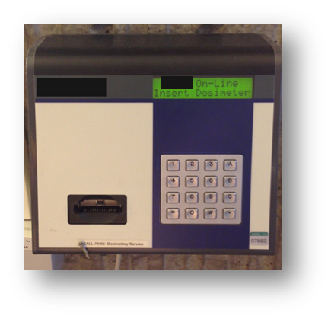
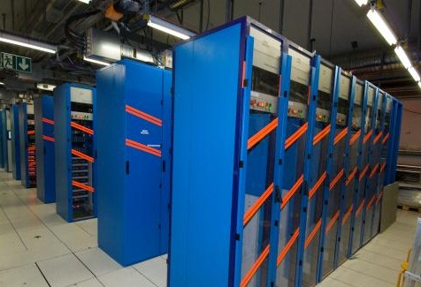
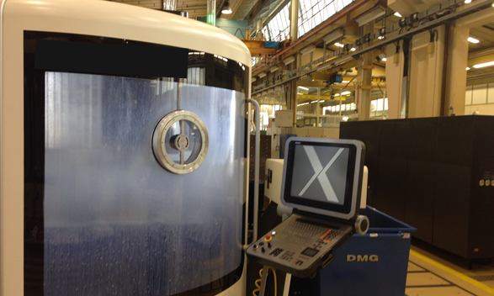
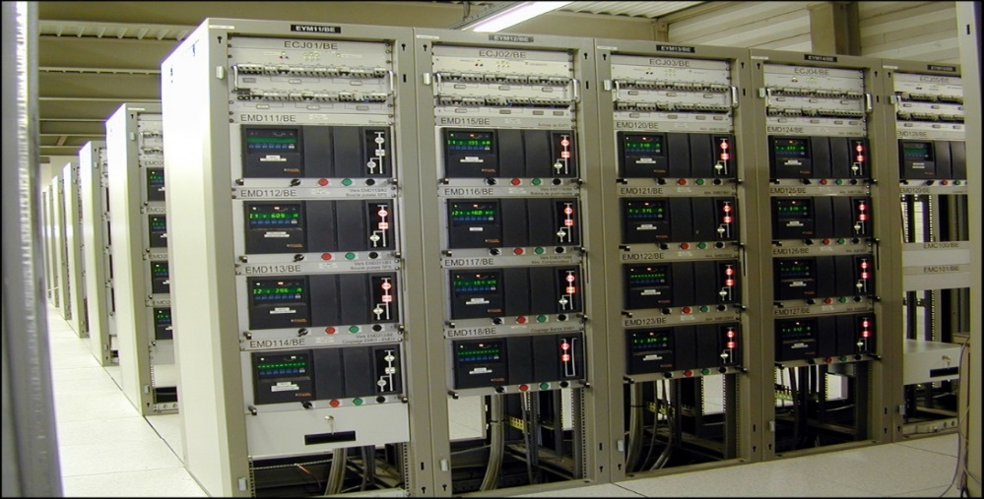
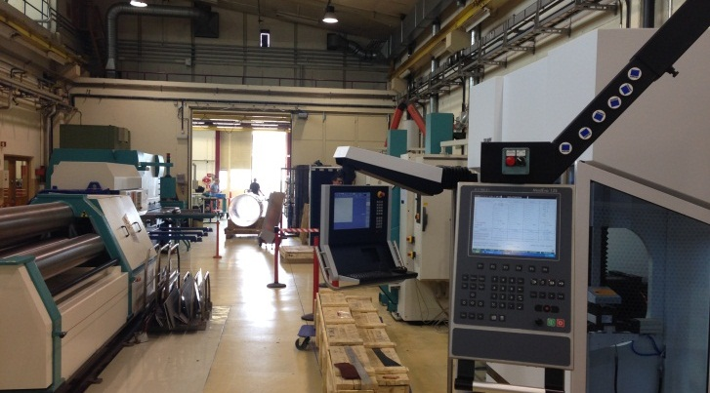
Examples of Control Systems

Slide 10
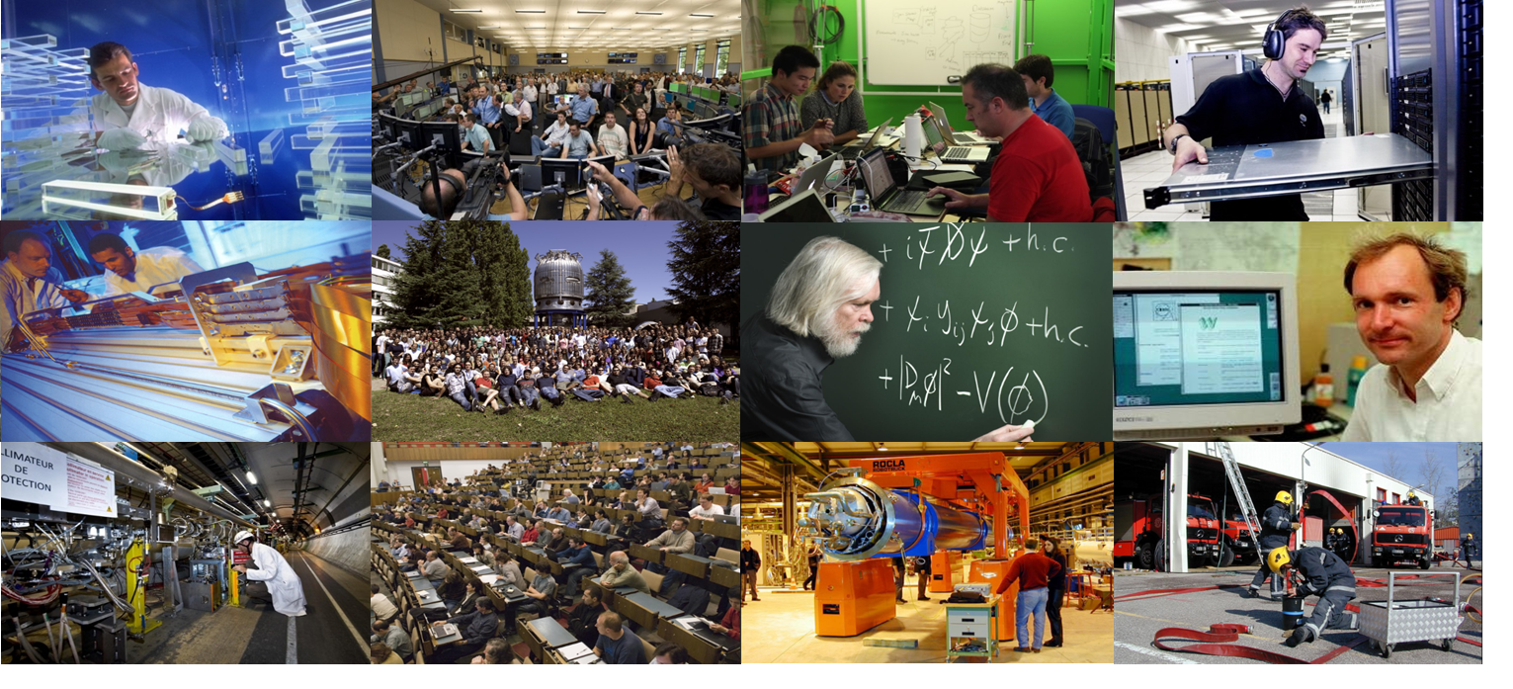
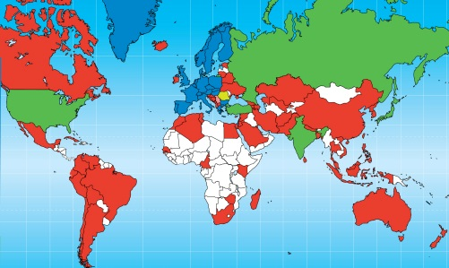
CERN Staff & Users

Slide 11
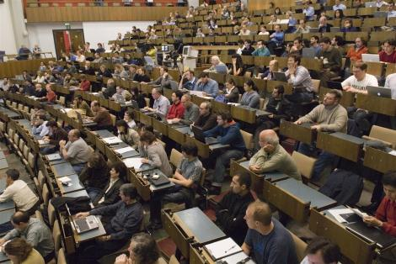
Academic Freedom
“May I point out that I do not have a tail and do not feel like being treated like a circus dog.”
“Why there are idiotic policies in place to forbid use of certain technologies?”
“I failed to pass the security courses, the questions were so stupid, that sometimes it's difficult to answer. If you want to meet with me personally, I can teach you computer security.”
“I fully recognise the importance of computer security at CERN. However, I am not sure that you have yet appreciated that computer security is not the raison d'être of CERN...”

Slide 12
The “Security” Risk Matrix
Operational | Financial | Legal | Reputational
Violation of copyrights
License infringements
Sabotage
Financial fraud
Data theft
Attacking third parties
Misuse of compute power
Defacement
Impersonation
Espionage
Water-Holing

Slide 13
Scope:
CERN ̶ Know your (security) footprint
Risks:
Adversaries & Attack Vectors

Slide 14
Like any other company, organization or university, CERN is under permanent attack.

Slide 15
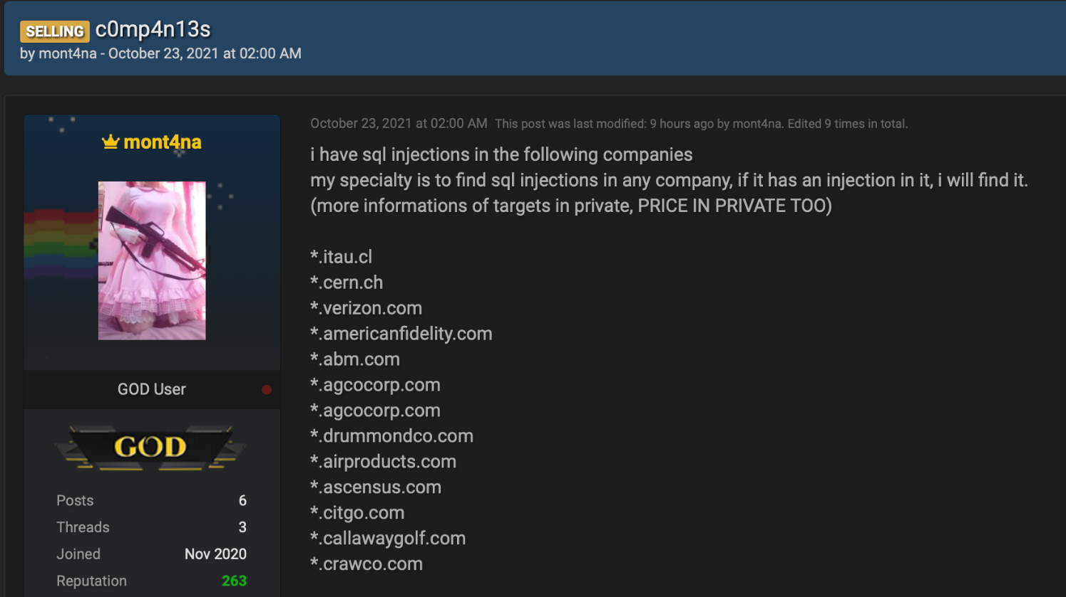
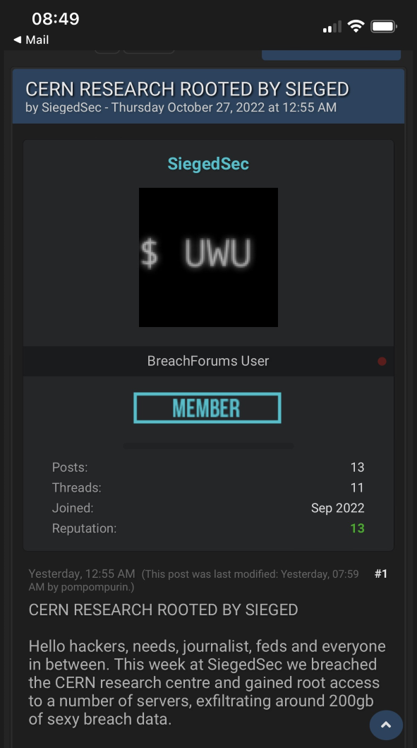
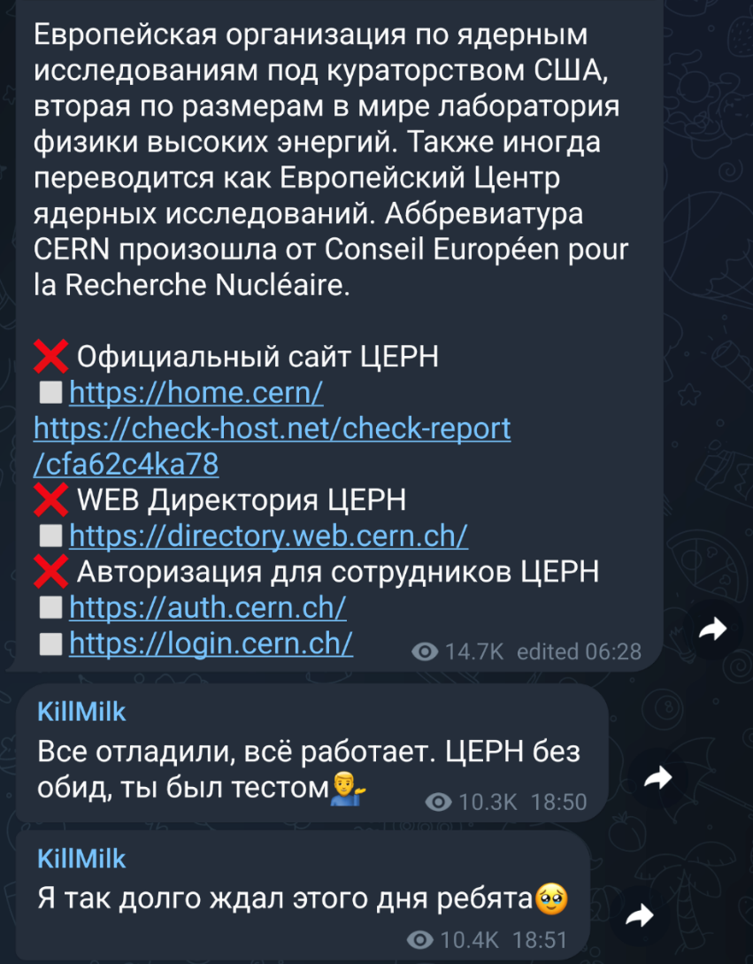
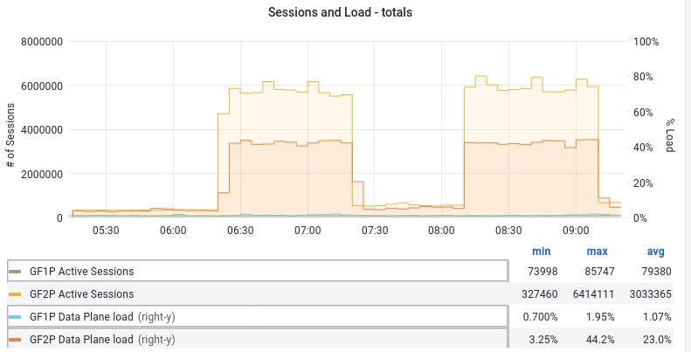


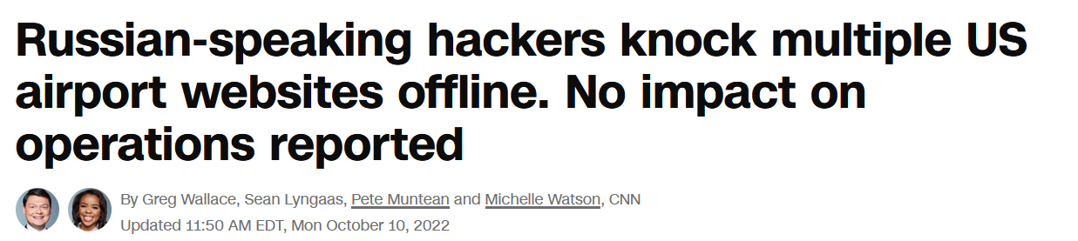
Multiple Adversaries

Slide 16
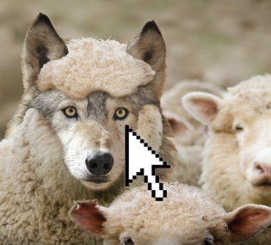
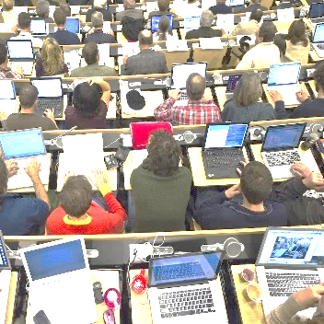
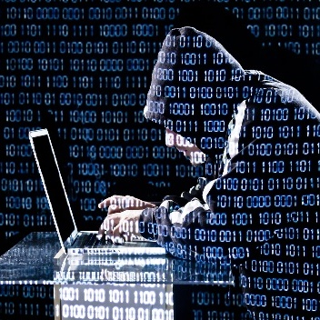
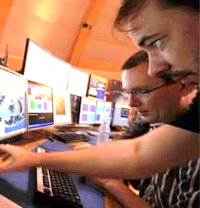
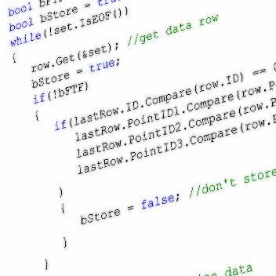
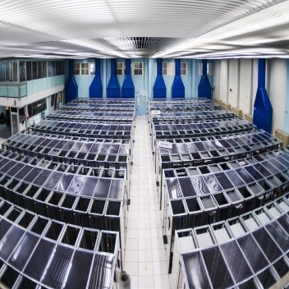
Primary Attack Vectors
Malicious URLs & attachments
Laptops,
smart phones
Adversaries
(“Hackers”)
People (us!)
Lateral movement
Malicious S/W, containers, …
IT services, control systems

Slide 17
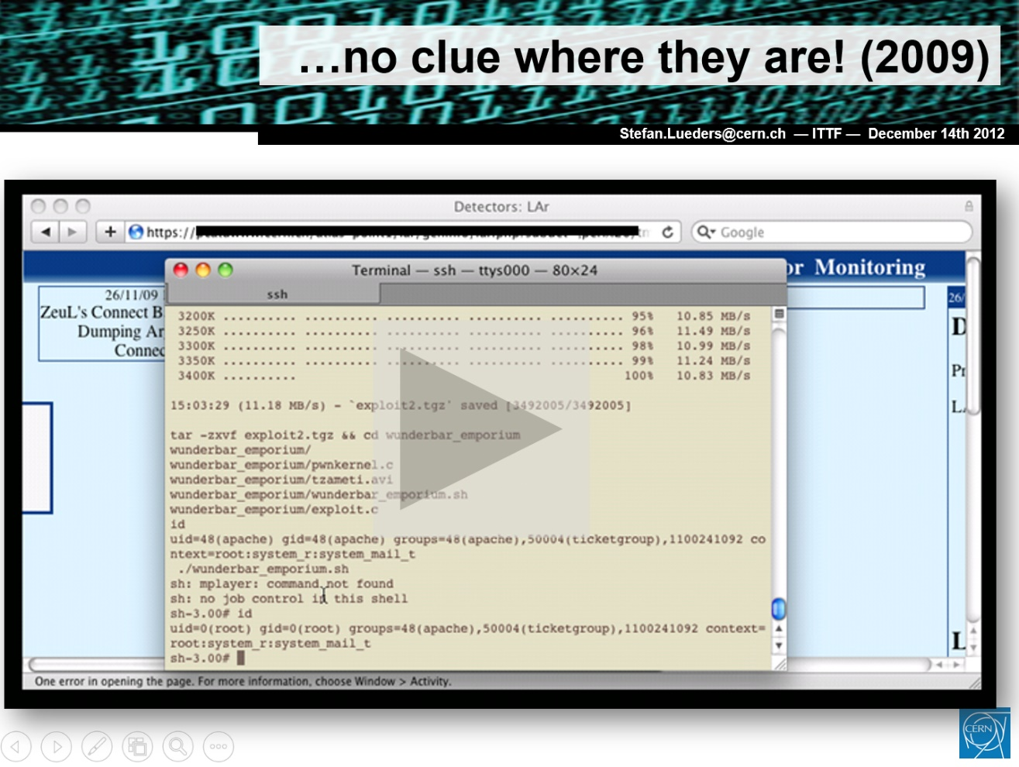
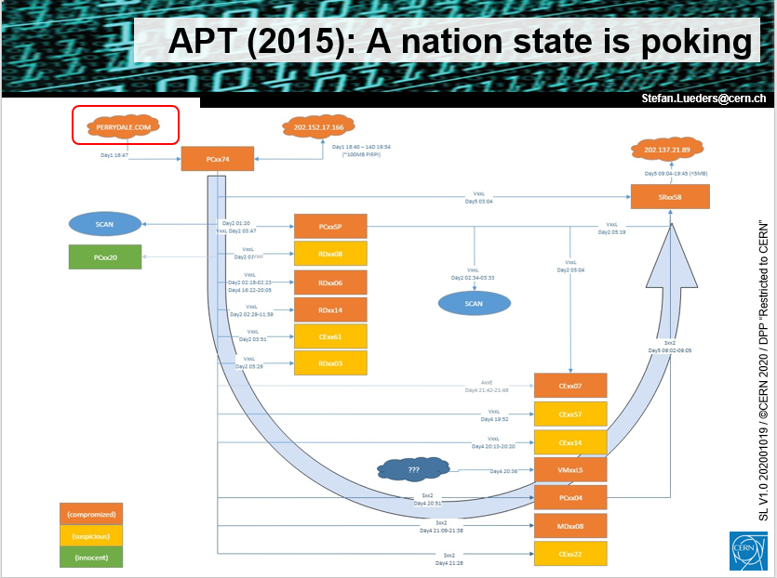
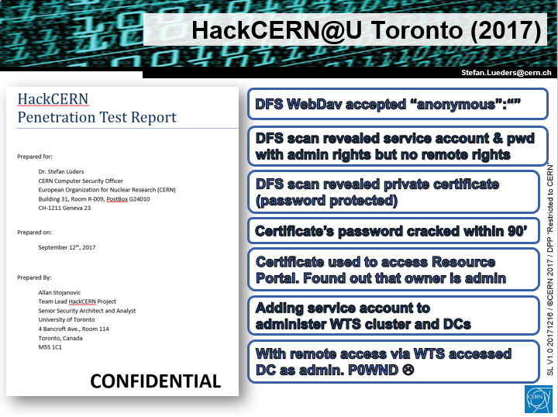
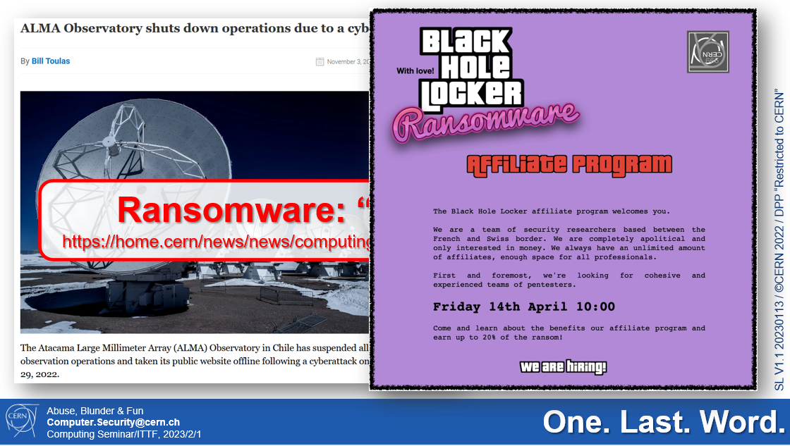
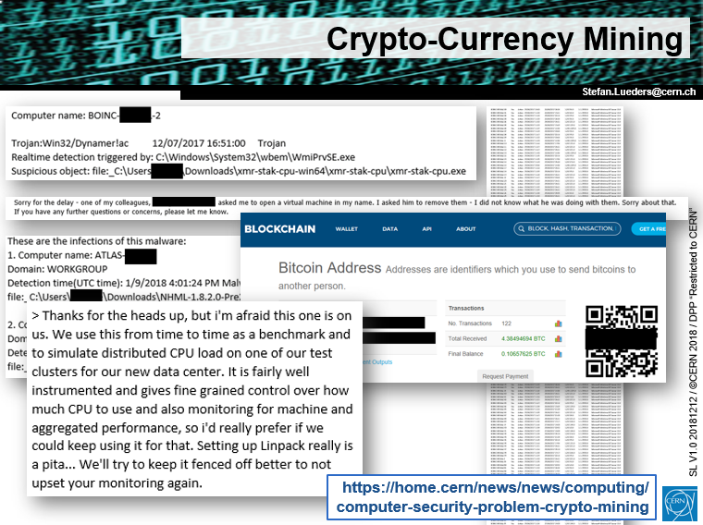
Operational Risks
2009
2015
2017
2018
2023

Slide 18
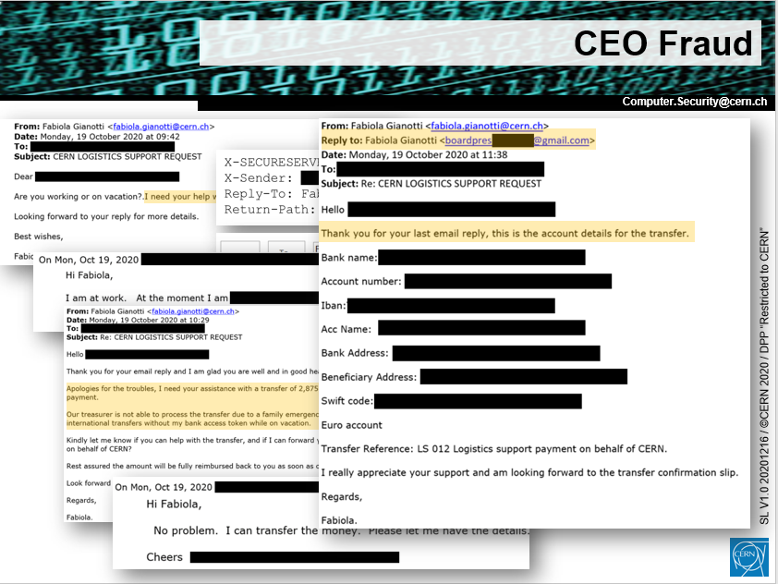
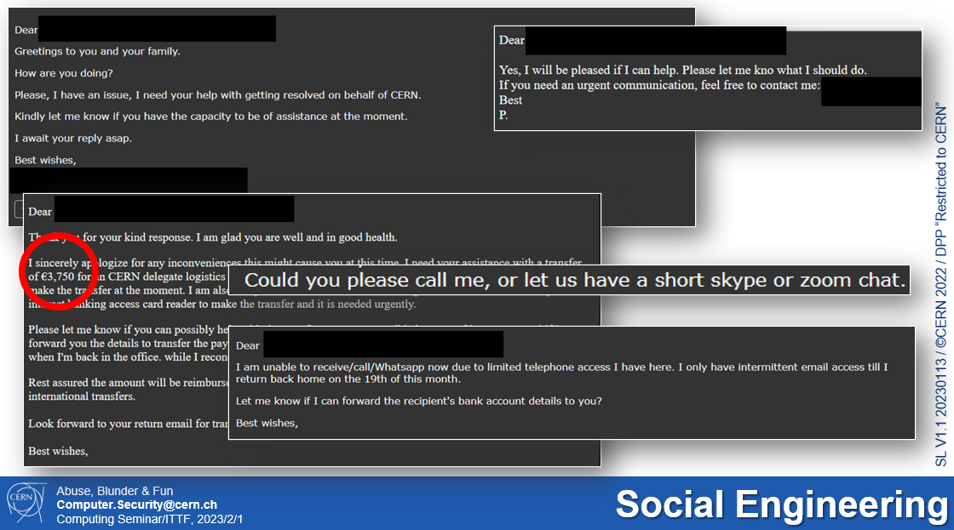
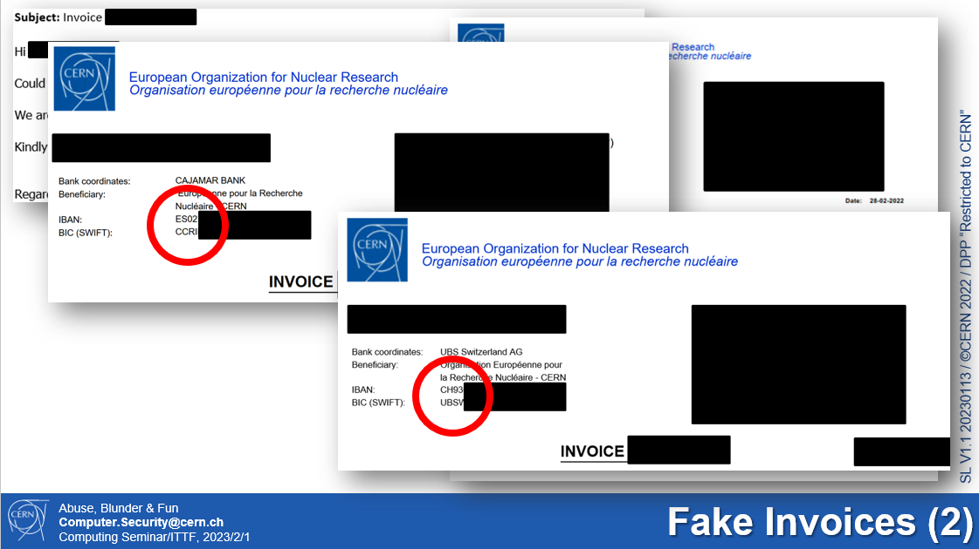
Financial Risks
2020
2023

Slide 19
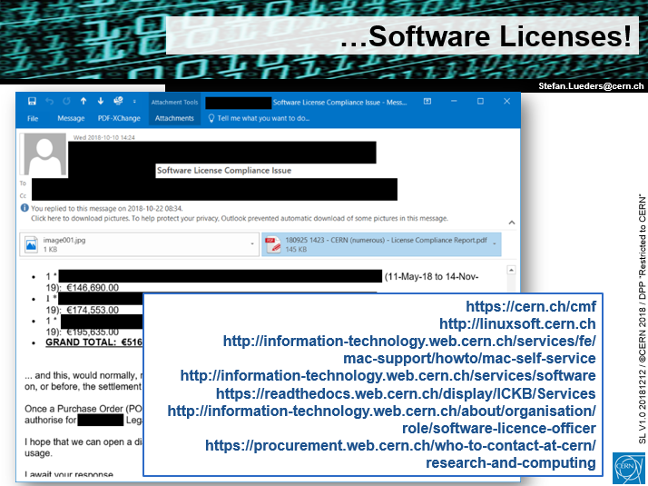
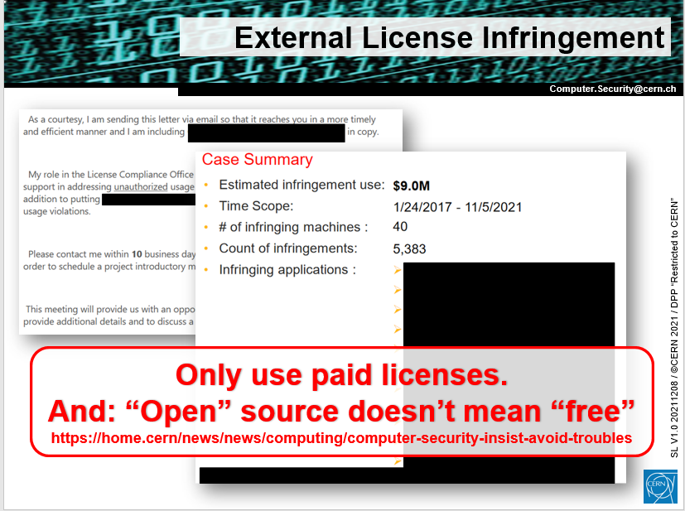
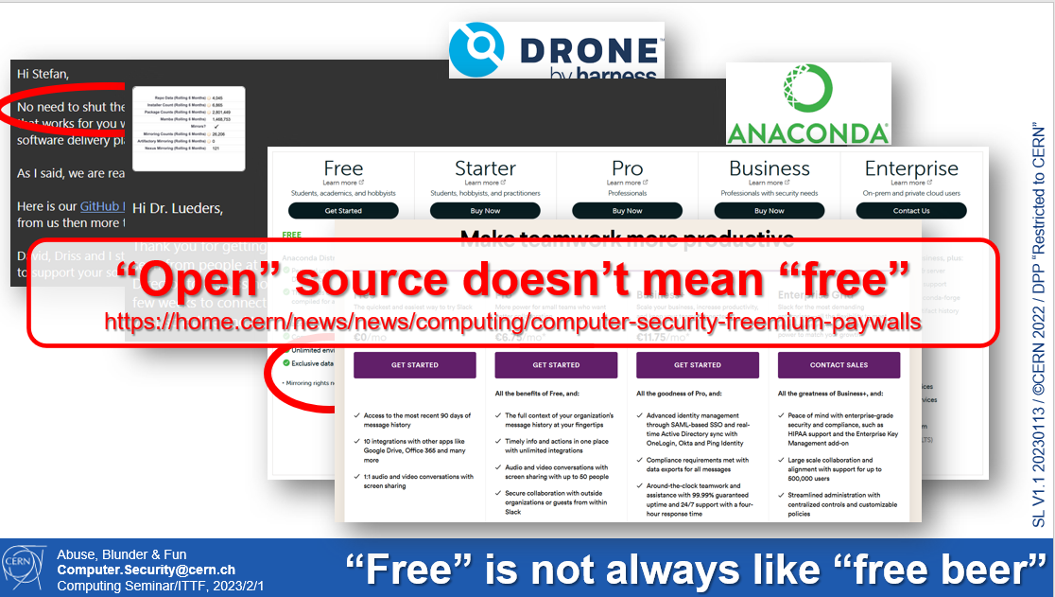
Legal Risks
2018
2021
2023

Slide 20
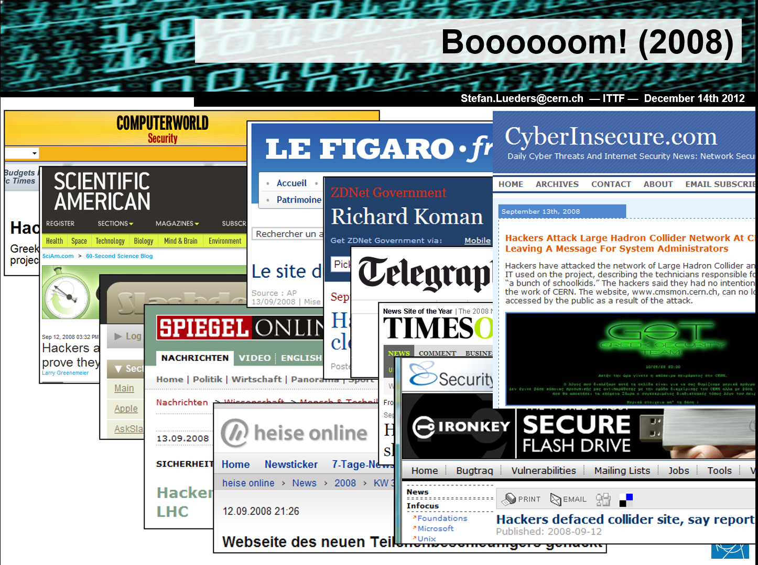
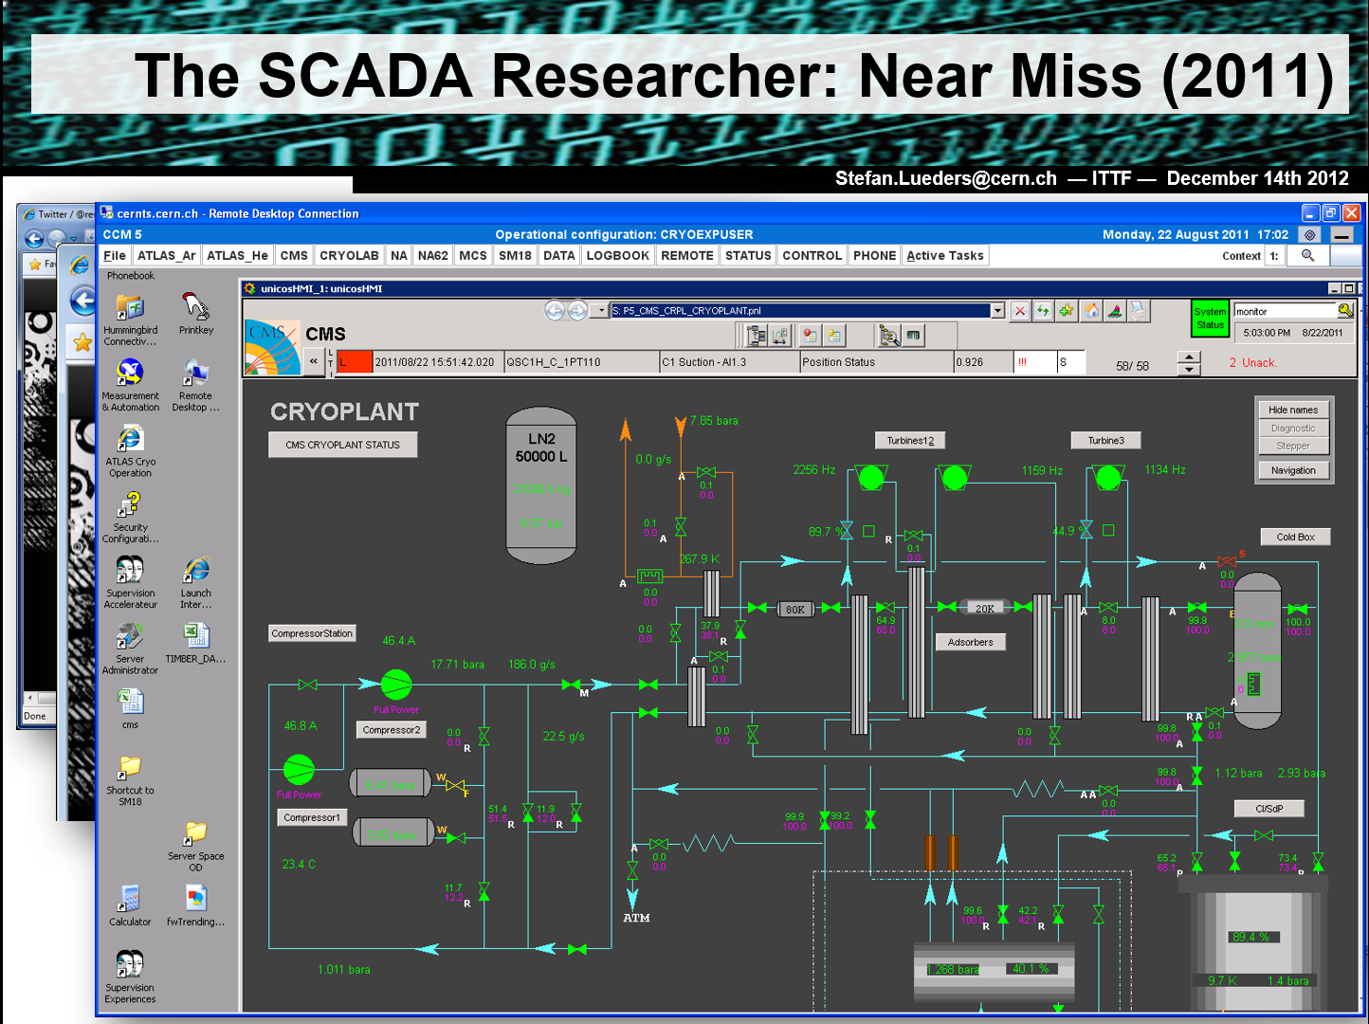
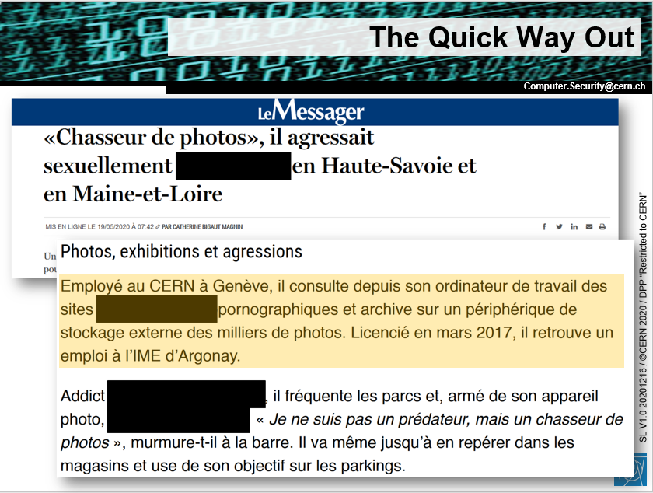
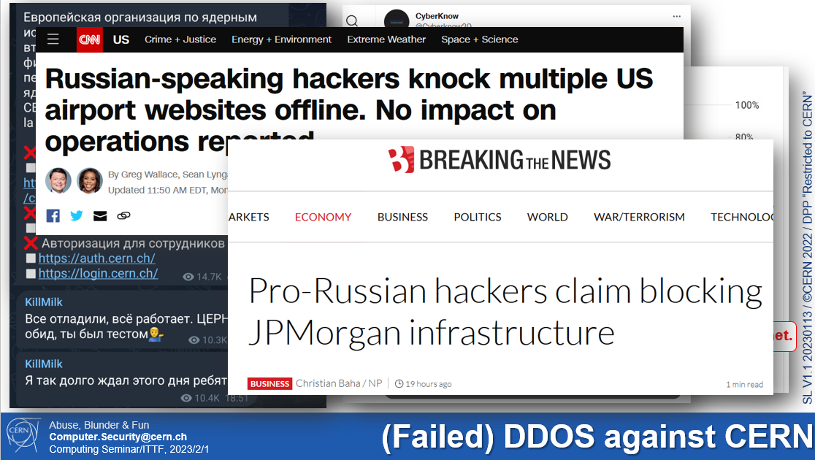
Reputational Risks
2008
2011
2020
2023

Slide 21
Adversaries & Motivation
Operational | Financial | Legal | Reputational
Insiders
Violation of copyrights
Insiders
Insiders
License infringements
Sabotage
Financial fraud
Cyber-criminals
Cyber-criminals
Cyber-criminals
Data theft
Attacking third parties
Misuse of computing power
White/Grey
Hacktivists
White/Grey
Hacktivists
White/Grey
Hacktivists
Defacement
Impersonation
Espionage
Nation states
Nation states
Water-Holing

Slide 22
Scope:
CERN ̶ Know your (security) footprint
Risks:
Adversaries & Attack Vectors
Countermeasures:
CERN Computer Security Controls

Slide 23
Risk Controls
Operational | Financial | Legal | Reputational
Resilience
Violation of copyrights
License infringements
Sabotage
Hardening
Hardening
Financial fraud
Awareness
Awareness
Awareness
Awareness
Data theft
Attacking third parties
Misuse of computing power
Defacement
Impersonation
Detection
Monitoring
Monitoring
Monitoring
Monitoring
Espionage
Water-Holing
Risk acceptance

Slide 24
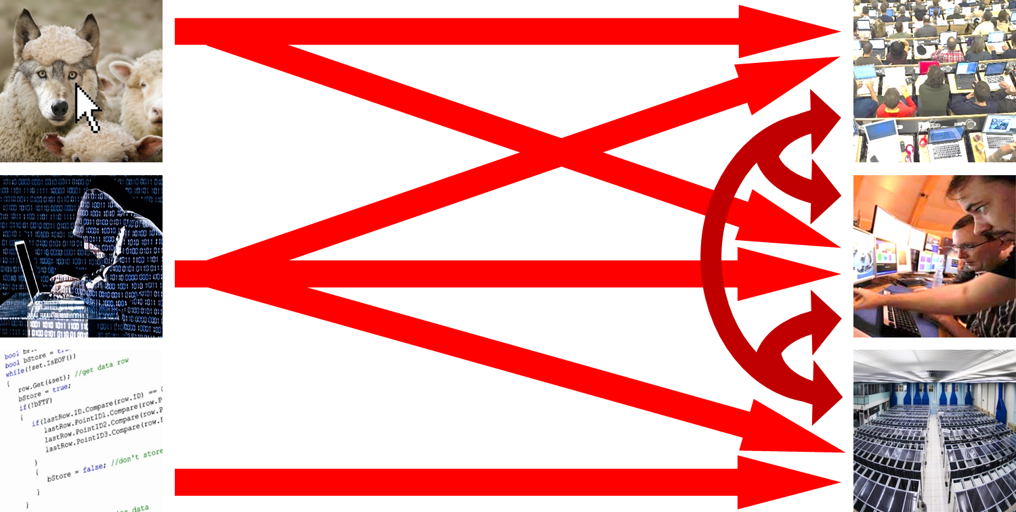
Principles
Computer Security Office’s Mandate: Protect
CERN’s operations & reputation against cyber-threats.
Incl. the WLCG and our academic R&E community.
Approach: Find a pragmatic balance between
“Operations”, “Academic Freedom” & “Security”.
Strategy: Enhance CERN’s security posture wherever
its agility/complexity/heterogeneity allows.
Have excellent threat intel to anticipate attacks.
Defend in depth; detect early; respond quickly & thoroughly.
https://home.cern/news/news/computing/computer-security-about-risks-and-threats
Notes:
R&E: Research & Education
Some systems change & die quickly (e.g. Malt->MS Exchange online; 2FA for CERNTS -> Malt -> ROG -> dead)

Slide 25

Awareness, Training & Policies
Policies: Maintaining CERN Computing Rules (OC5).
Improving governance and enforcement of “security”.
https://cern.ch/ComputingRules
No/low cost
Provisioned
Developm’t
Upcoming
Basic Training: Giving regular awareness/on-boarding sessions. Plus online security courses.
Plus “Bulletin” articles. Plus “clicking campaigns”.
1+ session per month; 300+ articles published in total; 2k+ out of 22k+ people phished ☹
https://security.web.cern.ch/training/en/CERN%20Articles%20On%20Computer%20Security.pdf
Dedicated Training: Providing in-depth training on security practices incl. programming.
Plus “Serious Gaming” and “WhiteHat Challenges“.
5 “Zebra” table-top exercises, one with real policemen from Geneva & Pays de Gex;
~100 CERN WhiteHats trained, plus many more students from external universities
“Thanks for cleaning up” ─ Bulletin article to come
Notes:
OC5: Operational Circular #5 on the Use of CERN’s Computing Facilities

Slide 26
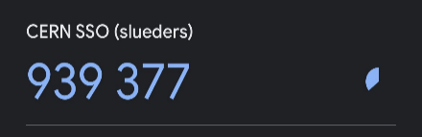
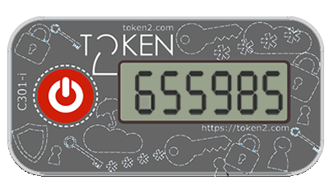

Account Protection
2FA:
Deploying extra protection to SSO/SSH.
4250+ accounts already enrolled. More to come
https://home.cern/news/news/computing/
computer-security-log-click-be-secure
“Gotham”: Notifying “unusual” logins.
~4770 notifications per month
https://home.cern/news/news/computing/
computer-security-your-remote-logins
Dumps of Exposed Passwords:
Notifying when used outside. Ditto for our community. Forcing reset when used at CERN.
Monitoring ~9k communities; reporting ~11k exposed passwords per day (~4/day for CERN)
https://home.cern/news/news/computing/computer-security-password-revolutions
Notes:
2FA: 2-Factor Authentication

Slide 27
Endpoint Protection
EOP ─ xorlab ─ MDO eMail-Filtering:
Quarantining SPAM & malware.
~115k analyzed per day; 10% SPAM; 2% quarantined; >12/d manually checked (MDO: >50% FP)
https://home.cern/news/news/computing/computer-security-fighting-spam-boss-level
ESET Anti-Virus/Anti-Malware:
Providing endpoint detection & response software
for BYOD and CERN-owned devices.
~600 Bring-your-own-devices (BYOD) and 200+ CERN-managed devices
https://home.cern/news/news/computing/
computer-security-winter-season-virus-time-one-free-pill-your-device
Threatray Memory Hashing:
Detecting anomalies on CERN-managed devices.
~1200 CERN-managed devices enrolled
Notes:
EOP: Exchange Online Protection (Microsoft)
MDO: Microsoft Defender for Office
BYOD: Bring Your Own Device

Slide 28
PenTests, Reviews & Consulting
Automatic Vulnerability Scanning:
Identifying weaknesses of endpoints & servers,
unused firewall openings, as well as exposed
secrets and ransomwared files on file storages.
~24k devices scanned per month; ~210 issues per month; ~12M EOS file actions analysed
https://home.cern/news/news/computing/computer-security-time-spring-clean
Security Consultancy & Reviews: Improving
CERN’s security posture (via cloud/software license
office, IT consultants, IT Architecture Review Board).
20-30 in-depth reviews per year
Self-Security Assessment for Cloud Services:
Providing metrics, guidelines & controls for better security.
Based on CISv8 standard. Prototype ready. Web-portal in development

Slide 29

Network Protection
PaloAlto Firewalling:
Performing deep packet inspection and
policy-based IP, domain & URL blocking.
>2x 200Gbps (ingress+egress) IPv4&v6 monitored in-line
https://home.cern/news/news/computing/
computer-security-cerns-new-first-line-defence
DNS RPZ & Firewall: Blocking
malicious & typo-squatting domains
(with SWITCH). Ditto for 50+ CH & F hospitals.
~800 domains blocked by CERN, >100/day by SWITCH. No hospital got ransomwared so far
https://home.cern/news/news/computing/computer-security-when-cernch-not-cern
pDNS Containers: Helping WLCG sites to do alike.
Notes:
DNS RPZ: DNS Response Policy Zone
pDNS: protective DNS

Slide 30
Software Security
Code / Container Scanning:
Deploying GitLab/GitCI and Harbor security features (SAST/DAST/…).
https://home.cern/news/news/computing/computer-security-avoiding-salmonella-your-code
Software-Bill-of-Materials (SBOM):
Pushing for a curation service to avoid
(automatic) downloading of
malicious libraries, packages, containers & VMs.
Document dependency trees and license constraints.
https://home.cern/news/news/computing/computer-security-when-your-restaurant-turns-sour
Notes:
CNIC: Computing and Network Infrastructure for Controls

Slide 31

Orchestration (the “SOC”)

Slide 32

Threat Intelligence
ThreatIntel:
Obtaining high-quality Indicators of Compromise.
e.g. IPs, domains, file hashes
from our peers and Prodaft, plus the IWF on CSAM
(child sexual abuse material).
~15M IoCs shared with 1000+ peer organizations; 100k+ IoCs currently actively monitored
https://home.cern/news/news/computing/computer-security-protective-intelligence
Collaboration: Acting as a trusted, neutral broker,
aiming at fostering cooperation and trust in our community:
WLCG/EGI/OSG, SWITCH (CH), REN-ISAC (5-eyes); +Governments: MELANI (CH), ANSSI (F), CH-CERTs;
+Law enforcement: Interpol, Europol, FBI, CISA, local police;
+Int’l org’s: GISSIG/UNISSIG; and with security vendors.
P.ex. 120+ universities world-wide notified this year of ransomware preparations in their IT infrastructure
Notes:
REN-ISAC: Research & Education Network Information Sharing & Analysis Centres
5-eyses: Australia, Canada, New Zealand, UK, USA + CERN
MELANI: Swiss Reporting and Analysis Centre for Information Assurance
ANSSI: Agence nationale de la sécurité des systèmes d'information
CISA: Cybersecurity & Infrastructure Security Agency
GISSIG: Geneva Information Security Special Interest Group
UNSSIG: UN Information Security Special Interest Group

Slide 33

Intrusion Detection
Ingestion, Processing & Storage:
Monitoring traffic at the Internet & TN gates,
DNS requests, CERN SSO logins,
activities on interactive Linux clusters, …
Google Workspace & MS Azure to come.
Ingesting: ~3TB of data;
Storing currently: ~220TB in total (~1PB if uncompressed);
Analysing per day: ~3B network connections,
~1.2B DNS requests,
~570k logins,
~4B command executions
https://home.cern/news/news/computing/computer-security-digital-trenches
Notes:
TN: Technical Network
SSO: Single Sign-On

Slide 34



Incident Response
“Auto-Notify”:
Notifying resource owners
(devices, accounts, websites, …)
of problems with their resources.
~300 reports per month (plus ~4700 “Gotham”)
https://home.cern/news/news/computing/
computer-security-our-findings-your-problem
Forensics: Providing capabilities and tools like Joe Security, Prodaft, Threatray, Velociraptor.
https://home.cern/news/news/computing/
computer-security-catch-me-if-you-can

Slide 35
CERN & HEP CSIRT
CERN Computer Security Rota:
Providing 2nd line Guys-on-Duty (“GoD”);
3rd line Security Escalation Cordinator (“SEC”);
4th line Computer Security Officer.
~150 SNOW and ~36 FIR tickets handled per month; 5-10 “heavy” incidents per year
Grid Security Rota:
Leading the WLCG Security Office;
Leading EGI Incident Response Taskforce;
Leading EOSCfuture Incident Response TF.
“SAFER” Community Security:
Providing world-wide incident response.
https://home.cern/news/news/computing/computer-security-safer-teamwork
Notes:
GoD: Guy/Girl on Duty
SEC: Security Escalation Coordinator
CSIRT: Computer Security Incident Response Team

Slide 36
Defense in Depth
Malicious URLs & attachments
Laptops,
smart phones
Adversaries
(“Hackers”)
People (us!)
Malicious S/W, containers, …
IT services, control systems

Slide 37


Summary
Strategy: Enhance CERN’s security posture wherever
its agility/complexity/heterogeneity allows.
Have excellent threat intel to anticipate attacks.
Defend in depth; detect early; respond quickly & thoroughly.
Strategy: Enhance CERN’s security posture wherever thoroughly despite its agility/complexity/heterogeneity allows.
Have excellent threat intel to anticipate attacks.
Defend in depth; detect early; respond quickly & thoroughly.
CERN Computer Security Controls:
As complex and manifold as our environment.
A comprehensive portfolio builds up slowly but steadily (like a Marathon that never ends).
Collaborate: This fight can’t be fought alone.
Collaborate, contribute, share with those willing to join.
Notes:
R&E: Research & Education
Some systems change & die quickly (e.g. Malt->MS Exchange online; 2FA for CERNTS -> Malt -> ROG -> dead)

Slide 38


Futher Reading
https://security.web.cern.ch/reports/en/monthly_reports.shtml
https://security.web.cern.ch/reports/en/articles.shtml

Slide 39
Thank you very much!

