Slide 1
Nozomi Networks
20 September 2025
Chandler Lawrence and Timothy Zingelman

Slide 2

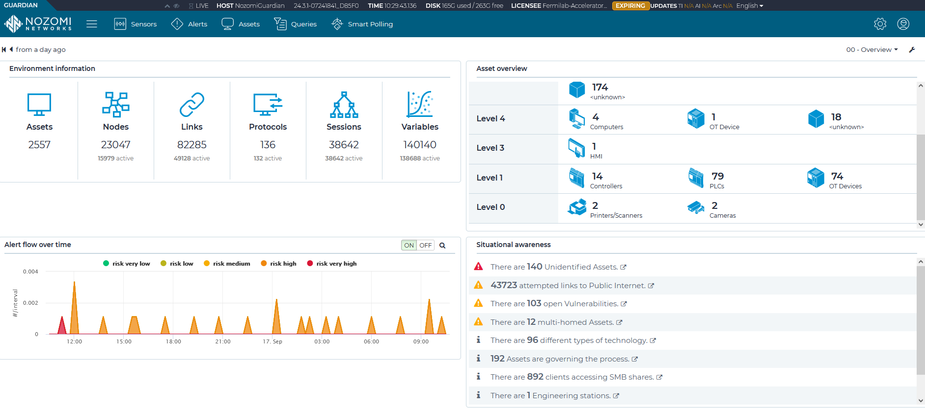
Nozomi Networks Dashboard
Here we have an intrusion detection system that provides immense visibility into the control system network that helps run the accelerator. It provides us a real-time snapshot of all important data that represents the status of the network.

Slide 3
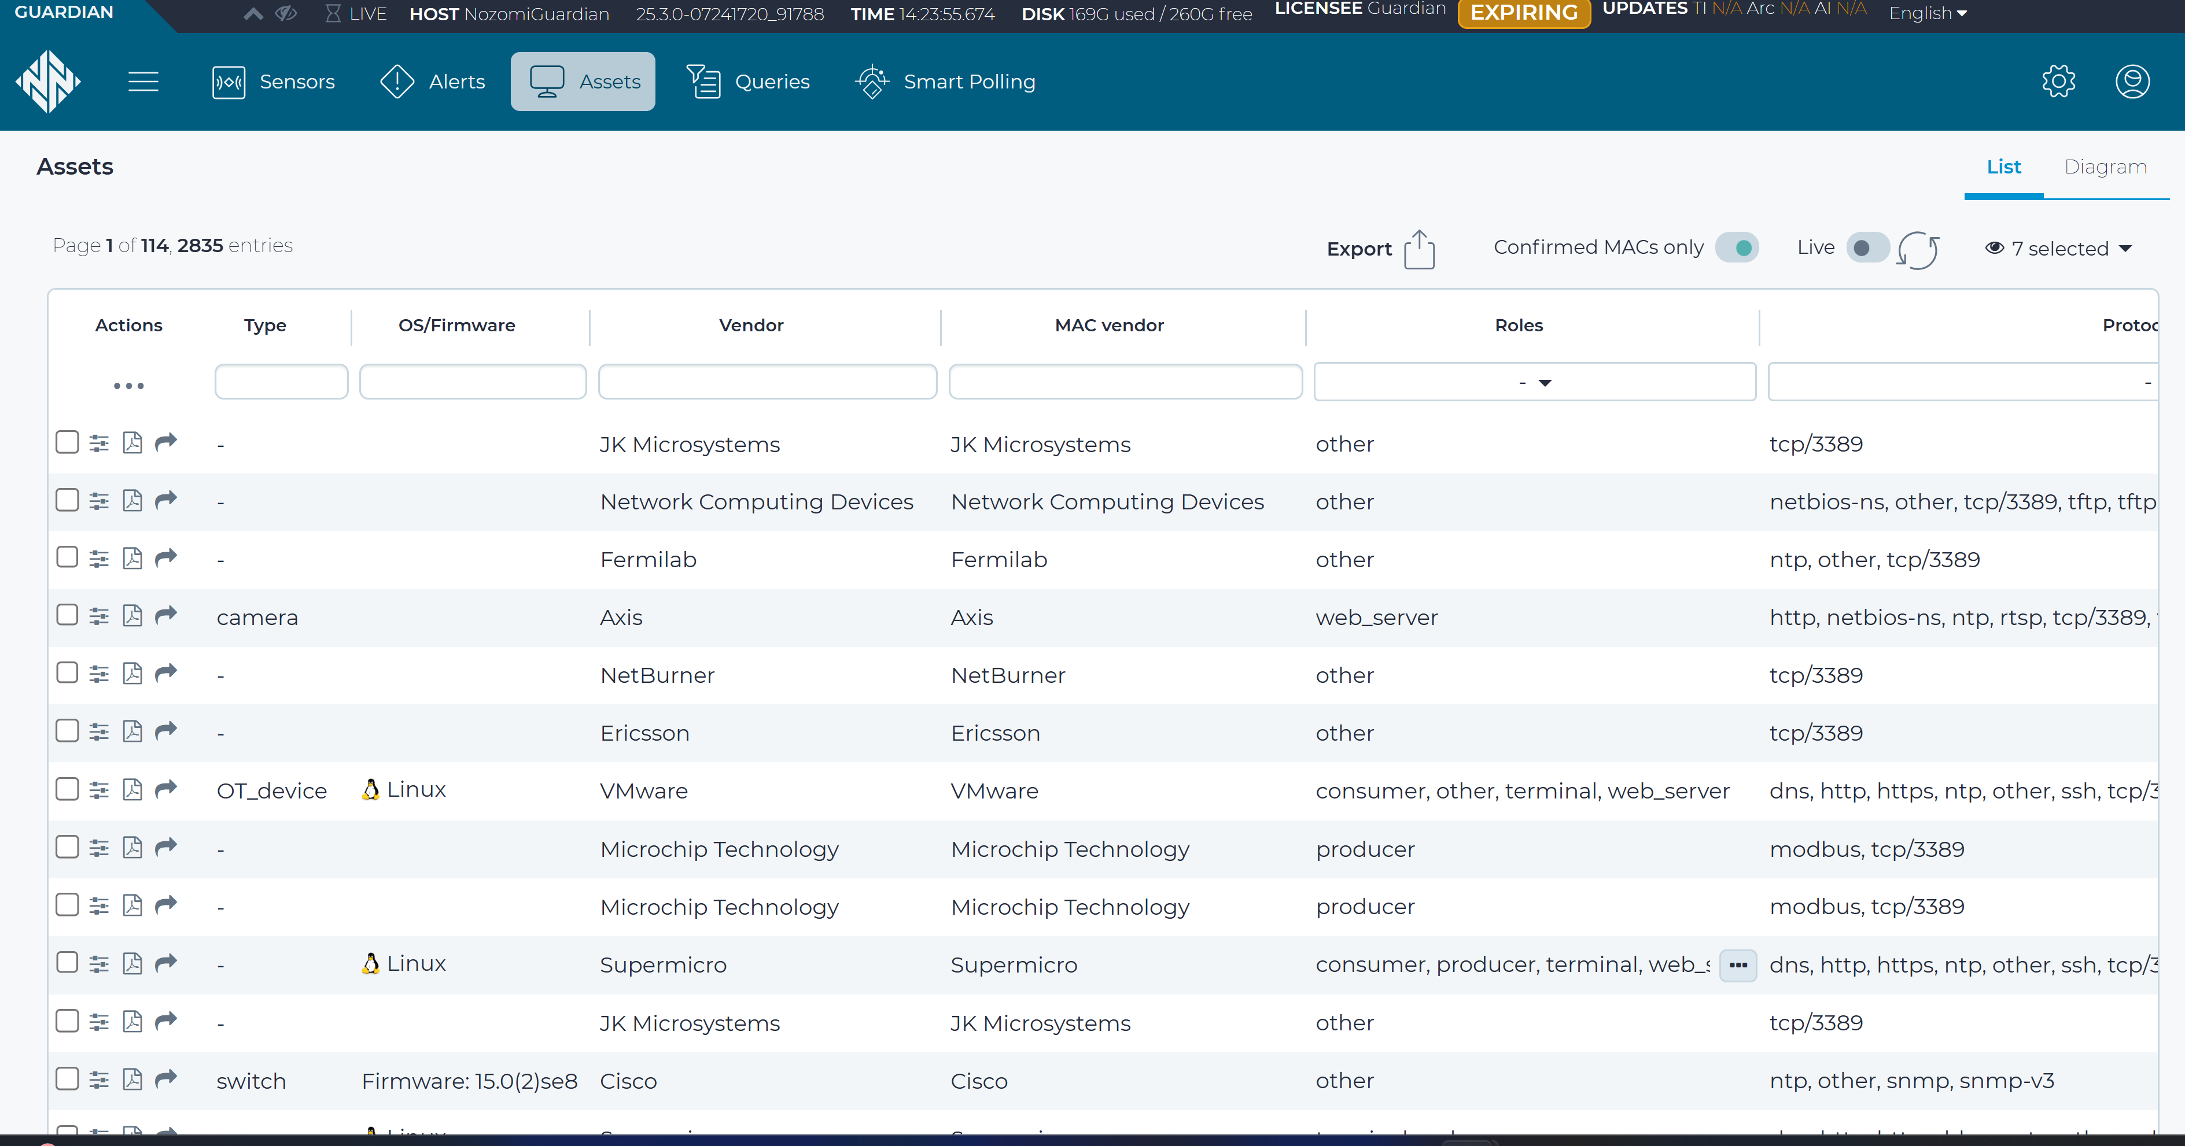
Nozomi Networks Assets
Asset inventory functionality maintains a real-time database of all industrial control system components, IT assets, and network devices within our air-gapped environment, including hardware specifications, software versions, and configuration details.

Slide 4
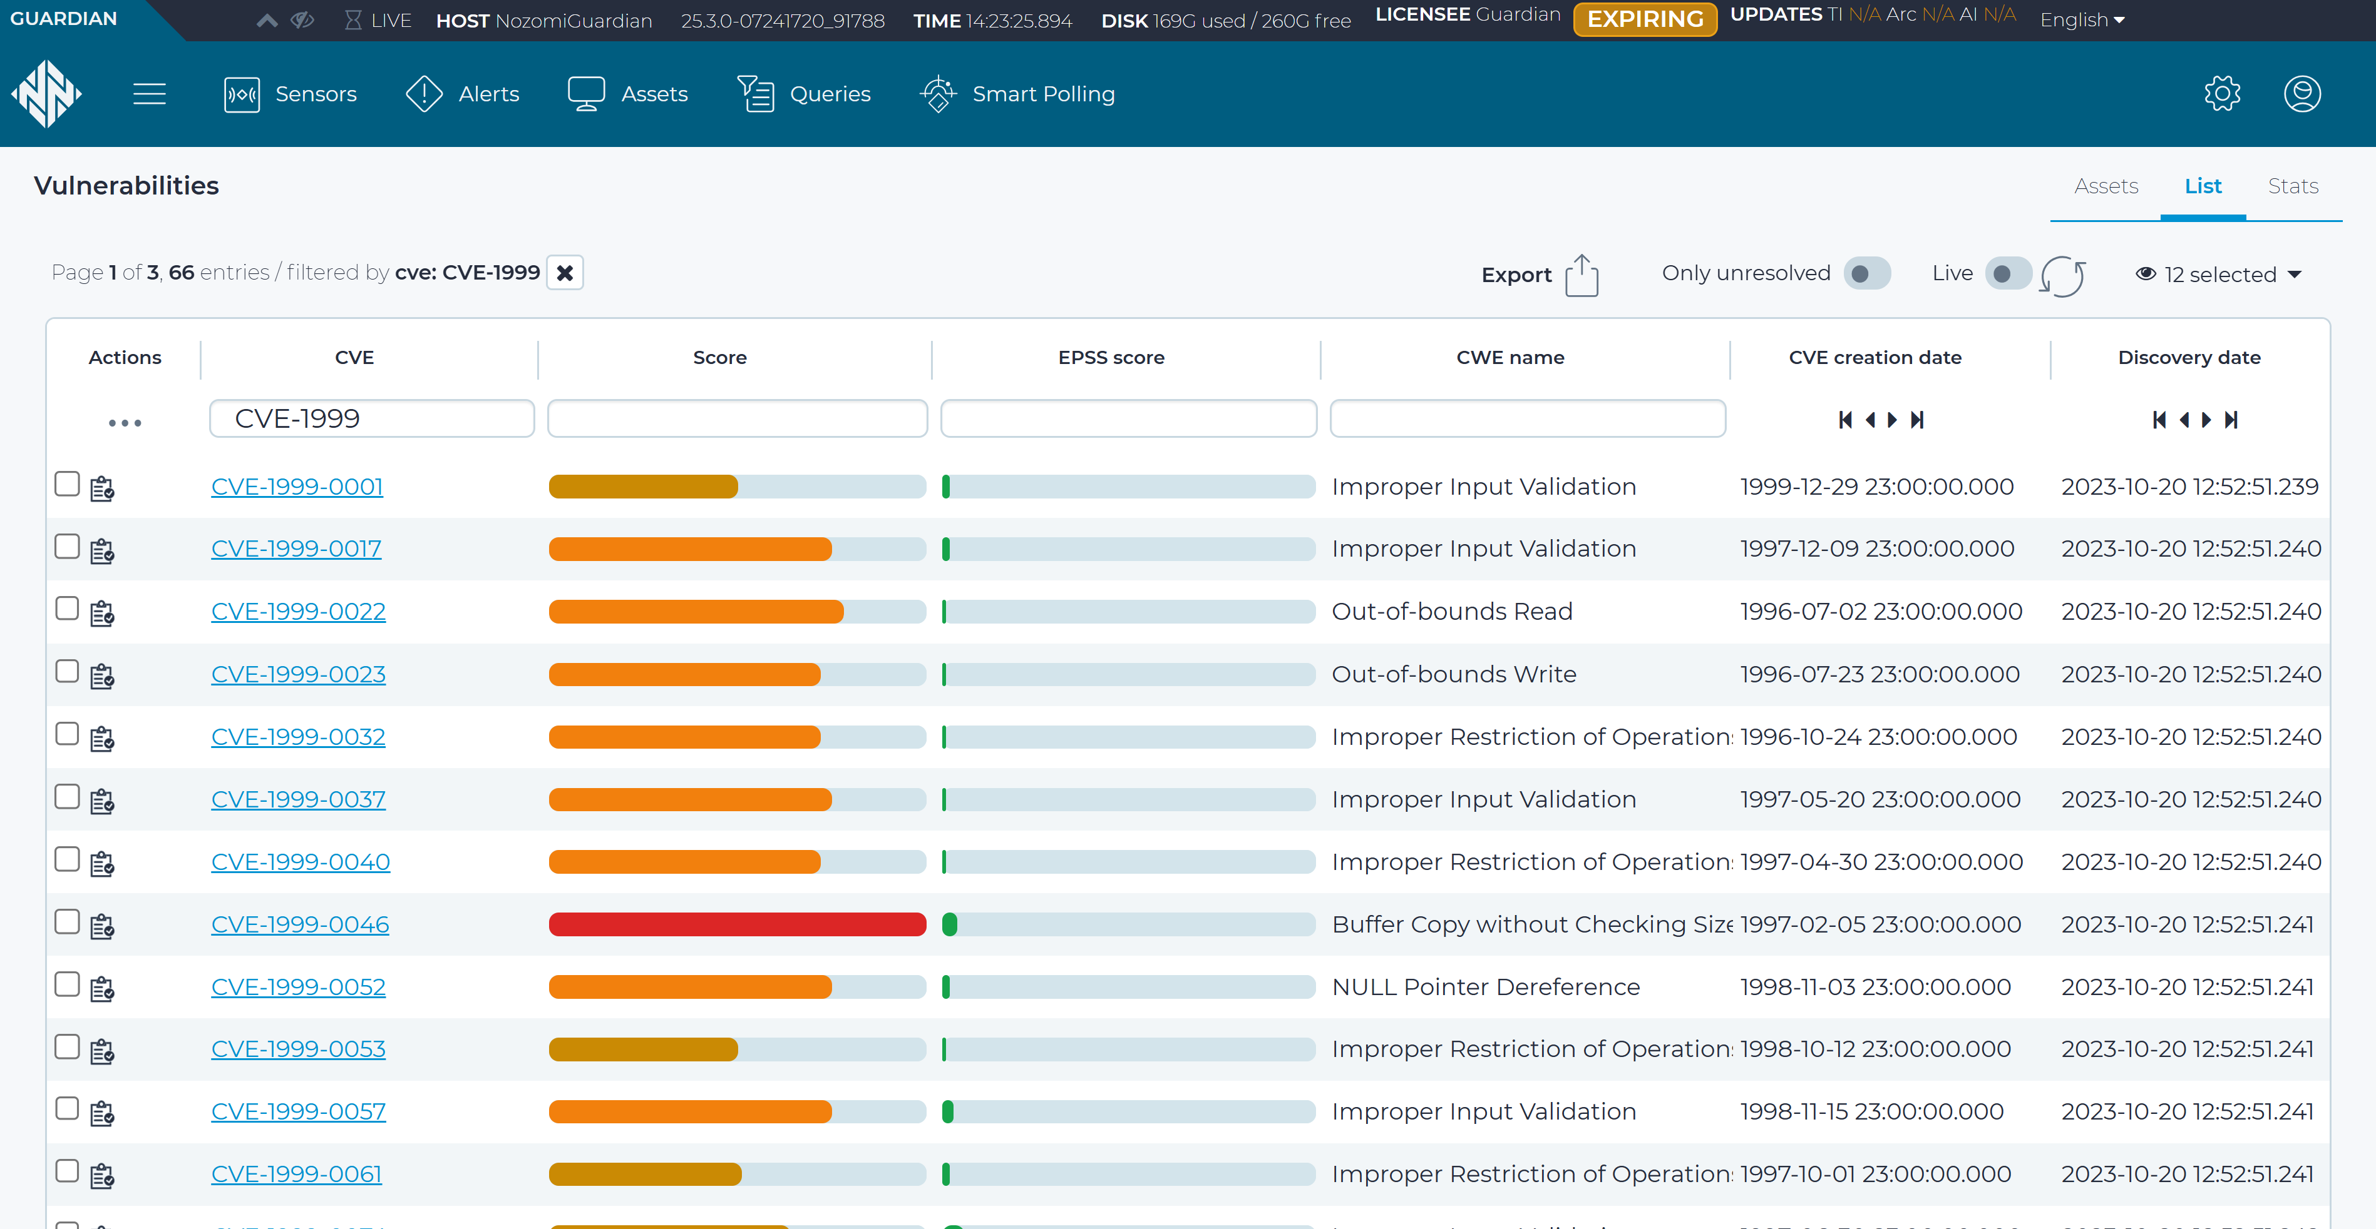
Nozomi Networks Vulnerability
The vulnerability management feature automatically identifies, assesses, and prioritizes security vulnerabilities across all assets in our control system environment, providing detailed risk analysis and remediation guidance for critical infrastructure protection.

Slide 5
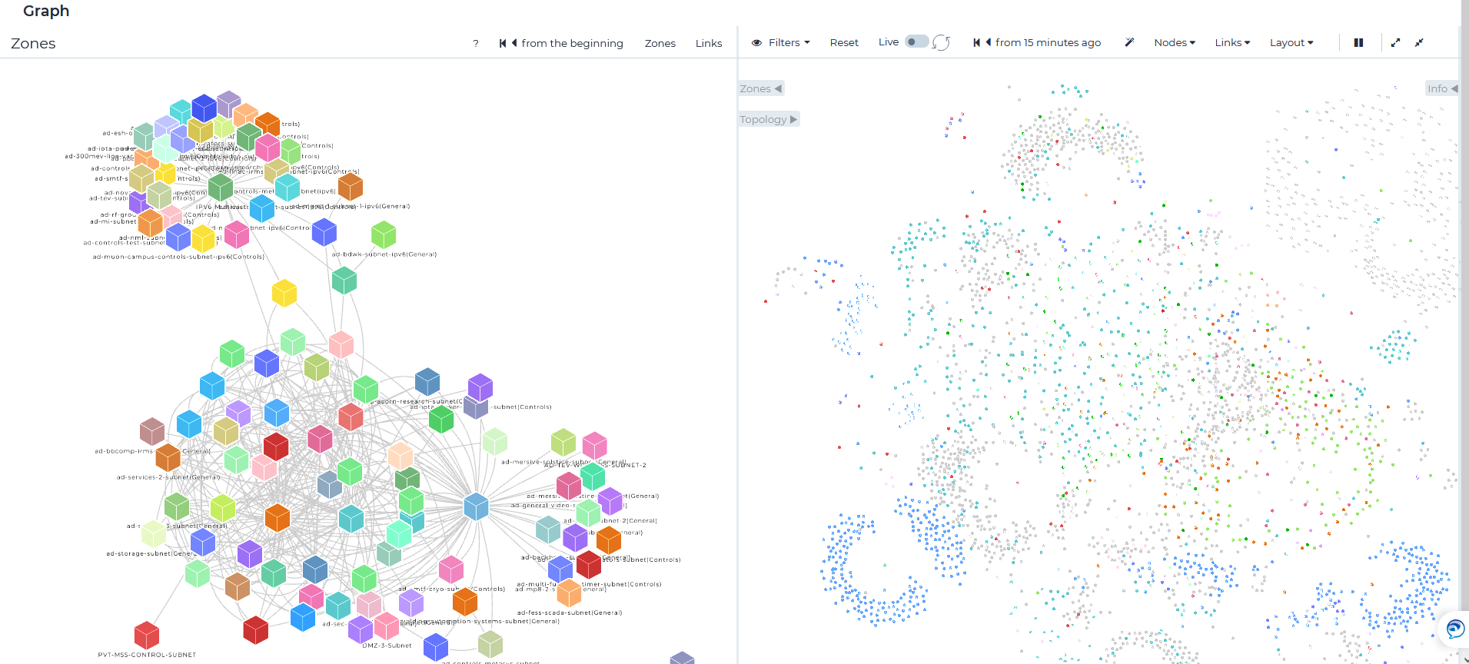
Nozomi Networks Topology
Here the tool presents us with a decorative network visualization graph that shows us all systems and their respective segmented network zones in the control system network.

Slide 6
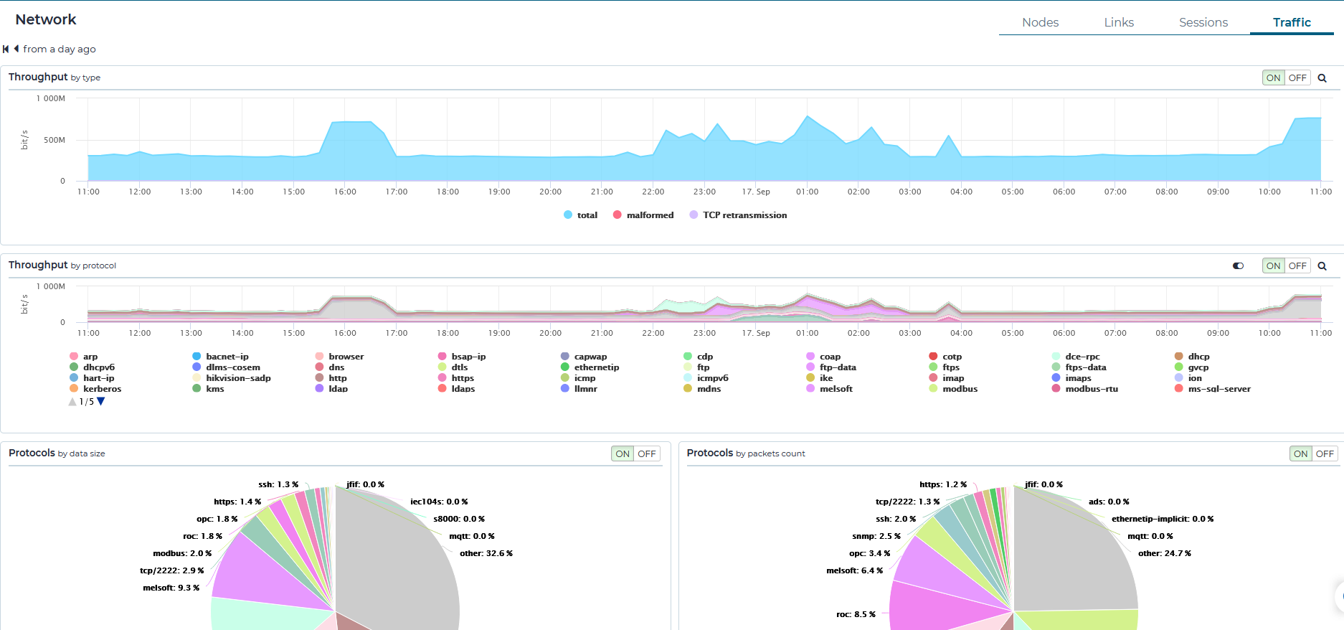
Nozomi Networks
Network Tab
In this view tab on the IDS tool we can see all pertinent information on the controls network related to network data traffic size, protocols most used in the network, and recent most used connections.

Slide 7
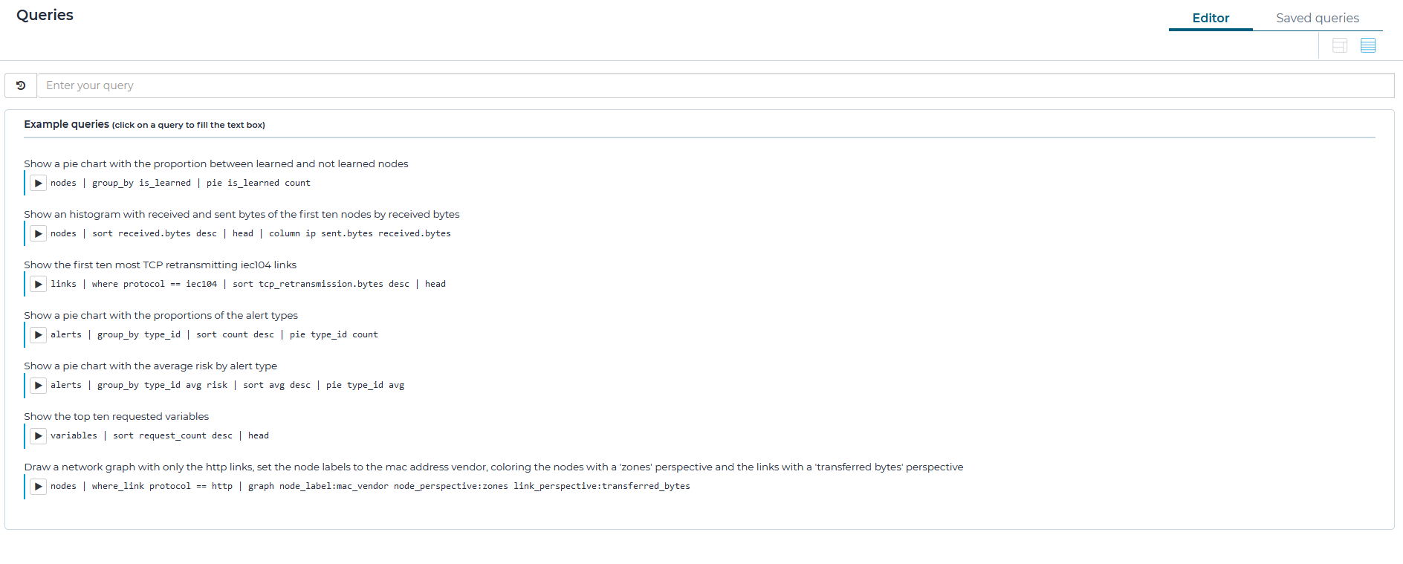
Nozomi Networks Query
This feature of the tool allows us to find and extract important information and data needed to aid in investigations when cyber incidents occur.

Slide 8
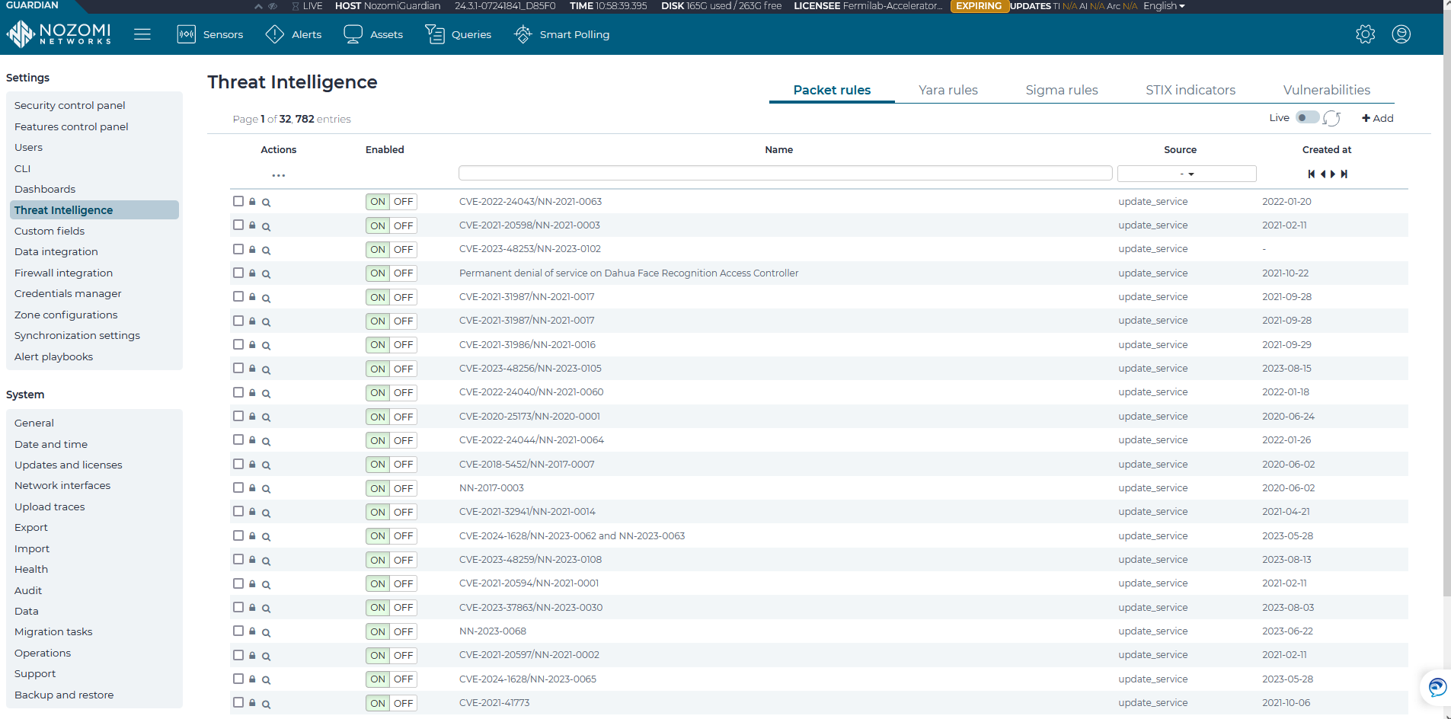
Nozomi Networks Threat Intelligence
This feature of the tool while updated, provides us with real time vulnerability and attack signatures, indicators of compromise, indicators of attack, tactics, techniques and procedures of threat adversaries.

Slide 9
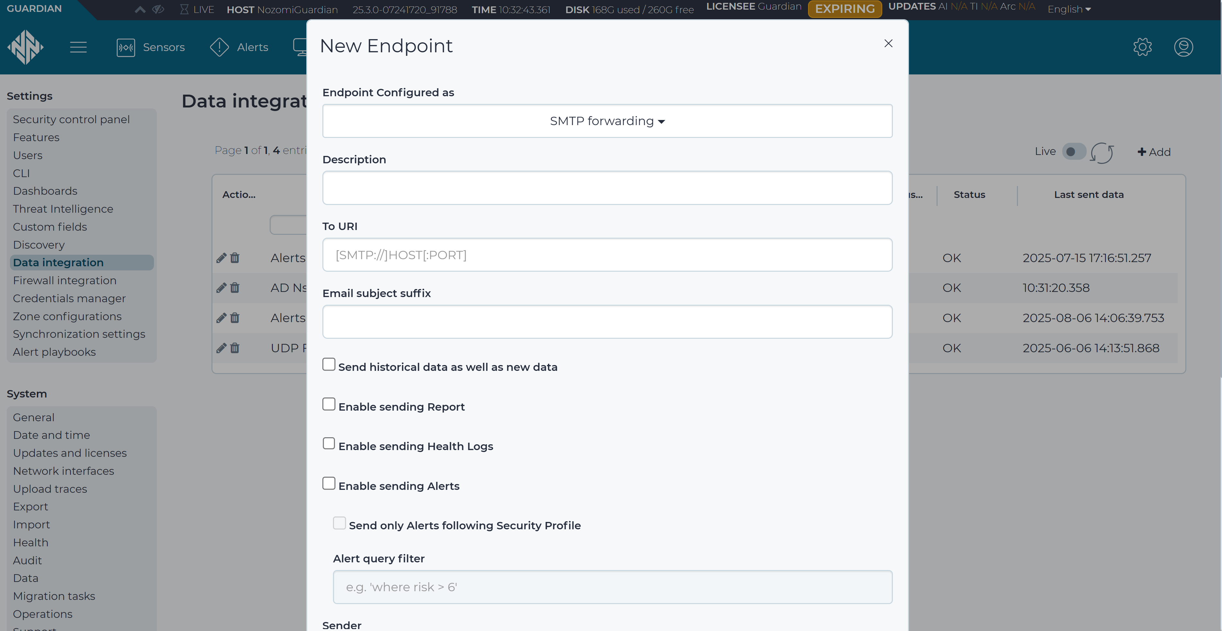
Nozomi Networks Email Configuration for Alerts
This feature provides 24/7 real-time monitoring and instant security alerts for critical incidents in our control system environment. This enables faster incident response capabilities and more efficient forensic data collection.

Slide 10
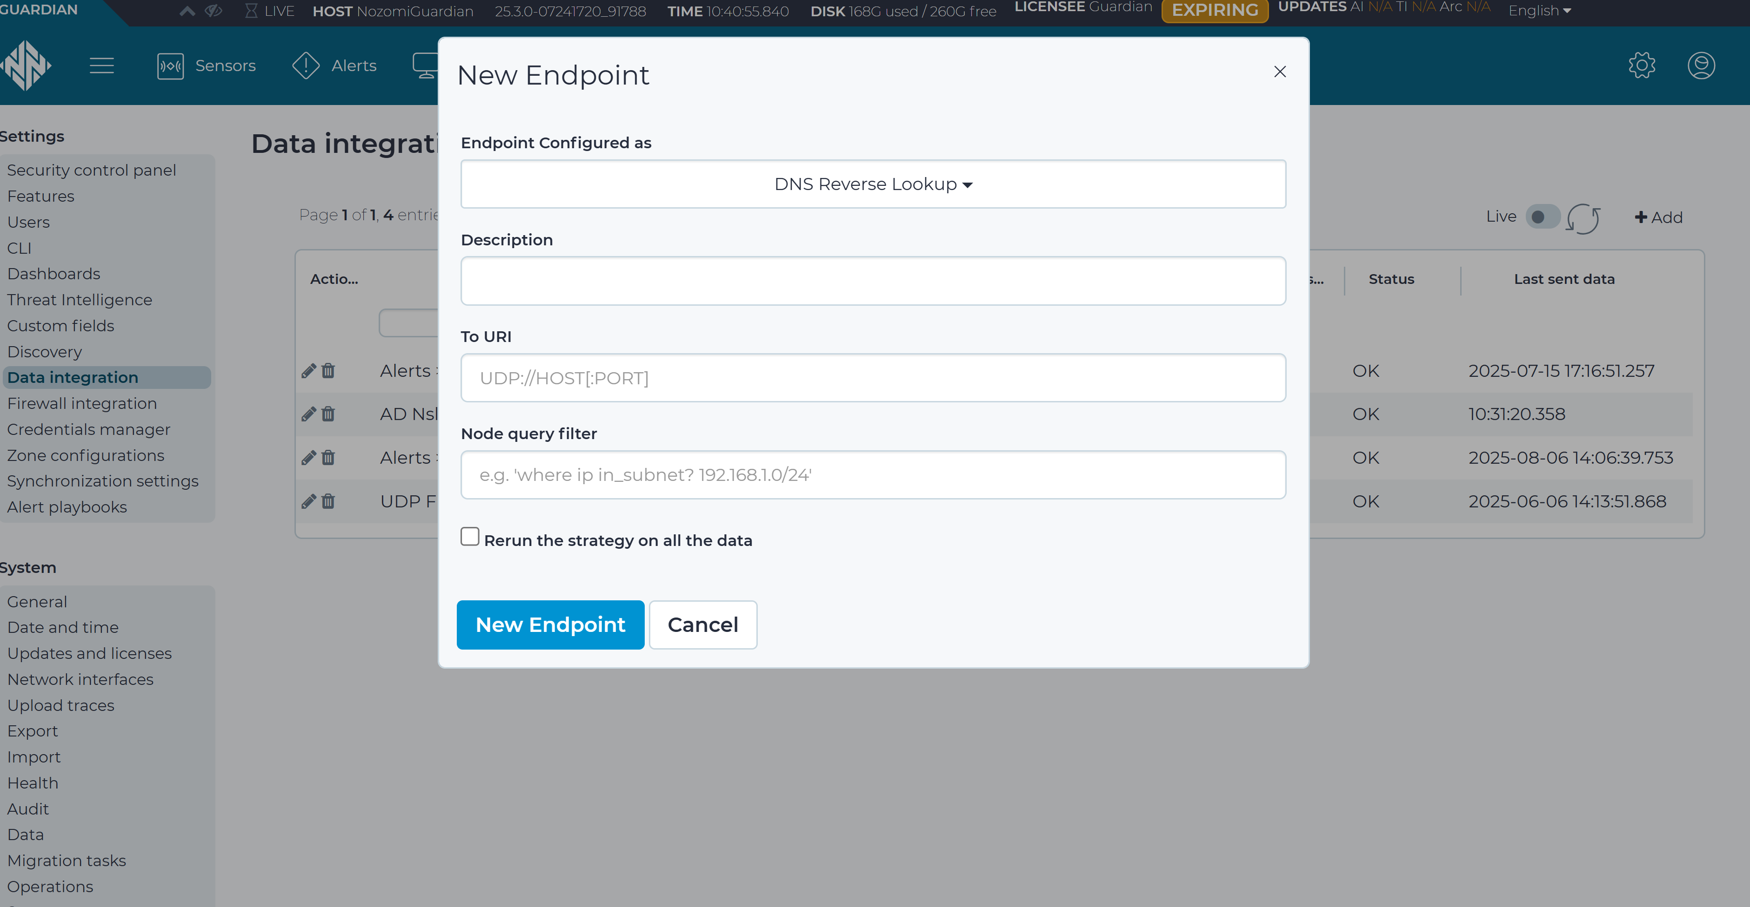
Nozomi Networks DNS Configuration Feature
The reverse DNS lookup functionality integrates seamlessly with our existing DNS infrastructure, enriching raw IP data with corresponding hostname information for automated improved analysis quality.

Slide 11
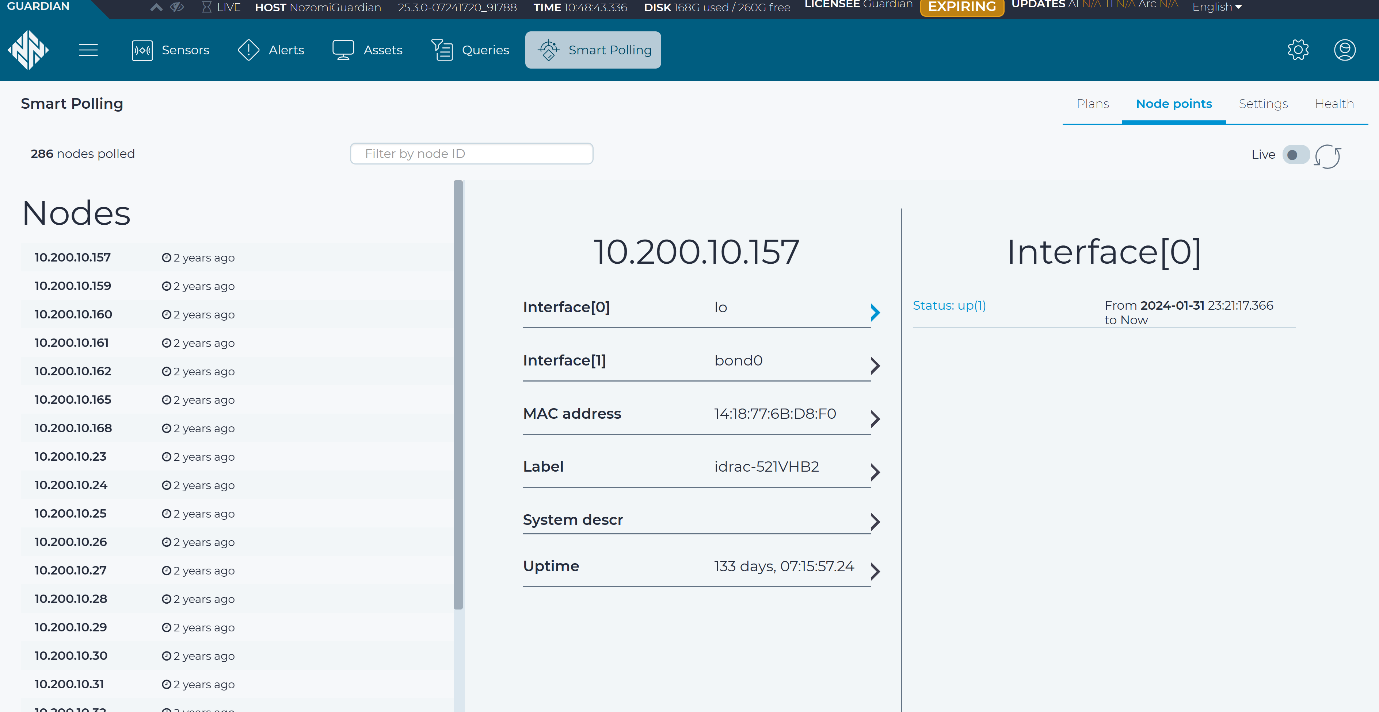
Nozomi Networks Smart Polling Feature
The smart polling feature automatically collects comprehensive device information including configuration changes, firmware versions, network topology data, device status, and performance metrics, providing deep visibility into network asset health and security posture.

Slide 12
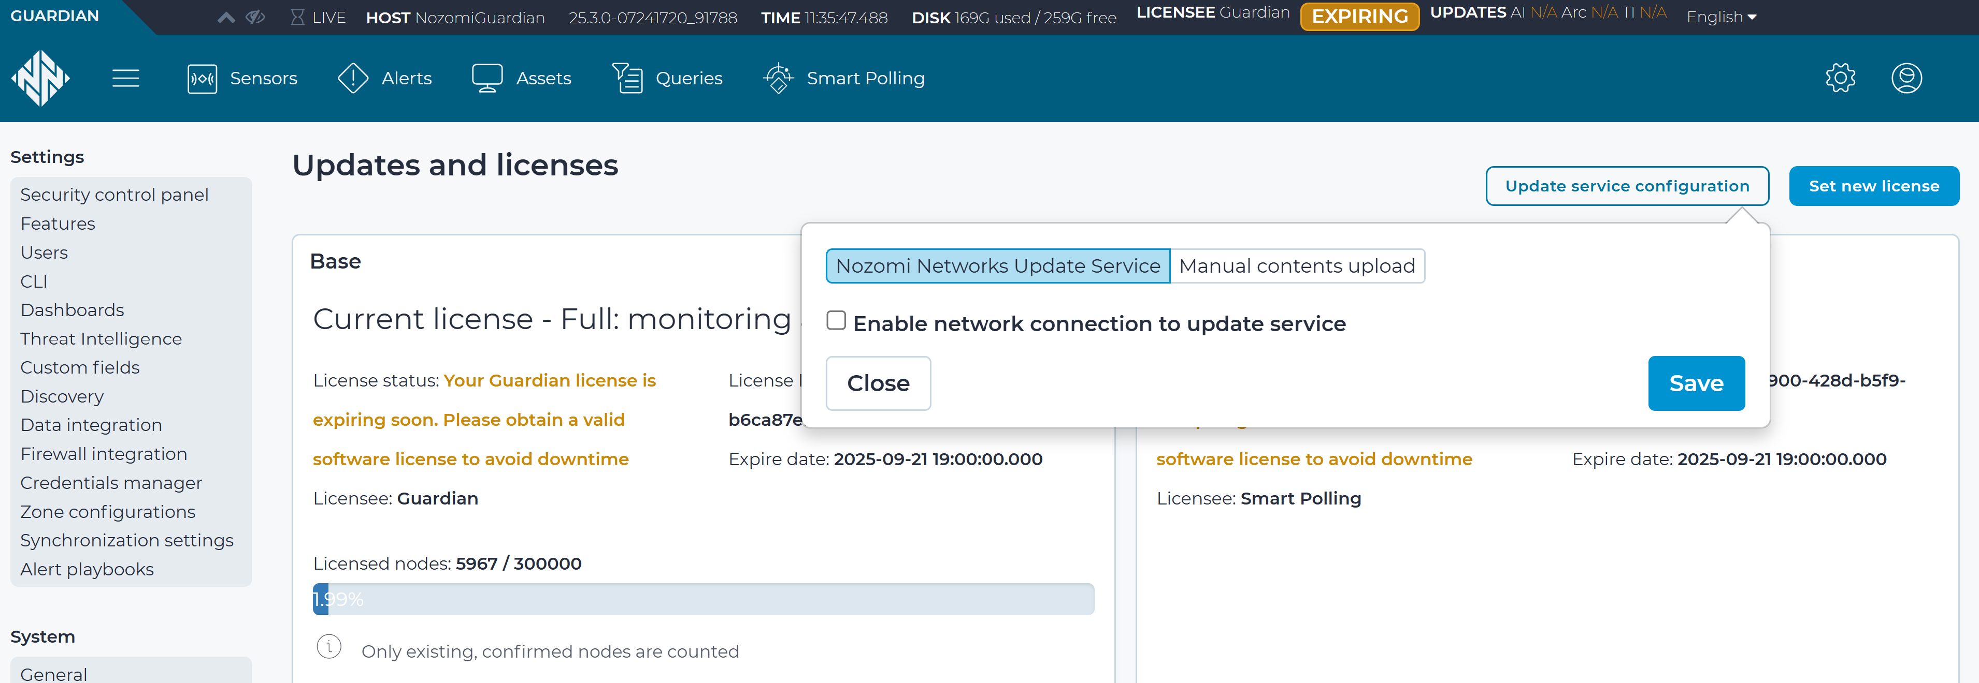
Nozomi Networks On-premis Updates
This secure update feature allows our air-gapped control system environment to receive vital security updates, detection rules, and threat intelligence signatures through controlled offline distribution that maintains our operational security.

Slide 13
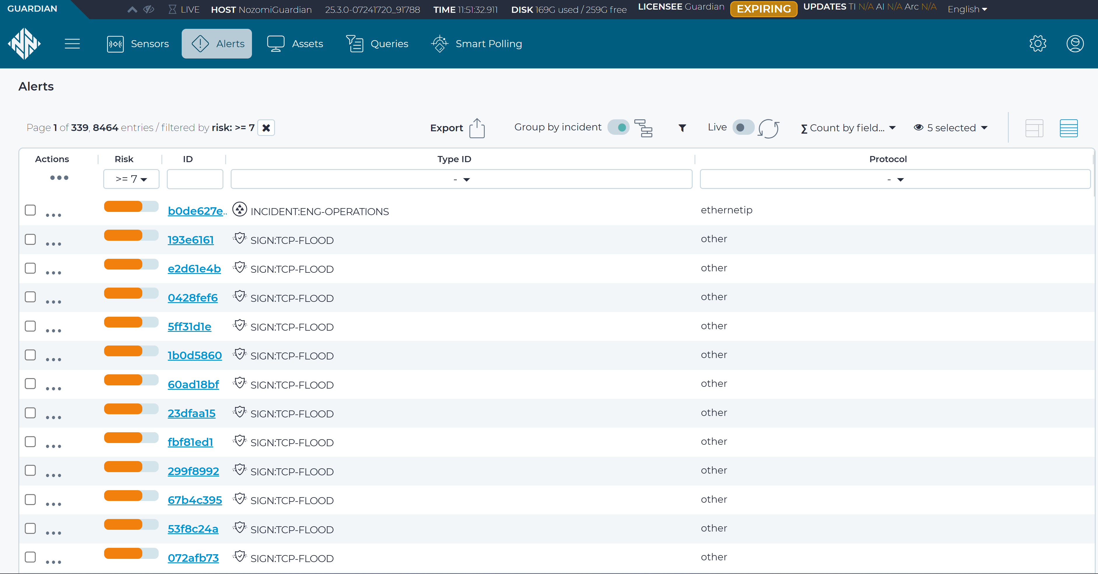
Nozomi Networks Alerts
We have received critical timely alerts relating to real live cyber incidents that has affected our control system. Thanks to the Nozomi tool, it has given us all the data that we needed to resolve the situation and recover rapidly.

Slide 14
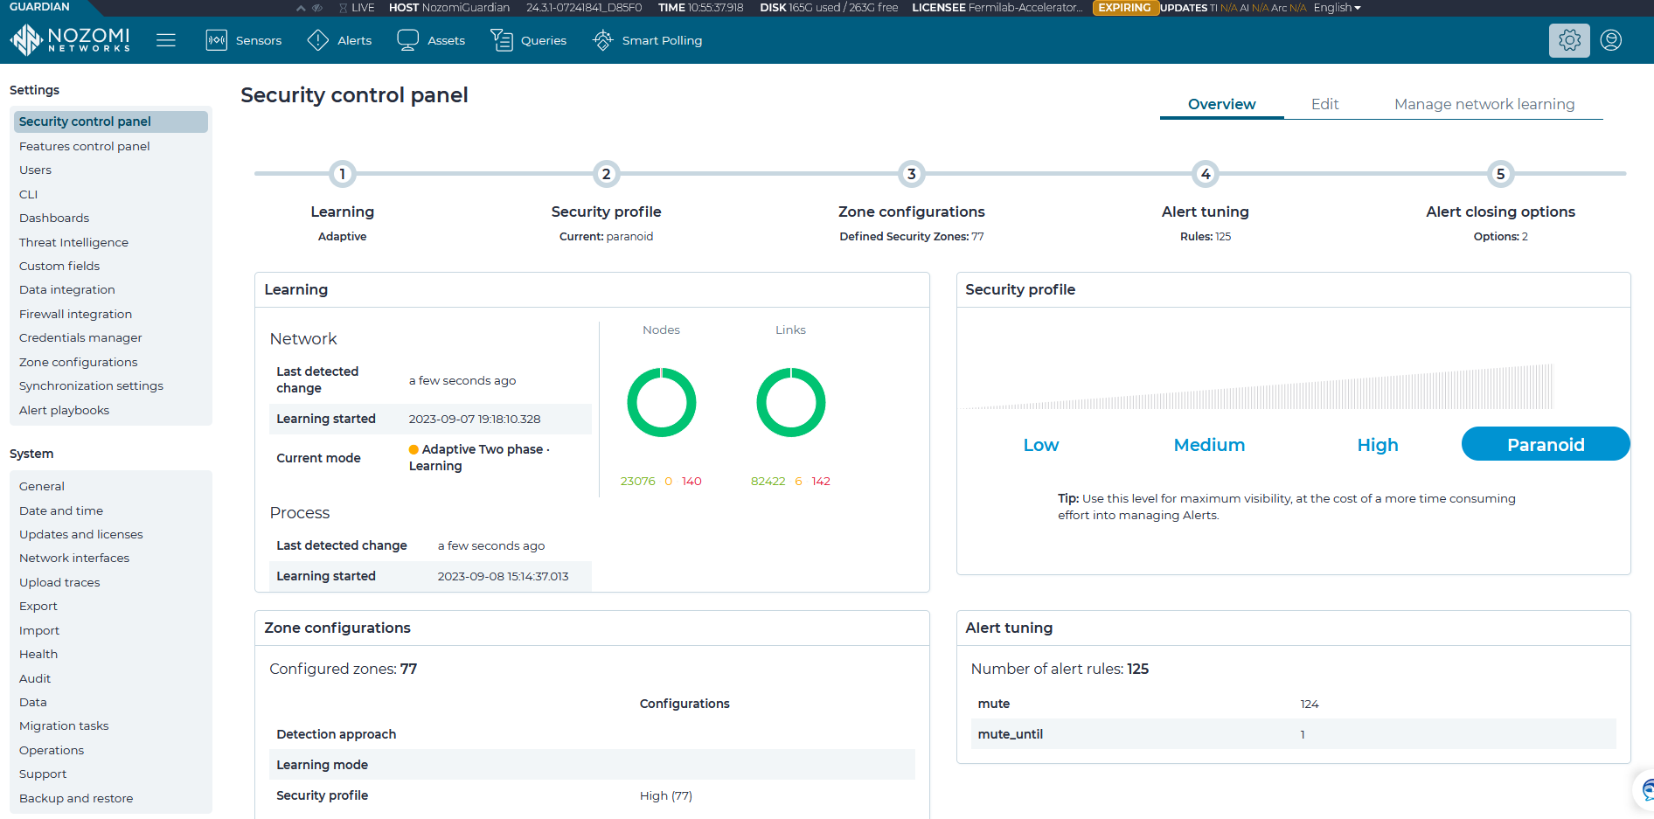
Nozomi Networks Security Control Panel
The security control panel is the administrative way that the tool has been configured to be set up on the control system network for a length of time to study and learn to establish a baseline configuration of network traffic and behavior. Fine tuning it to correctly and proactively learn the network and detect security incidents that deviate from normal baseline network behavior.

