Slide 1
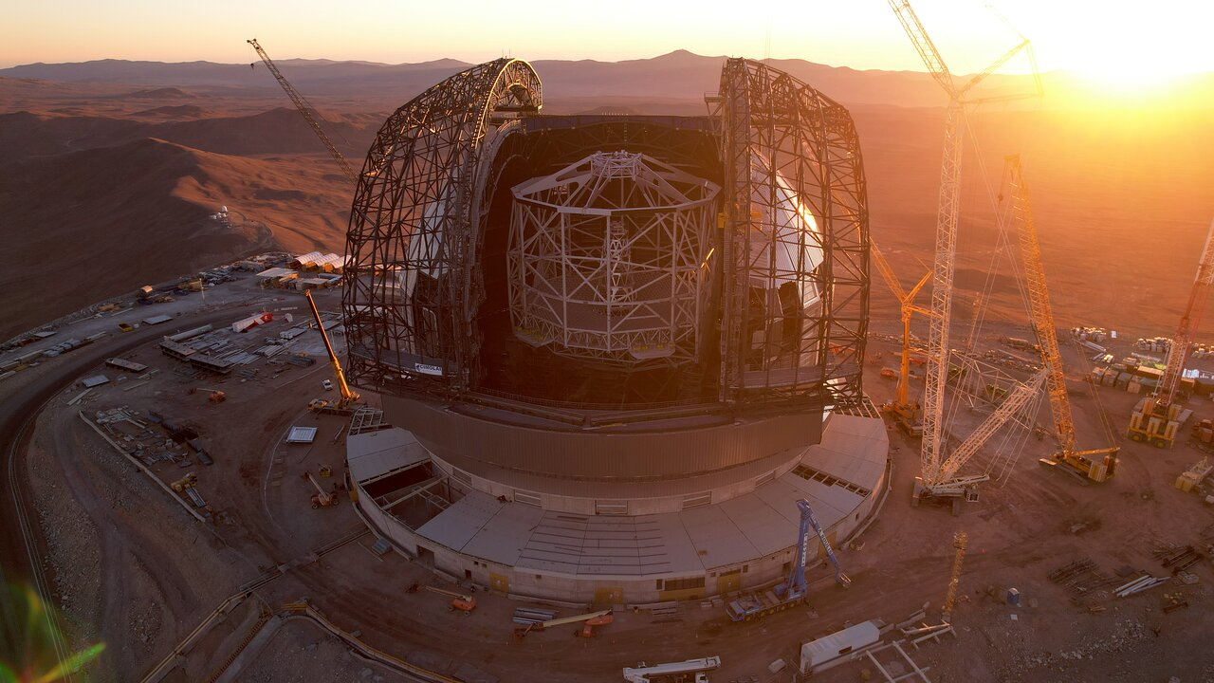
The ELT Primary Mirror
Cyber-Security Workshop
Notes:
The European Southern Observatory is building [in Chile, in the Atacama desert, on Cerro Armazones at 3000m elevation] a new [optical] telescope: the Extremely Large Telescope (ELT).
This presentation is about the local control SW of a subsystem of this telescope: the primary mirror.

Slide 2
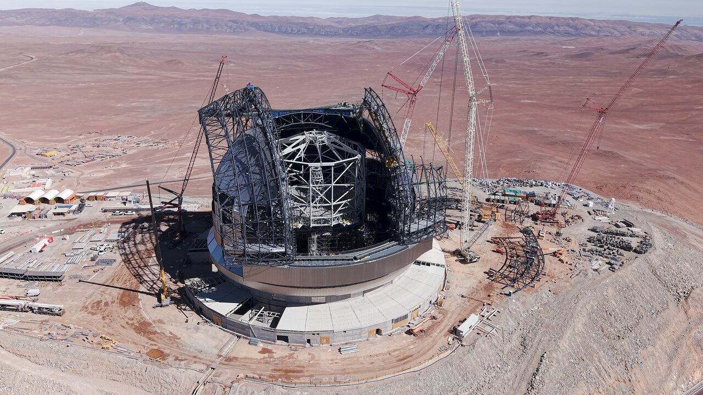
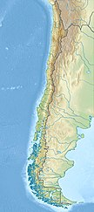
Name: Extremely Large Telescope (ELT)
Location: Cerro Armazones (3046m), Atacama Desert, Chile
First Light: 2029
Cost: 1.4 Billion EUR

Slide 3
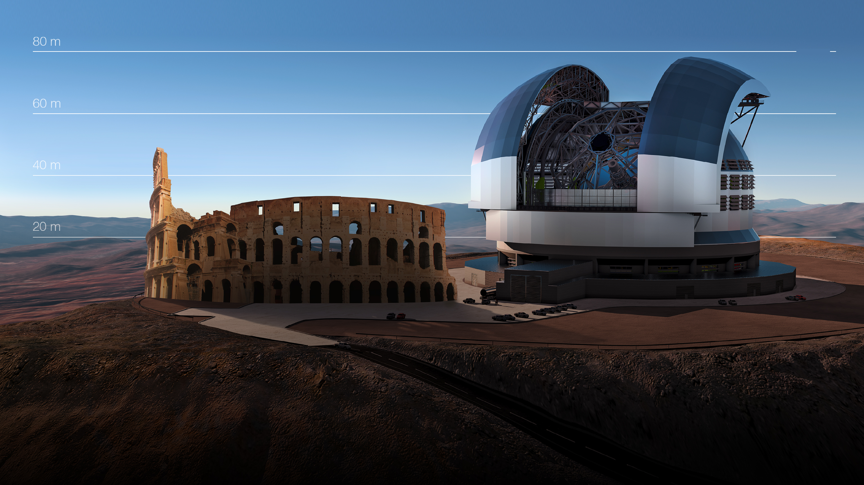

The primary mirror (M1) of ESO’s Extremely Large
Telescope has a diameter of 39 m

Slide 4
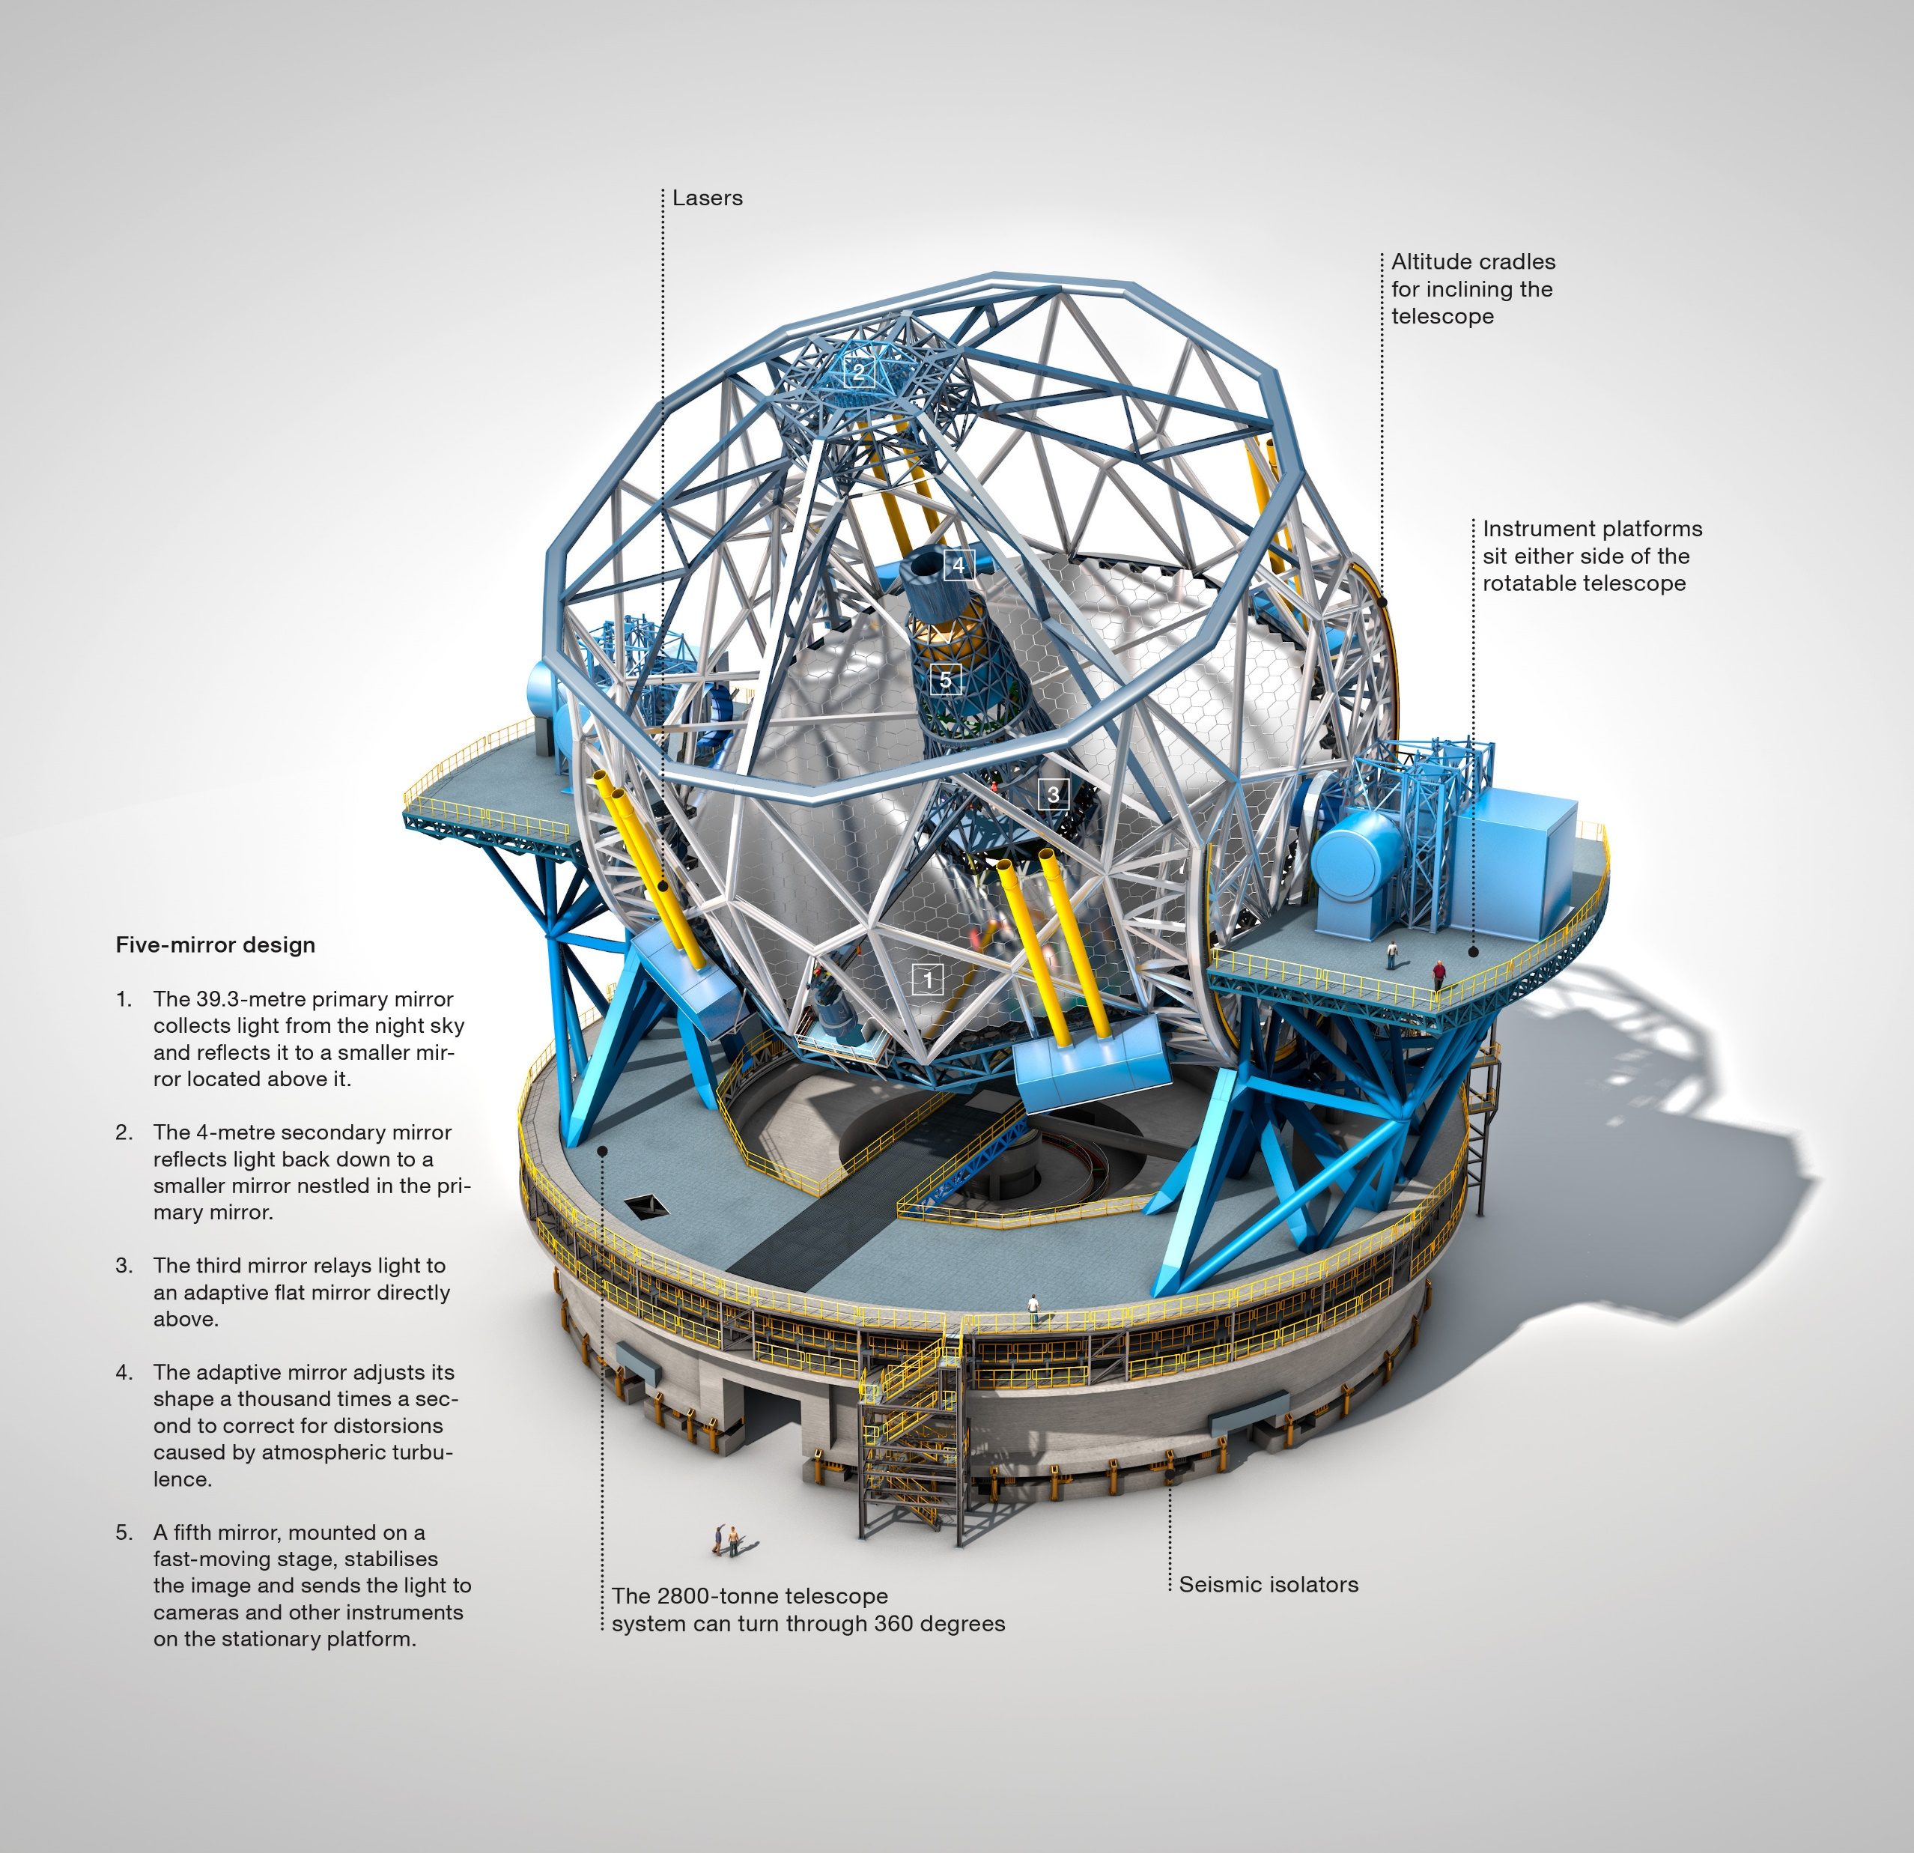
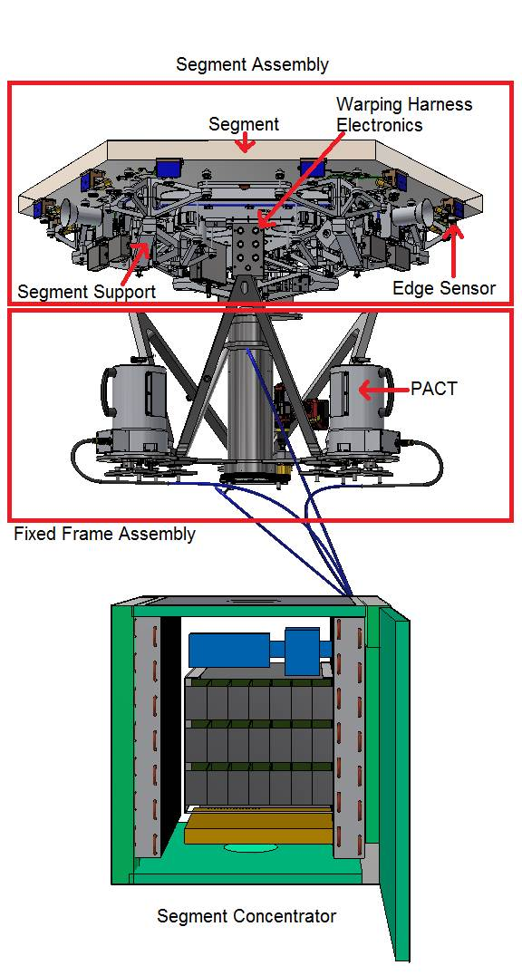
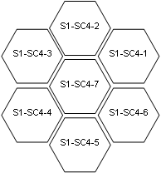

Slide 5
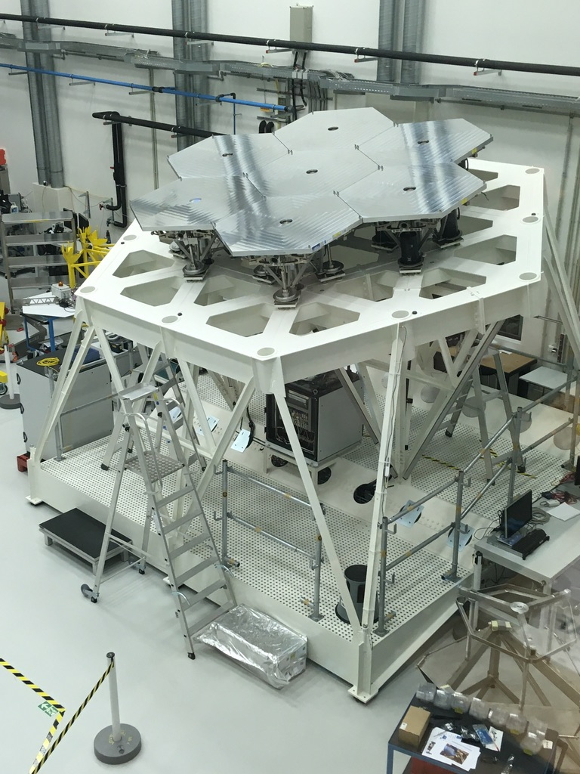
M1 Segments
Segments are organized in flowers of up to 7 segments
Each flower is controlled by 1 Segment Concentrator Cabinet (SegC) for a total of 132 cabinets (PLC, PSU, Control Modules, Network Switch)
In addition, there are 6 Sector Distribution Cabinets (PLC, PSU)

Slide 6
Network Layout
M1 cell
1 GigB
Ethernet
100 MegB
Ethernet
Computer Room
SegC Switch
(1 of 132)
10 GigB
Ethernet
Sector Switch
(sector 1 of 6)
SegC Switch
(2 of 132)
Sector Switch
(sector 1 of 6)
...
SegC Switch
(21 of 132)
M1LCU(s)
CR Switch
...
...
...
...
SegC Switch
(22 of 132)
...
...
CR Switch
SegC Switch
(112 of 132)
Sector Switch
(sector 6 of 6)
SegC Switch
(113 of 132)
...
Sector Switch
(sector 6 of 6)
SegC Switch
(131 of 132)
SegC Switch
(132 of 132)

Slide 7
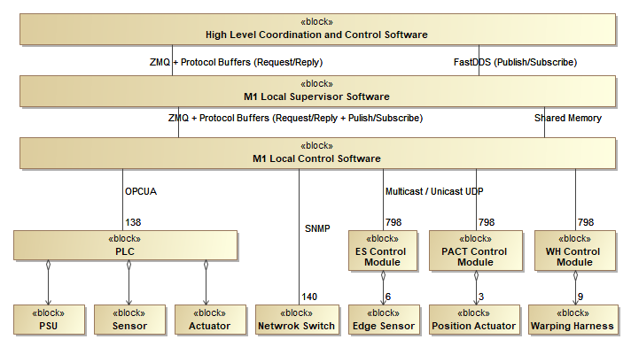
System Stack
SW Stack
Linux with RT profile
GNU C++, Python
ZMQ, FastDDS, OPCUA, SNMP
Redis, Nomad, Consul
RAD: Rapid Application Framework based on interpreted State Machines (SCXML)
GUI: Qt + Taurus

Slide 8
SW Installation & Deployment
Installation using Ansible scripts:
  RPMs installation
  User environment config.
  Server RT properties (core isolations, etc.) config.
  Nomad/Consul services config.
  Time service config. (PTP)
  Network config. (NIC)
  Other services configs. (shared volumes)
Deployment using Nomad/Consul:
  Start/Stop applications on remote servers
  Reserve static IP/port assignment
  Remote monitoring
  Periodic health check
  Auto-restart

Slide 9
Remote Access / Remote Engineering Data Access
Remote Access (ELT):
  Requires special approval
  Not defined yet the technology
Remote Access (VLT):
  Requires special approval
  Only from dedicated ESO offices
  A person must supervise the remote session at the Observatory
  Using VNC:
    Observatory starts VNC server
    VNC client connects
Remote Eng. Data Access (ELT):
  TBD
Remote Eng. Data Access (VLT):
  Via a dedicated “bridge” server which allows using SFTP to:
    write/read the data to/from the “bridge” server from outside the control network
    write/read the data to/from the “bridge” server from within the control network

