Slide 1
Controls Systems, Cyber Security and Conflicting Priorities
September 21, 2025
Karen S. White
Spallation Neutron Source
Notes:
Accessing Title Slide Options
The standard ORNL presentation template includes five branded title slide layouts:
Title | Standard. The preferred layout for lab-wide and general presentations. Features a default aerial photograph of the lab.
Title | Custom Image. Allows replacement of the default background with a custom full-slide image (16:9 or 4:3 landscape format).
Title | Custom Portrait Image. Supports inclusion of a custom 4:3 portrait image positioned next to the introductory text.
Title | Custom Landscape Image. Supports inclusion of a custom 16:9 landscape image positioned next to the introductory text.
Title | Text Only. Offers additional space for longer titles and multiple presenters.
Additional Lab-approved title slides specific to directorates and user facilities are available in PowerPoint under the following folders: Custom Title Slides and User Facility Templates, located in Electronic Presentation Templates.
Custom Title Slide Guidelines
Image Rights. Any custom images, graphics, or photography must be owned by ORNL or used with documented permission from the original creator or source.
Appropriate Image Use. Select images that work well with the layout. Ensure the focal point of the image is not obscured by the title text and white overlay box.
Relevance and Impact. Visuals are a key element of effective communication. Whenever possible, use imagery that enhances the message of your presentation and reflects ORNL’s mission and values.
Quality and Clarity. Use high-resolution images for clarity on large screens. Avoid overly complex or dark images that may conflict with the title text.
Text-Only Option. If no appropriate or approved imagery is available, or if imagery is not permitted for the subject matter, the Title | Text Only layout provides a clean, professional alternative.
Learn more about ORNL electronic presentations
https://ornl.sharepoint.com/sites/branding/SitePages/electronic-presentations.aspx

Slide 2
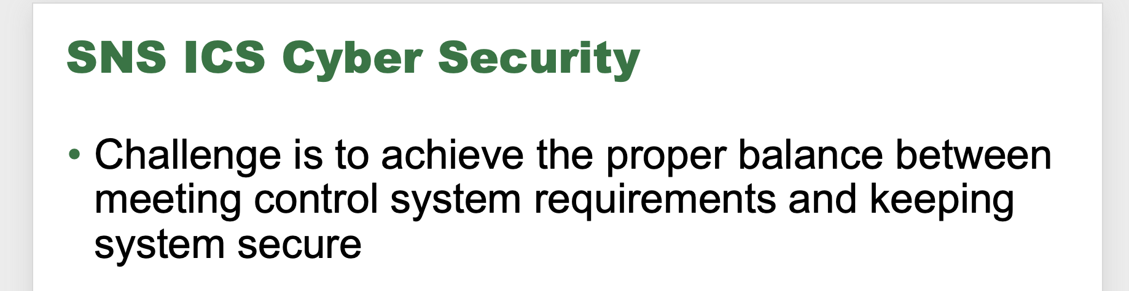
From this workshop 2015

Slide 3

Traditional control system cyber security model
Build your control system behind a firewall
Put lots of holes in your only protection
Assume unauthorized users will leave your system alone
Run your machine and experiments

Slide 4

Now we need much more
Hackers are relentless
A cyber intrusion puts your facility at risk
  Prolonged shutdown
  Loss of sensitive data
  Expensive repairs
  Loss of public (taxpayer/funder) confidence
  A mountain of extra work

Slide 5

Big disconnect between controls experts and cyber experts (IT)
CONTROLS
VOID
IT
CONTROLS
COMMON
IT
The truth looks more like this;
It is complicated!!
Closing the understanding gap is essential

Slide 6
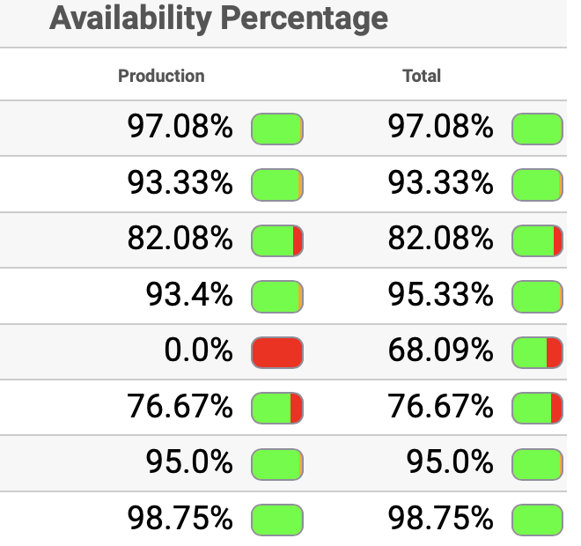
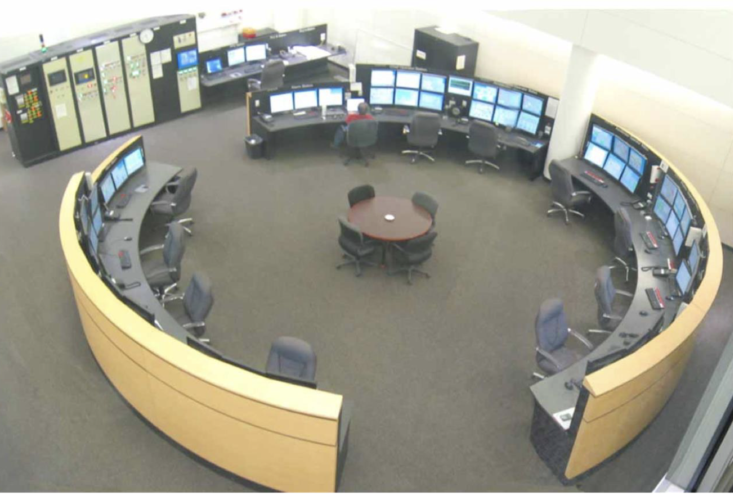
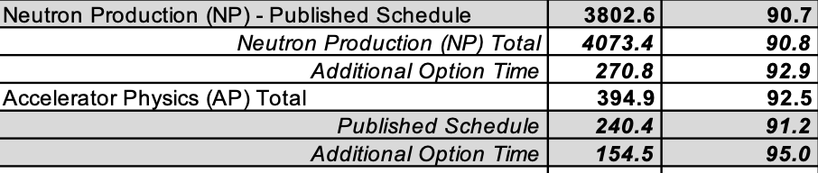
What do scientific user facilities require?
Integrated Control System
High Availability
Maximum Facility Utilization
Large networked distributed control systems to monitor and control everything
Tens of thousands of diverse network nodes
Ideally, some (limited) access from outside
DOE Basic Energy Science expects
>95% availability for light sources
>90% for neutron sources
DOE Basic Energy Science expects 5000-6000 hours of beam delivered for users each year, following published schedule

Slide 7
What does cyber security require?
Latest cyber security requirements drive significant work
Patching
Unsupported software
Scanning
Zero Trust Architecture
15 days for critical
30 days for high
~150 machines to patch is about 5 days of work
Also need time to test new patches prior to deployment
Challenge – meet patching requirements without compromising system performance and operations schedule
Should not be used
We have a large installed base of site or community developed open-source software
Support is informal (you cannot purchase from vendor)
Unclear definition of “supported”
Commercial packages that are “end-of-life” must be removed
Requirement for regular vulnerability scanning
Some common control system CPUs do not response well to common scans (e.g. PLCs)
ORNL scanning tool occasionally makes mistakes
Exemption tool does not allow grouping
Need to Perform “test scans” to analyze operational impact and tailor scans accordingly
ZTA and encryption
Require significant changes to EPICS
EPICS Collaboration working on Secure EPICS
Will only be available for EPICS 7+
Higher configuration workload to manage certificates
Notes:
Example Python 2 EOL 2020, many of our applications Controls, XAL, etc. use this, significant work to upgrade in many codes

Slide 8
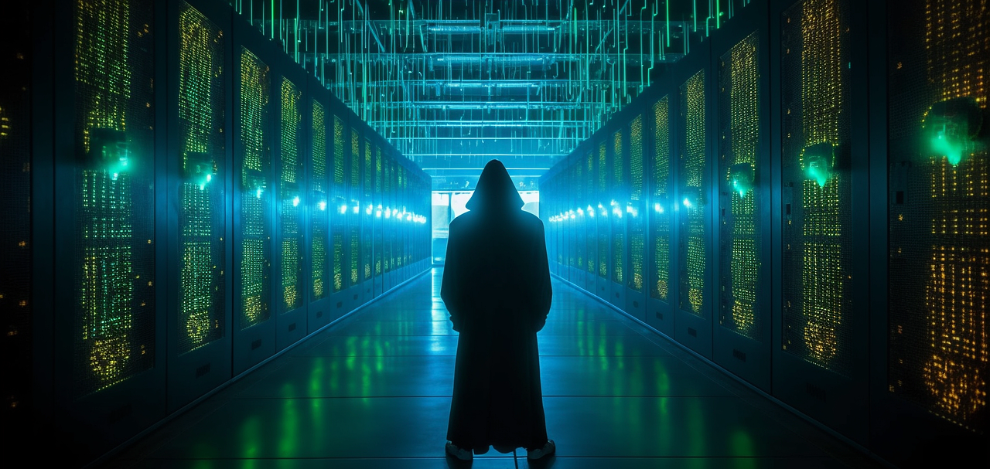


Cybersecurity Requirements
DOE O 205.1D on Cybersecurity (76 pages)
States there are no exemptions, then requires exemptions and the exemption process to be documented (confusion??)
NIST 800-53 Security Standard (318 pages)
Basis for 205.1D requirements for federal information
Designed for enterprise systems
Includes 1189 privacy and security controls
NIST 800-82 is standard for industrial control systems(ICS, aka OT) but currently does not drive DOE requirements (ICS treated as enterprise)
DOE O 200.1A Change 2 on IPV6 (42 pages)
Provides an exclusion path for “certain types of highly-specialized system that do not function as general-purpose IT systems…” ; exemption process TBD

Slide 9
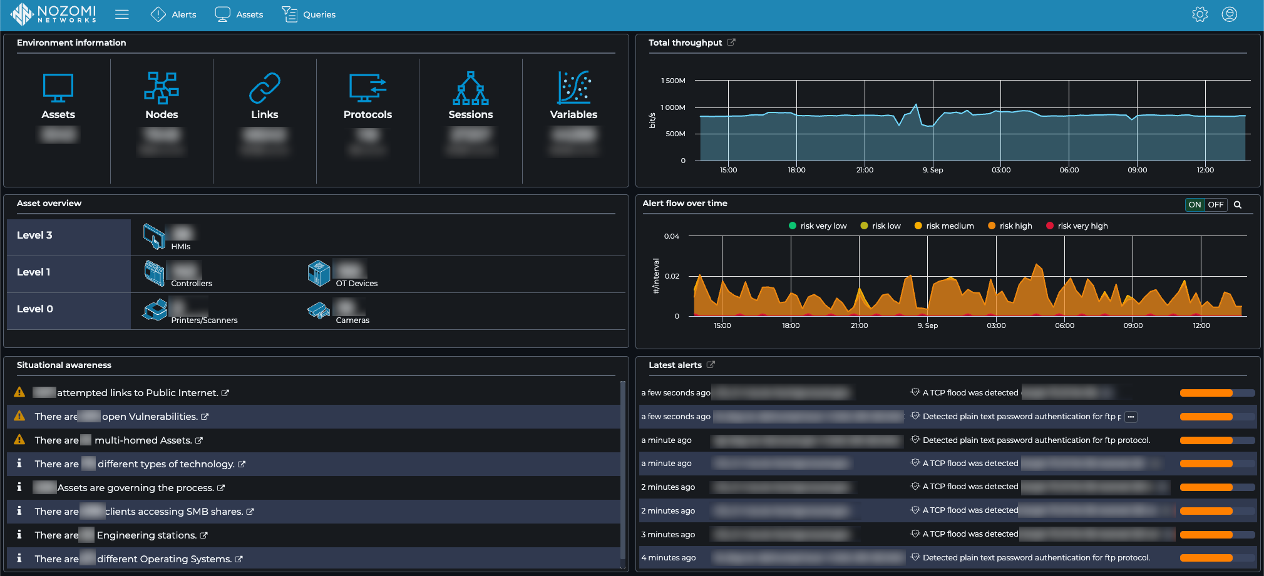
Scanning requirement
ORNL IT is using Tenable to meet active scanning requirement on enterprise
Failure to patch identified vulnerabilities withing 15-30 days results in machine quarantine until issue is resolved
This can be problematic for machine and instrument control systems due to vulnerable devices
User facilities have limited schedule maintenance time to accomplish these scans and patch
Alternatively, DOE order allows passive scanning for OT systems
Nozomi now used for the SNS machine control systems, runs continuously
Does not disrupt control system operations in any way
Gives a lot of valuable information that would be gathered by invasive active scan

Slide 10
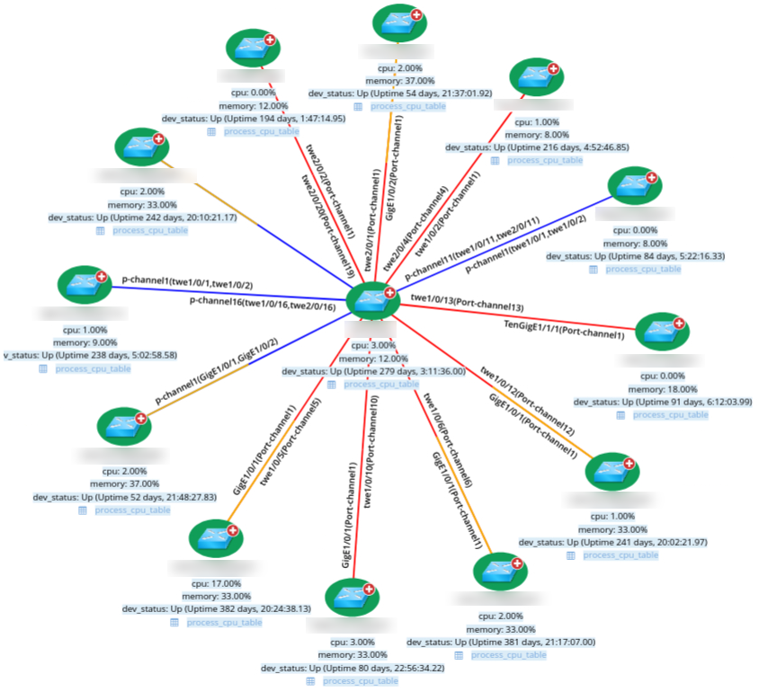
Also using NetBrain to more closely monitor the network to proactively identify cyber and other issues
Before NetBrain:
Manual troubleshooting network issues
No consistency in switch configurations
Lengthy process for any system-wide network changes
No grasp of issues lurking “under the hood”
Corrective maintenance was main driver
After NetBrain:
Simplified troubleshooting process (less commands)
Moving towards CISecurity.org Benchmark switch configurations
Standardizing network changes through NetBrain
Much stronger understanding of the network
Identified and corrected 50+ issues BEFORE they caused beam downtime

Slide 11
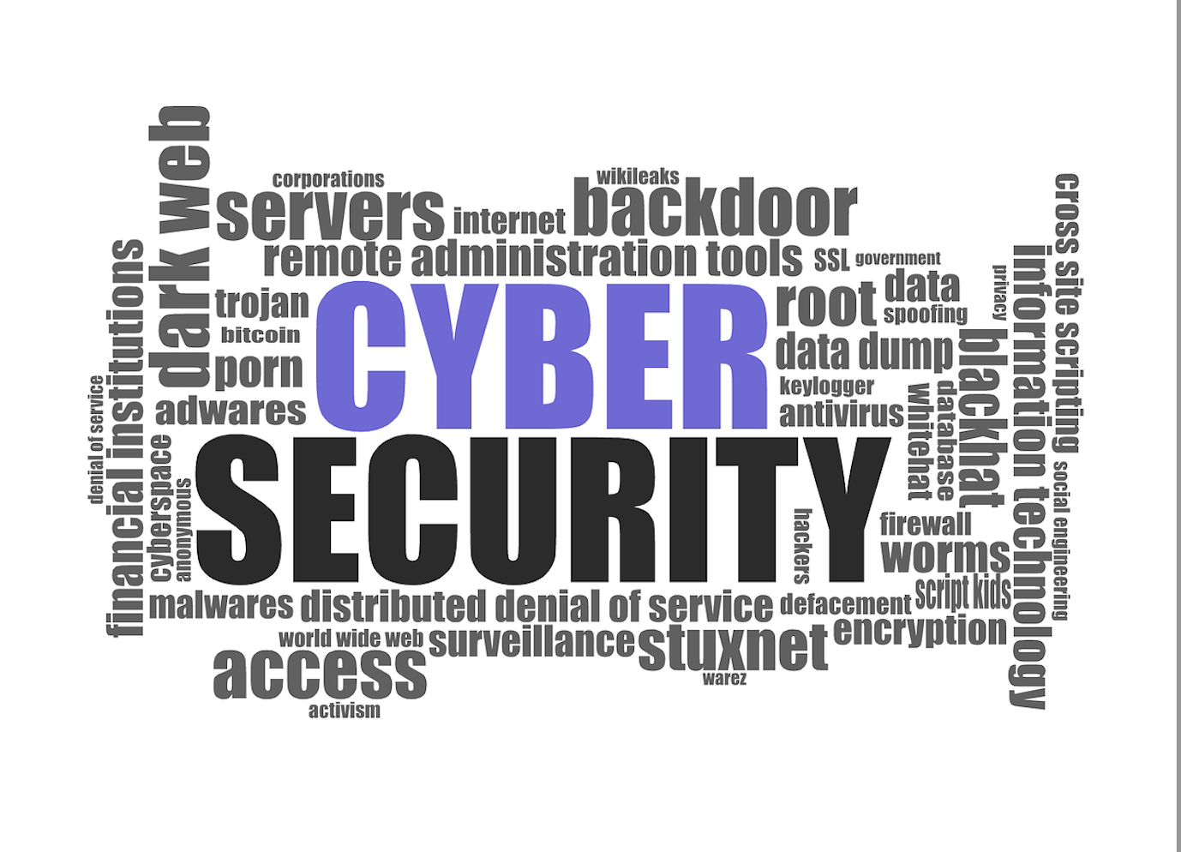
Discussion

